Slide 1
Graph Programming Model Efficient Approach For Sensor Signal Processing
Mr. Steve Kirsch
Principal Fellow
Raytheon Space and Airborne Systems
9/10/2012
Copyright © 2012 Raytheon Company. All rights reserved.
Customer Success Is Our Mission is a registered trademark of Raytheon Company.

Slide 2
Agenda
Graph Programming Model (GPM) goals
Overview of GPM basics
GPM hierarchical program structure
A brief look at how GPM achieves efficiency
Conclusion and Path Forward

Slide 3
Key Goals Of The Graph Programming Model (GPM)
Goals
Efficiency
Portability
Scalability
Productivity
Efficiency – High throughput without exposing processing target details thus maintaining a clean programming abstraction
Portability – Require no or minimal application software modifications when target hardware is upgraded or application is move to a significantly different target architecture
Scalability – Provide increased application performance with no application modification as target hardware capabilities increase
Productivity – Provide process and tools that reduce the complexities of developing a highly efficient parallel program

Slide 4
GPM: Basic Concept of Operation
GPM utilizes Directed Acyclic Graphs (DAGs) as the basic building block
Collection of vertices and directed edges
Each edge connects one vertex to another, such that there is no way to start at a vertex and follow a sequence of edges that eventually loops back to the same vertex
A precedence relationship is established by the data flow pattern

Slide 5
Agenda
Graph Programming Model (GPM) goals
Overview of GPM basics
GPM hierarchical program structure
A brief look at how GPM achieves efficiency
Conclusion and Path Forward

Slide 6
GPM: Basic Concept of Operation DAGs Used To Express Data Level Parallelism (DLP)
Datasets
Represents multi-dimensional data (eg Radar sensor fast time samples across a row, slow time (pulse to pulse samples) down a column)
Typically data dependencies exist in one dimension (or few dimensions) and expose data level parallelism in the other dimensions
JobClasses
SPMD processing model
JobClasses are designed to consume data level parallelism
JobClass Views
Data parallelism description
JobClass
Dataset 1
Dataset 2
D1.0
1.0
D2.0
D1.1
1.1
D2.1
1.n
-
1
D1.n
-
1
D2.n
-
1
D1.n
1.n
D2.n
SPMD
SPMD
Single Program
Multiple Data
SPMD Machine
GPM Explicitly Exposes Algorithmic DLP

Slide 7
GPM: Basic Concept of Operation DAGs Used To Express Thread Level Parallelism (TLP)
SubGraphs
JobClasses are grouped into a subGraph
A set of subGraphs forms an MPMD machine
Subgraphs are separately allocatable processing threads
Datasets consumed by a subgraph are allocated to memory local to where the subgraph executes
SubGraphs can be allocated to processing resources in real time
Datasets
Datasets
D0
Dn+2
D1
Dn+3
SubGraph
2
DN
-
1
DM
-
1
DN
n
DM
-
1
GPM Explicitly Exposes Algorithmic TLP
n

Slide 8
GPM: Basic Concept of Operation JobClass Views Express Data Reorganization
JobClass View
Expresses how data is access by each vertex
The view describes a virtually contiguous subset of the dataset
A JobClass view can express any arbitrary reorganization of the data
Typically used for transposing data between sequential processing stages
JobClass
JobClass
Dataset
Dataset
Dataset
D1.0
1.0
2.0
D2.0
D3.0
D1.1
1.1
D2.1
2.1
D3.1
1.n
-
1
2.n
-
1
D1.n
-
1
D3.n
-
D2.n
1
-
1
D1.n
1.n
2.n
D3.n
D2.n
Data Reorganization is Systematically Handled in GPM

Slide 9
Agenda
Graph Programming Model (GPM) goals
Overview of GPM basics
GPM hierarchical program structure
A brief look at how GPM achieves efficiency
Conclusion and Path Forward

Slide 10
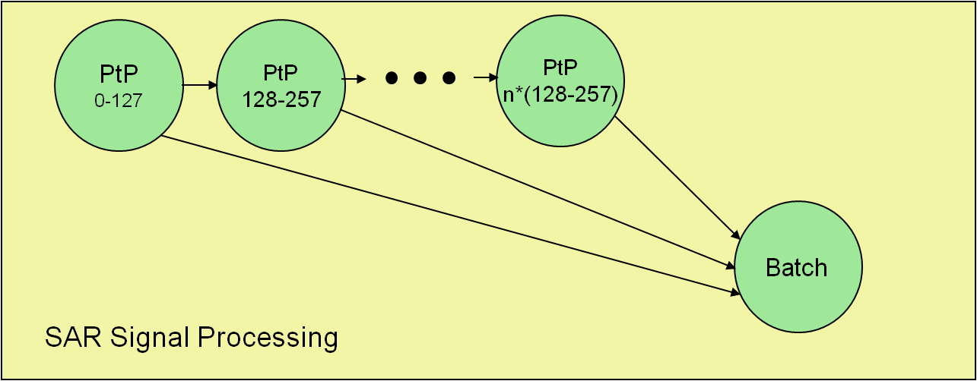
GPM: Hierarchical Program Structure Graphs are the fundamental building blocks
Graphs are used as building blocks to construct a signal processing application
Graphs are reusable DAGs that can be parameterized (eg number of collected samples to process, number of pulses to process, etc)
SAR (Synthetic Aperture Radar ) signal processing example
A single PtP (Pulse to Pulse) graph type is used for processing segments of a long coherent collection
Batch Graph for integrating the PtP outputs where data dependences exist between the pulse to pulse graphs
Multiple PtP Graphs maybe processed in parallel when collection time < processing time
Graph are used to express a course gain inherent algorithm TLP

Slide 11
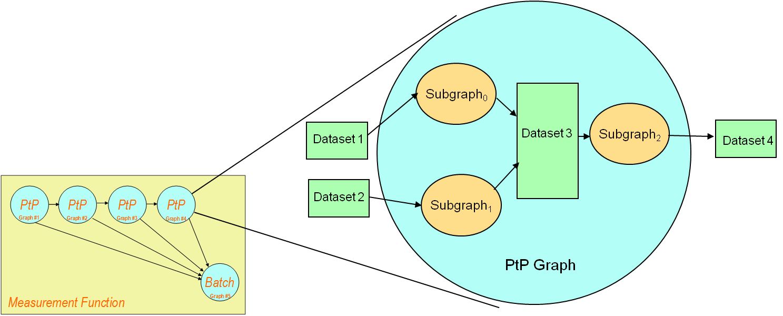
GPM: Hierarchical Program Structure Graphs are decomposed into Subgraphs
Subgraphs represent a finer gain expression of TLP
Independent grouping of data and processing
May execute in parallel thus utilizing parallel processing resources
Provides an opportunity to manage processing latency
Inter-subgraph communication implementation can utilize message passing
Typical for a loosely coupled memory hierarchy

Slide 12
GPM: Hierarchical Program Structure Subgraphs are decomposed Into Jobclasses
Subgraphs are composed into one or more Jobclasses
Jobclasses are SPMD (shown on an earlier chart) that consume the DLP that exists in datasets
A Jobclass consists of one or more Jobs
Each Job may execute in parallel on a cluster of processing nodes allocated to the subGraph
If a jobclass contains more Jobs then processing nodes than jobs will be queued and execute sequentially

Slide 13
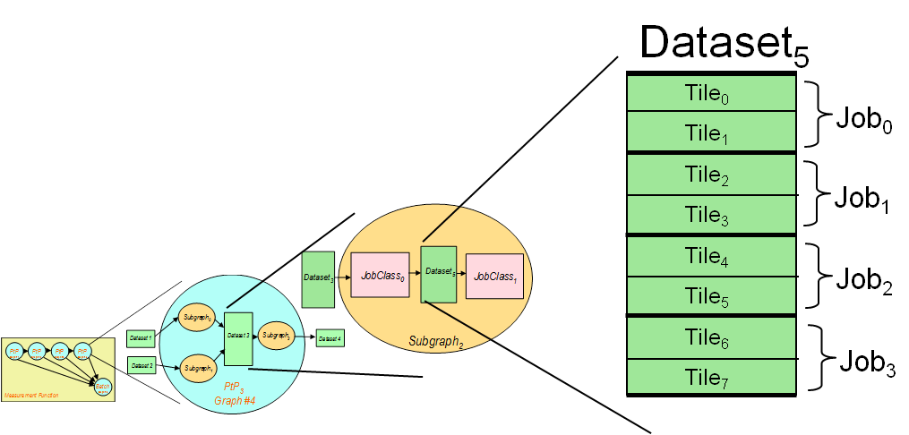
GPM: Hierarchical Program Structure Dataset are decomposed into Tiles
Dataset is divided into tiles exposing Data Level Parallelism (DLP)
A Jobclass view defines how to carve up the dataset into tiles
Tiles represent virtually contiguous chunks of data that can be processed in parallel
Typically there are 100s of tiles that comprise a dataset
Tiles are grouped and assigned to Jobs
Jobs process tiles in parallel
A single job processes its tiles sequentially
Job Class View Attributes
Number of Dimensions
Atomic Dimension
Number of dimension required to access a tile
Dimension structure
Length
Stride

Slide 14
Agenda
Graph Programming Model (GPM) goals
Overview of GPM basics
GPM hierarchical program structure
A brief look at how GPM achieves efficiency
Conclusion and Path Forward

Slide 15
GPM Achieves Efficiency: By Using Data tiling
Ability to simultaneously move data and perform useful computation is key to high performance
Job Sequencing and Data tiling provides the ability to bury data movement
Spawns Graph
Middleware
Waits for inputs
Graph Controls
Queues Jobs
Calls Begin
Calls Compute₀
Dataset
Job 0
Calls Compute₁
Tile 2
Calls Compute₂
Tile 0
Tile 0
Input
Buffers
Calls Compute₃
Dataset complete
Tile 3
Calls End
Tile 1
Tile 1
Tile 1
Tile 2
Tile 2
Tile 0
Output
Buffers
Tile 3
Tile 3
Tile 1
Tile 4
Job 1
Tile 5
Tile 6
Tile 6
Tile 4
Input
Buffers
Tile 5
Tile 7
Tile 7
Tile 5
Tile 4
Tile 6
Output
Buffers
Tile 7
Tile 5

Slide 16
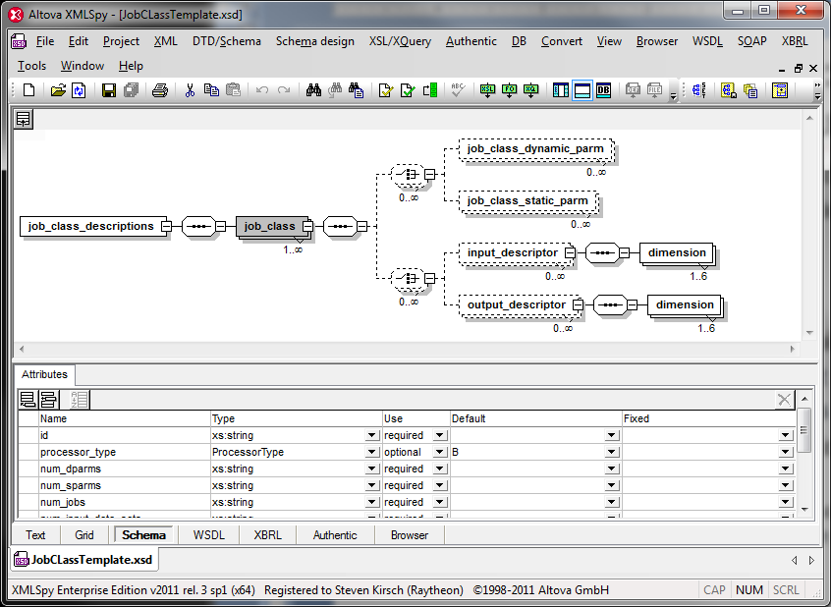
GPM Achieves Efficiency: Utilizing Heterogeneous Processing
Heterogeneous processing transparently integrated into the GPM
Achieving performance/SWAP requires the flexibility of a variety of processor types
Multi-core GP GPGPUs
Multi-core SIMD arrays FPGAs
Key to transparent integration is a consistent API across processor types
Exploiting TLP and DLP with a consistent interface
Communication between processor types utilizing a consistent user abstraction
GPM achieve this by parameterizing the processor type
Graph description simple references a processor type
Allows an implementation to allocate the processing step to the appropriate resource
Signal Processing within a JobClass utilizes a custom library assigned processor type
JobClass Description

Slide 17
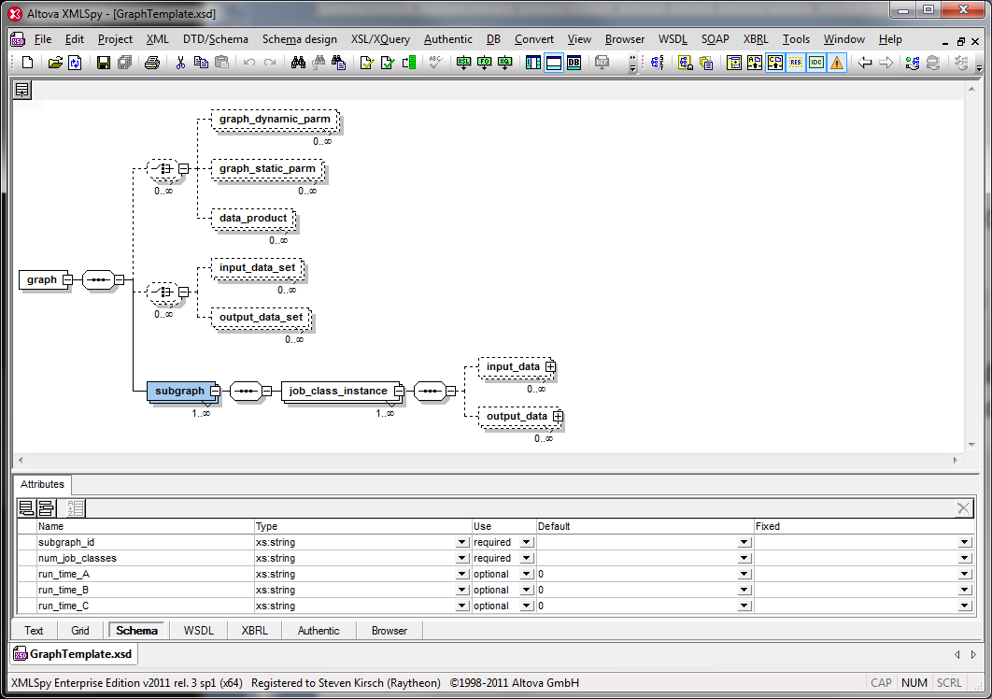
GPM Achieves Efficiency: Utilizing The Optimal Transport
Many signal processing problems are too large for a single SWAP constrained SMP machine thus requires a hybrid of SMP and message passing
Partitioning a design to best utilizing the optimal transport is a function of the TLP available in an algorithm
GMP exposes TLP is a systematic way that enables a runtime implementation to select the appropriate transport without impact to the signal processing design
Intra-subgraph dataset utilize SMP communication
Inter-subgraph dataset utilize message passing
Graph Description

Slide 18
GPM Achieves Efficiency: By Variety Of Other Mechanisms
Coarse scale real time load balancing
Coarse level load balancing is enable by use of subgraphs
Subgraphs are independent so that they can be allocated in real time to the next available processing “Cluster” (Cluster is a group of SMP coupled machines)
Fine scale real time load balancing
Data processed by a JobClass is partitioned between Jobs which at run time are allocated to processing nodes
Work can be evenly spread across all the nodes within a cluster
Data locality control
Since subgraphs are allocated to a cluster a runtime implementation can push dataset to the memory where the data will be consumed
Dataset writes are executed in parallel with tile compute cycles so the data movement can buried
Data Alignment
Efficient use of modern processors is typically sensitive to alignment of data to a fundamental hardware architecture constraint (e.g. cache line size)
GPM parameterizes this fundament constraint which enforce data movement between JobClasses and datasets to be optimized for the target hardware

Slide 19
GPM Efficiency Measured Results
Compute cycles and data IO transport time can be balanced thus reducing processing time verse unburied approaches
Current runtime implementation measured over dozens of JobClasses showed a mix between memory bandwidth limited jobClasses and compute bound as a function of algorithmic processing step
10% - 75% of the I/O time or compute cycle time can typically be buried
GPM implementation can achieve a low runtime overhead
Typically 5% of total compute cycles
Heterogeneous processing comparison
Results have shown that by carving out a few processing intense algorithms Performance/SWAP can be improved by more then 2x
FPGA vs IBM Cell processor example
IQ formation (FIR)
IQ Calibration (Cross Coupled FIRs)
Pulse Compressing (Fast Convolution)
Motion Compensation (Phase ramp gen and complex multiple)

Slide 20
Conclusions and Path Forward
Graph Programming Model achievement of goal can be directly associated with features of the architecture
Discussed features of GPM that contribute to efficiency
Portability, Scalability, Productivity features not discussed here are briefly described in the published paper Graph Programming Model: An Efficient Approach For Sensor Signal Processing
Runtime implementation of GPM has been characterized and has shown excellent results
Path Forward
Add additional GPM features
Data dependent cyclic behavior within a subgraph
Continue to improve current implementation and development tool suite
Performance model calculator
Port runtime to multiple target platforms
Addition of a GPGPU processor type
Addition of a Graphical editor

