Slide 1
Big Ocean Data: Numerically Conservative Parallel Query Processing
Bill Howe
UW eScience Institute
Computer Science & Engineering
University of Washington
Scott Moe
Applied Math
University of Washington

Slide 3
http://escience.washington.edu

Slide 4
eScience Scalable Data Analytics Group
Bill Howe, Phd (databases, cloud, data-intensive scalable computing, visualization)
Postdocs (past and present)
Dan Halperin, postdoc (distributed systems, algorithms)
Seung-Hee Bae, postdoc (scalable machine learning algorithms)
(alumni) Marianne Shaw, Phd (hadoop, graph query, health informatics)
Staff (past and present)
Sagar Chitnis (cloud computing, databases, web services)
(alumni) Alicia Key (web applications, visualization) (alumni)
(alumni) Garret Cole (databases, cloud computing, web services) (alumni)
Students
Scott Moe (2nd yr Phd, Applied Math)
Partners
CSE DB Faculty: Magda Balazinska, Dan Suciu
CSE students: Paris Koutris, Prasang Upadhyaya, Shengliang Xu, Jinjing Wang
UW-IT (web applications, QA/support)
Cecilia Aragon, Phd, Associate Professor, HCDE (visualization, scientific applications)

Slide 5
Summary of Big Data in the Ocean Sciences
In transition from expedition-based to observatory-based science
Enormous investments in infrastructure for linking sensors
Ad hoc, on-demand integration of large, heterogeneous, distributed datasets is the universal requirement in this regime
“Integration” means “regridding”
mesh to pixels, mesh to mesh, trajectory to mesh
satellites to models, models to models, observations to models
Regridding is hard
Must be easy, tolerant of unusual grids, numerically conservative, efficient
Summary of our work
We have the beginnings of a “universal regridding” operator with nice algebraic properties
We’re using it to implement efficient distributed data sharing applications, parallel algorithms, and more

Slide 6
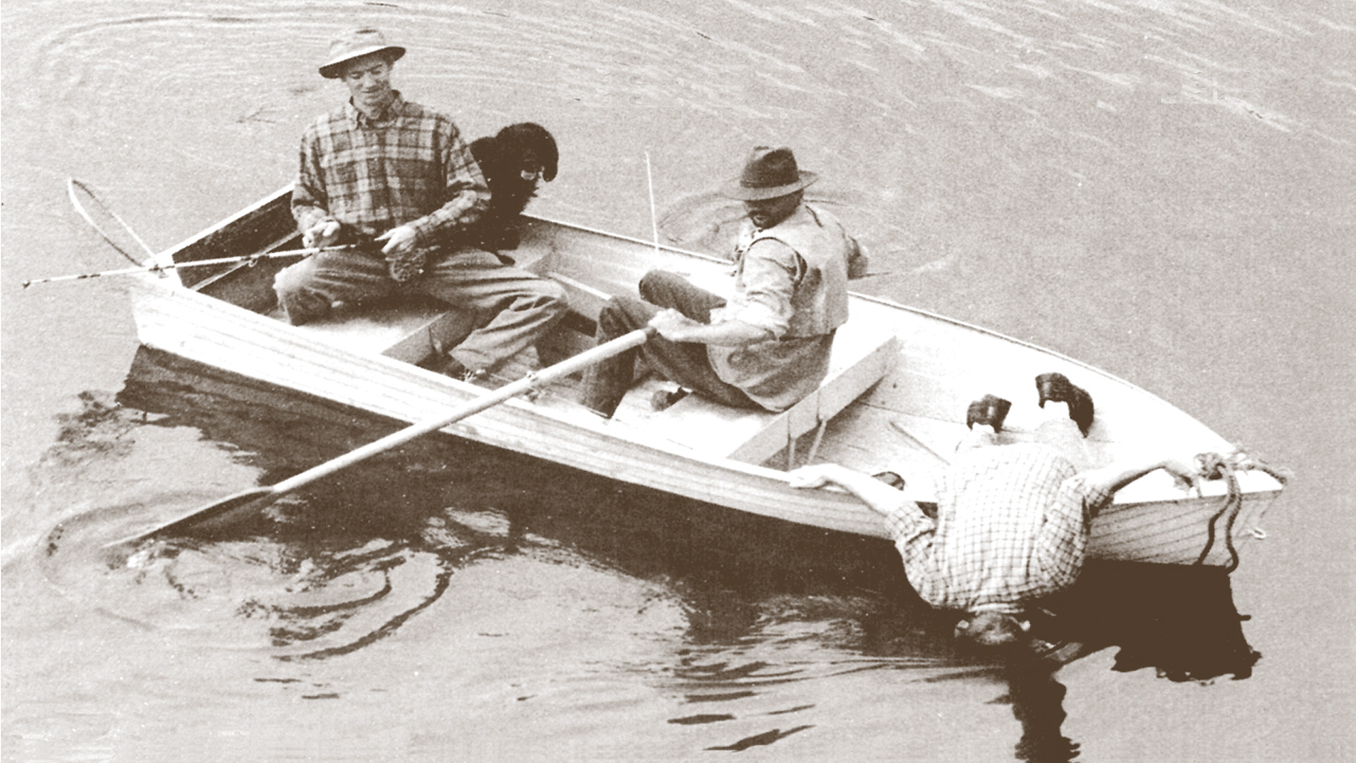
slide: John Delaney, UW

Slide 7
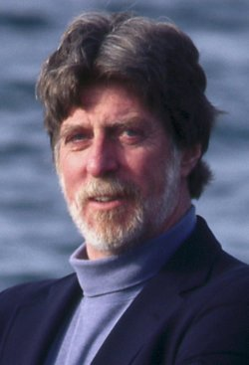
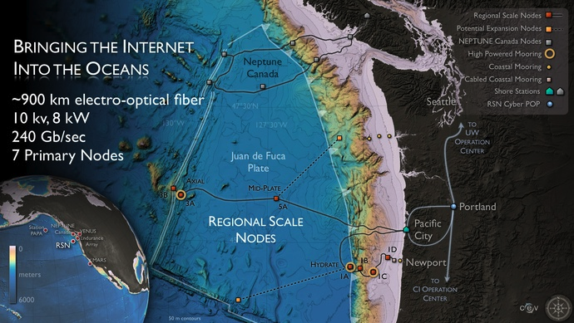
Regional Scale Nodes
John Delaney
10s of Gigabits/second from the ocean floor
Notes:
OOI: ~$100M, ~$40, ~$60, ~$100, ~$60 in 2009 – 2013

Slide 8
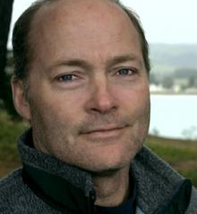
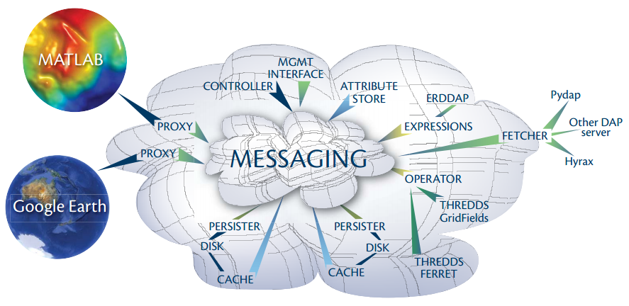
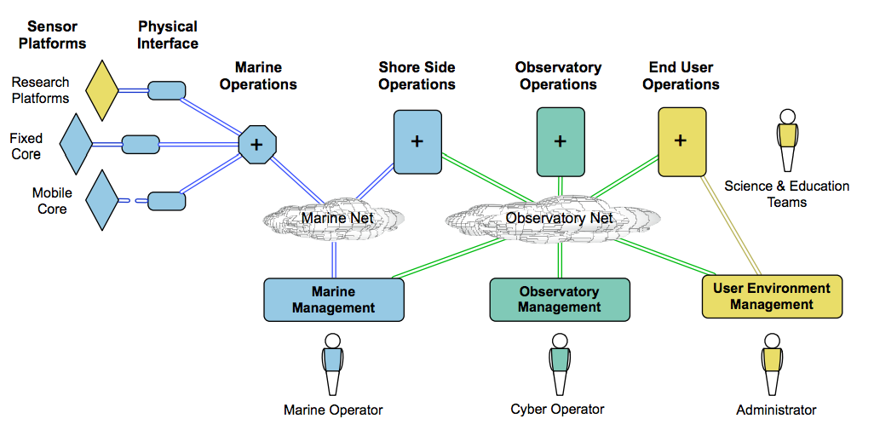
Cyberinfrastructure
Matthew Arrot
“Integration of numerical ocean models and their output as derived data products”
“Generation and distribution of qualified science data products in (near) real time”
“Access to, syntactic transformation, semantic mediation, analysis, and visualization of science data, data products, and derived data products”

Slide 9
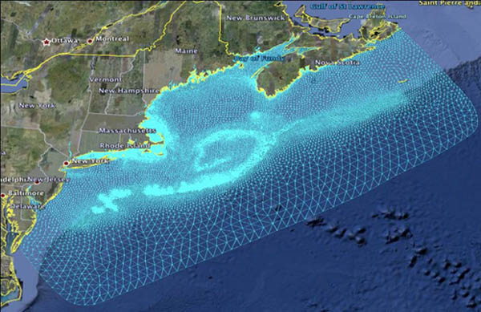
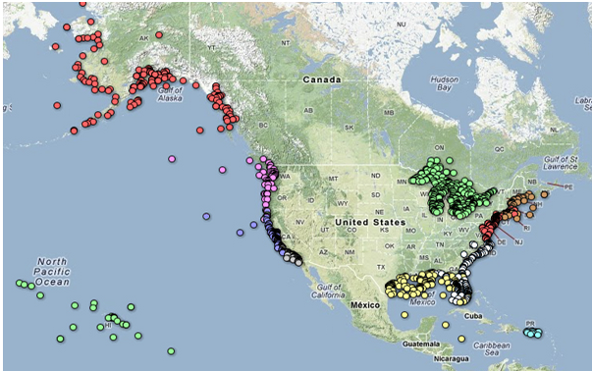
17 federal organizations named as partners
“a strategy for incorporating observation systems from … near shore waters as part of … a network of observatories.”
11 Regional Associations
Notes:
IOOS: $37M in 2012, up from 2010, down from 2004-2007

Slide 10
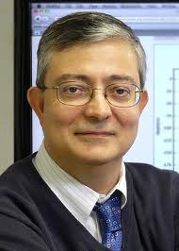
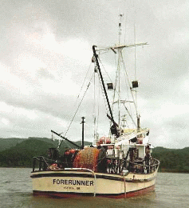
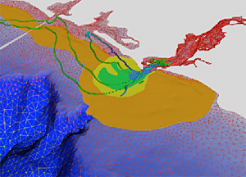
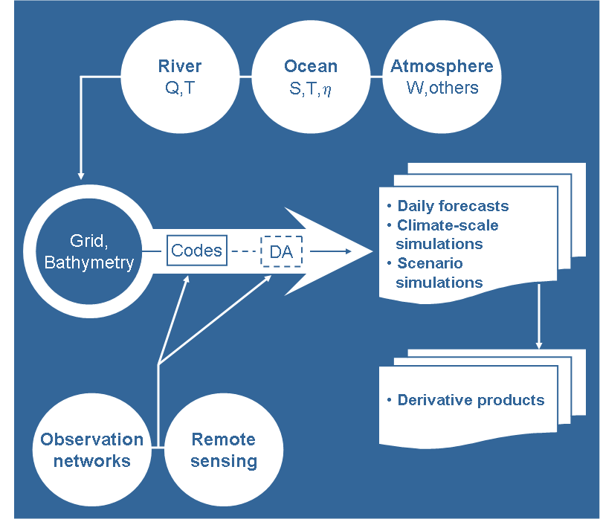
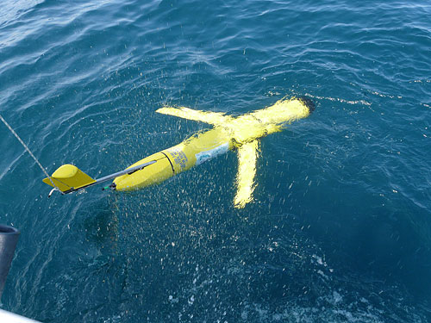
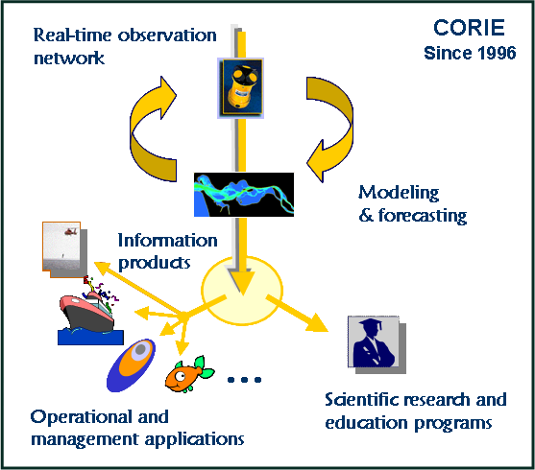
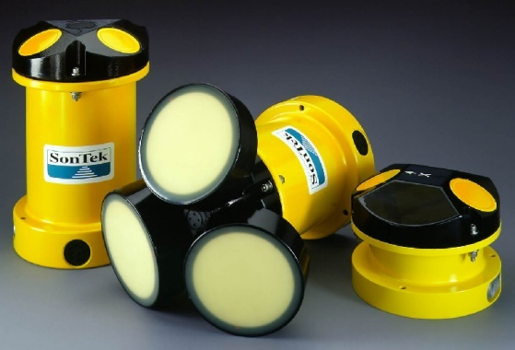
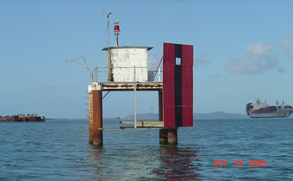
Center for Coastal Margin Observation and Prediction (CMOP)
Antonio Baptista
Notes:
$17M

Slide 11
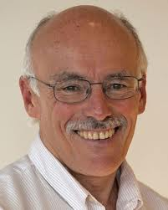
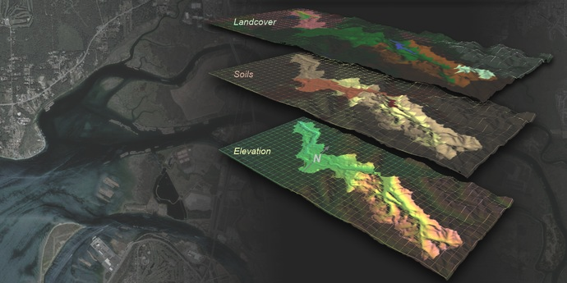
Virtual Mekong Basin
Jeff Richey
img src: Mark Stoermer, UW Center for Environmental Visualization

Slide 12
3 V’s of Big Data
Volume
Variety
Velocity
LSST (~100PB; images, spectra)
Astronomy
PanSTARRS (~40PB; images, trajectories)
telescopes
SDSS (~400TB; images, spectra, catalogs)
n-body sims
spectra
Ocean Sciences
models
# of bytes
stations
OOI (~50TB/year; sims, RSN)
IOOS (~50TB/year; sims, satellite, gliders, AUVs, vessels, more)
CMOP (~10TB/year; sims, stations, gliders, AUVs, vessels, more)
AUVs
gliders
cruises, CTDs
flow cytometry
ADCP
satellites
# of data sources

Slide 13
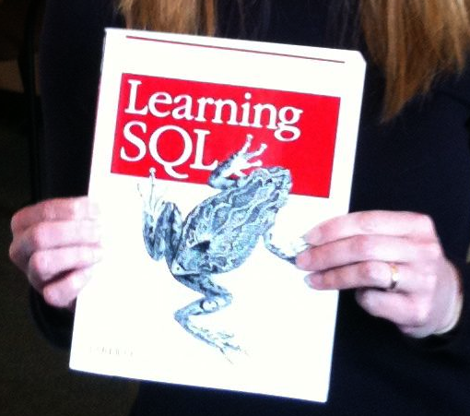
SQLShare: Ad Hoc Databases for Science
Problem
Data is captured and manipulated in ad hoc files
Made sense five years ago; the data volumes were manageable
But now: 50k rows, 100s of files, sharing
Why not put everything into a database?
A huge amount of up-front effort
Hard to design for a moving target
Running a database system is a huge drain
Solution: SQLShare
Upload data through your browser: no setup, no installation
Login to browse science questions in English
Click a question, see the SQL to answer it question
Edit the SQL to answer an "adjacent" question, even if you wouldn’t know how to write it from scratch
https://sqlshare.escience.washington.edu/

Slide 14
Summary of Big Data in the Ocean Sciences
Transition from expedition-based to observatory-based science
Enormous investments in integrating infrastructure for data acquisition and interoperability
Ad hoc, on-demand integration of large, heterogeneous, distributed datasets is the universal requirement in this regime
“Integration” means “regridding”
mesh to pixels, mesh to mesh, trajectory to mesh
satellites to models, models to models, observations to models
Regridding is hard
Must be easy, tolerant of unusual grids, numerically conservative, efficient
Summary of our work
We have the beginnings of a “universal regridding” operator with nice algebraic properties
We’re using it to implement efficient distributed data sharing applications, parallel algorithms, and more

Slide 15
Status Quo
“FTP + MATLAB”
“Nascent Databases”
File-based, format-specific API
UniData’s NetCDF, HDF5
Some IO optimization, some indexing
Data Servers
Same as file-based systems,
but supports RPC
None of this scales
- up with data volumes
- up with number of sources
- down with developer expertise
Hyrax

Slide 16
What do we really need here?
Claim: Everything reduces to regridding
Model-data comparisons skill assessment?
Regrid observations onto model mesh
Model-model comparison?
Regrid one model’s mesh onto the other’s
Model coupling?
Regrid a meso-scale atmospheric model onto your regional ocean model
Visualization?
Regrid onto a 3D mesh, or regrid onto a 2D array of pixels

Slide 17
Why is this so hard?
Needs to handle Unstructured Grids
Needs to be Numerically Conservative
Needs to be Lightweight and Efficient
Notes:
Data Integration
State of the art: Download all the files you need, write your own MATLAB
The Database Game: Bring the computation to the data rather than the data to the computation
This works great for simple things like tables, and even arrays. What about meshes?
They’re harder:
Standards-resistant
Standards group working off and on for 7 years
Show lots of different kind of grids? AMR, warped, finite element, finite difference
Numerical conservation is important
“I don’t trust your processsing; I need access to the raw data”
“Raw” may still be grossly downsampled for convenience purposes
Fundamental operation is regridding:
Visualization? Regrid onto a smooth mesh, or regrid onto pixels
Data Integration? Regrid one model’s results onto another’s for comparison
Model coupling? Regrid one model’s results onto another’s for comparison
Model-data comparisons? Induce a “grid” on the data if necessary, then regrid onto the model
Fundamental operation is restriction:
“I only care about this region”
Use a meso-scale atmospheric model to force a local estuary model
Parallel processing: break a large mesh into pieces and process them in parallel
Fundamental Law of Efficient Ocean Data Integration:
Restrict * Regrid = Regrid * Restrict
Example: Server-side query:
“I need the data around the mouth of the estuary, regridded to a regular grid.”
Option 1: Restrict * Regrid
Option 2: Regrid * Restrict
Naïve method: interpolate. It commutes, but it is not conservative and the error is significant
Alternative for conservative regridding: Supermeshing [Farrell]
Supermeshing requires identical domains, and so does not commute with restrict.
Our approach: enhance supermeshing with masking and lumping to make it commute with restrict.
Results:

Slide 18
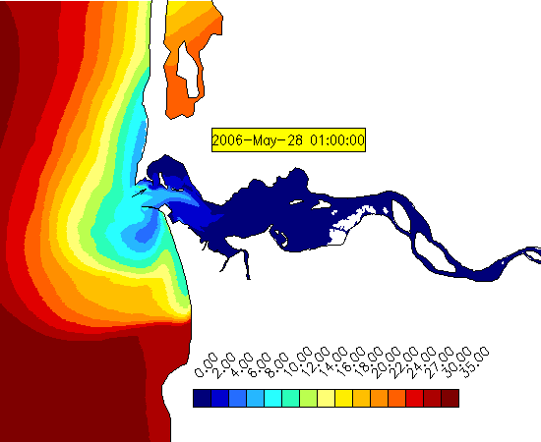
Columbia River Estuary
Washington
Oregon

Slide 19
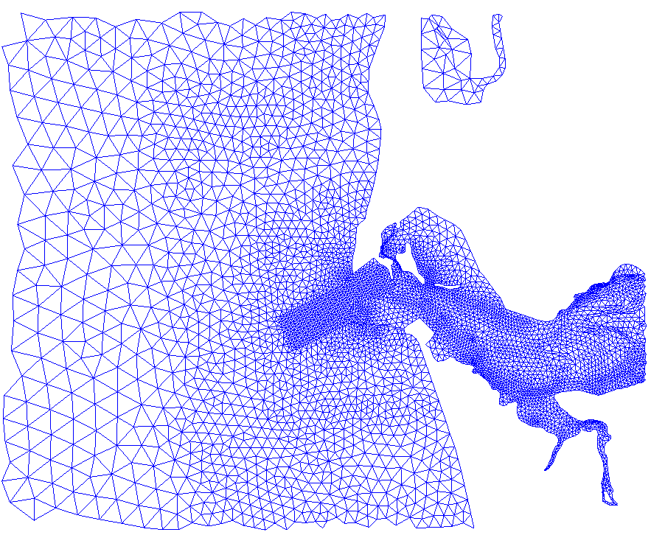
Columbia River Estuary
Washington
Oregon
Notes:
Unstructured grids model complex domains more precisely, and naturally capture multi-scale dynamics

Slide 20
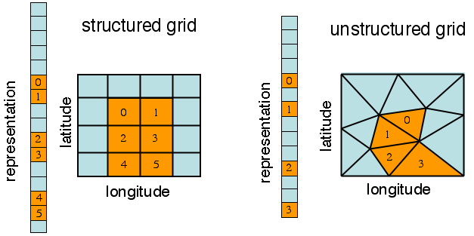
GridFields
ESMF
SciDB
Hyrax
VTK/Paraview
Notes:
Project: New software for serving oceanographic model results, requiring collaboration between UW, OPeNDAP.org, and OOI.
Problem: Who wants to provide guest accounts for the other two?
Observation: EC2 is “Google Docs” for developers: a shared environment outside the jurisdiction of overprotective sysadmins.
Outcome: Waited two weeks for credentials to be established, then spun up an EC2 instance and were rolling within an hour. We can work on the same code base -- no bugs closed as “Can’t Replicate”
Conclusion: The cloud is the ultimate collaborative development environment.

Slide 21
Structured grids are easy
The data model
(Cartesian products of coordinate variables)
immediately implies a representation,
(multidimensional arrays)
an API,
(reading and writing subslabs)
and an efficient implementation
(address calculation using array “shape”)

Slide 22
Why is this so hard?
Needs to handle Unstructured Grids
Needs to be Numerically Conservative
Needs to be Lightweight and Efficient
Notes:
Data Integration
State of the art: Download all the files you need, write your own MATLAB
The Database Game: Bring the computation to the data rather than the data to the computation
This works great for simple things like tables, and even arrays. What about meshes?
They’re harder:
Standards-resistant
Standards group working off and on for 7 years
Show lots of different kind of grids? AMR, warped, finite element, finite difference
Numerical conservation is important
“I don’t trust your processsing; I need access to the raw data”
“Raw” may still be grossly downsampled for convenience purposes
Fundamental operation is regridding:
Visualization? Regrid onto a smooth mesh, or regrid onto pixels
Data Integration? Regrid one model’s results onto another’s for comparison
Model coupling? Regrid one model’s results onto another’s for comparison
Model-data comparisons? Induce a “grid” on the data if necessary, then regrid onto the model
Fundamental operation is restriction:
“I only care about this region”
Use a meso-scale atmospheric model to force a local estuary model
Parallel processing: break a large mesh into pieces and process them in parallel
Fundamental Law of Efficient Ocean Data Integration:
Restrict * Regrid = Regrid * Restrict
Example: Server-side query:
“I need the data around the mouth of the estuary, regridded to a regular grid.”
Option 1: Restrict * Regrid
Option 2: Regrid * Restrict
Naïve method: interpolate. It commutes, but it is not conservative and the error is significant
Alternative for conservative regridding: Supermeshing [Farrell]
Supermeshing requires identical domains, and so does not commute with restrict.
Our approach: enhance supermeshing with masking and lumping to make it commute with restrict.
Results:

Slide 23
Naïve Method: Interpolation (Spatial Join)
For each vertex in the target grid,
Find containing cell in the source grid,
Evaluate the basis functions to interpolate

Slide 24
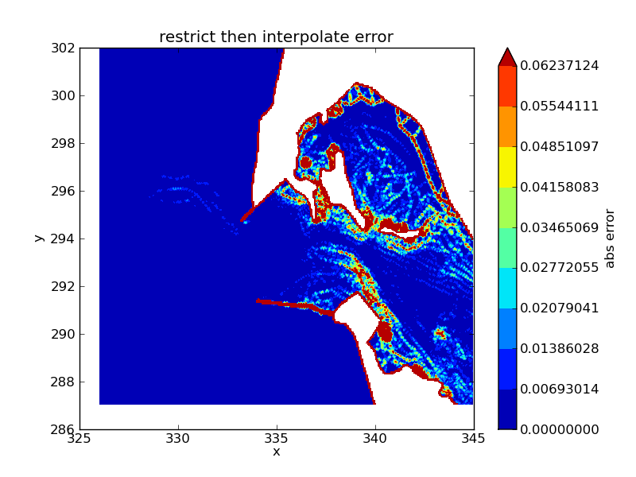

Slide 25
Supermeshing [Farrell 10]
For each cell in the target grid,
Find overlapping cells in the source grid,
Compute their intersections
Derive new coefficients to minimize L2 norm
* Guaranteeed Conservative
* Minimizes Error
But:
Domains must match exactly

Slide 26
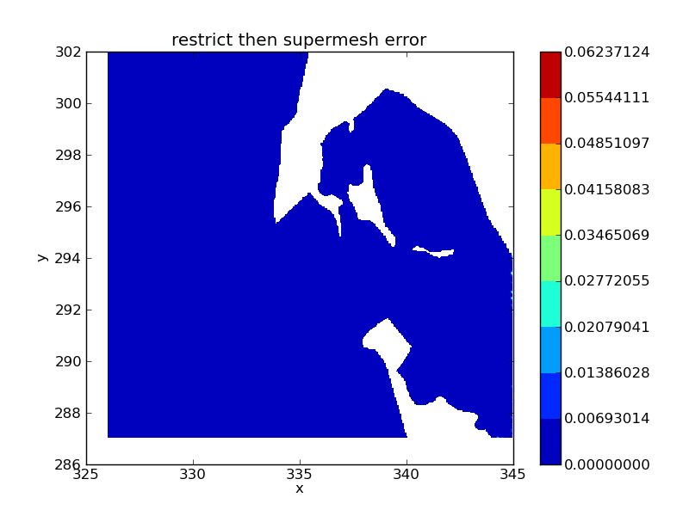

Slide 27
Why is this so hard?
Needs to handle Unstructured Grids
Needs to be Numerically Conservative
Needs to be Lightweight and Efficient
Notes:
Data Integration
State of the art: Download all the files you need, write your own MATLAB
The Database Game: Bring the computation to the data rather than the data to the computation
This works great for simple things like tables, and even arrays. What about meshes?
They’re harder:
Standards-resistant
Standards group working off and on for 7 years
Show lots of different kind of grids? AMR, warped, finite element, finite difference
Numerical conservation is important
“I don’t trust your processsing; I need access to the raw data”
“Raw” may still be grossly downsampled for convenience purposes
Fundamental operation is regridding:
Visualization? Regrid onto a smooth mesh, or regrid onto pixels
Data Integration? Regrid one model’s results onto another’s for comparison
Model coupling? Regrid one model’s results onto another’s for comparison
Model-data comparisons? Induce a “grid” on the data if necessary, then regrid onto the model
Fundamental operation is restriction:
“I only care about this region”
Use a meso-scale atmospheric model to force a local estuary model
Parallel processing: break a large mesh into pieces and process them in parallel
Fundamental Law of Efficient Ocean Data Integration:
Restrict * Regrid = Regrid * Restrict
Example: Server-side query:
“I need the data around the mouth of the estuary, regridded to a regular grid.”
Option 1: Restrict * Regrid
Option 2: Regrid * Restrict
Naïve method: interpolate. It commutes, but it is not conservative and the error is significant
Alternative for conservative regridding: Supermeshing [Farrell]
Supermeshing requires identical domains, and so does not commute with restrict.
Our approach: enhance supermeshing with masking and lumping to make it commute with restrict.
Results:

Slide 28
Digression: Relational Database History
Pre-Relational: if your data changed, your application broke.
Early RDBMS were buggy and slow (and often reviled), but required only 5% of the application code.
“Activities of users at terminals and most application programs should remain unaffected when the internal representation of data is changed and even when some aspects of the external representation are changed.”
-- Codd 1979
Key Idea: Programs that manipulate tabular data exhibit an algebraic structure allowing reasoning and manipulation independently of physical data representation
Notes:
It provides a means of describing data with its natural structure only--that is, without superimposing any additional structure for machine representation purposes. Accordingly, it provides a basis for a high level data language which will yield maximal independence between programs on the one hand and machine representation on the other.

Slide 29
Key Idea: An Algebra of Tables
select
project
join
join
Other operators: aggregate, union, difference, cross product
Notes:
It turns out that you can express a wide variety of computations using only a handful of operators.

Slide 30
Review: Algebraic Optimization
N = ((4*2)+((4*3)+0))/1
Algebraic Laws:
1. (+) identity: x+0 = x
2. (/) identity: x/1 = x
3. (*) distributes: (n*x+n*y) = n*(x+y)
4. (*) commutes: x*y = y*x
Apply rules 1, 3, 4, 2: N = (2+3)*4
two operations instead of five, no division operator
Same idea works with very large tables, but the payoff is much higher

Slide 31
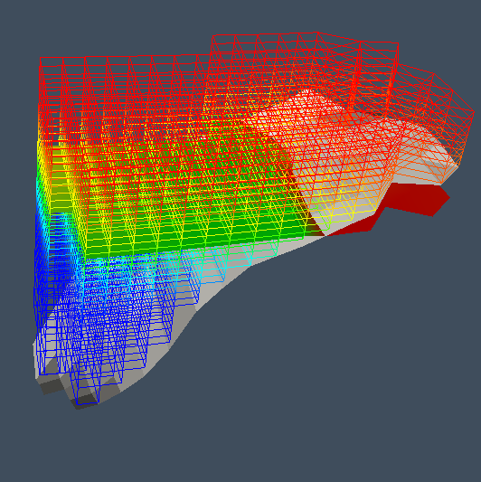
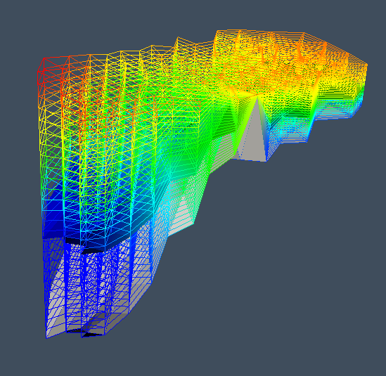
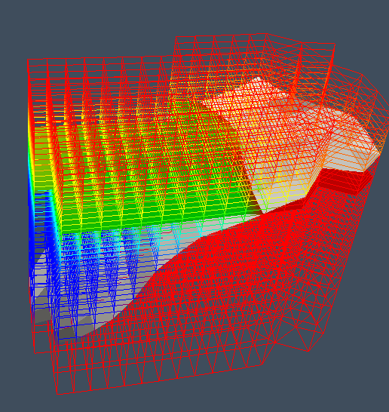
GridFields: An Algebra of Meshes
color is depth
color is salinity
C
apply(0, z=(surf − b) * σ )
⊗
bind(0, surf)
H₀ : (x,y,b)
V₀ : (σ )
B
restrict(0, z >b)
A
Algebraic Manipulation of Scientific Datasets, B. Howe, D. Maier, VLDBJ 2005
⊗
H₀ : (x,y,b)
V₀ : (z)

Slide 32
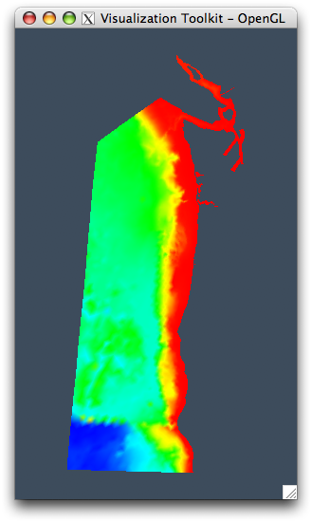
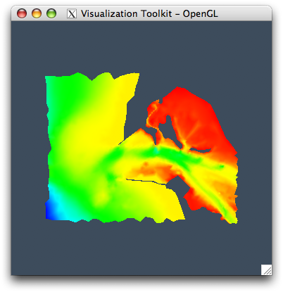
Example (1)
predicate
dimension
H = Scan(context, "H")
rH = Restrict("(326<x) & (x<345) & (287<y) & (y<302)", 0, H)
H =
rH =
color: bathymetry

Slide 33
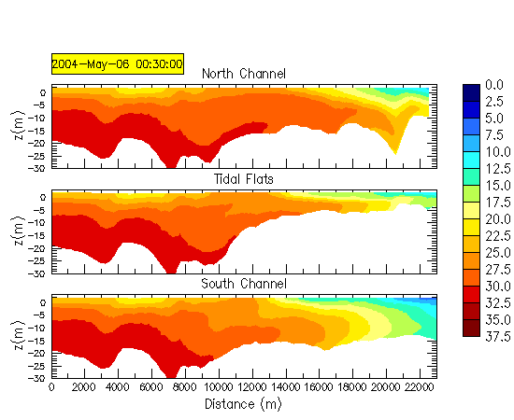
Example: Transect
P

Slide 34
Transect: Bad Query Plan
Construct full-size 3D grid
Construct 2D transect grid
Join 1) with 2)
H(x,y,b)
⊗
r(z>b)
b(s)
regrid
V(z)
⊗
P
P ⊗ V

Slide 35
Transect: Optimized Plan
Find 2D cells containing points
Create “stacks” of 2D cells carrying data
Create 2D transect grid
Join 2) with 3)
H(x,y,b)
regrid
⊗
b(s)
regrid
P
V(z)
⊗
P ⊗ V

Slide 36
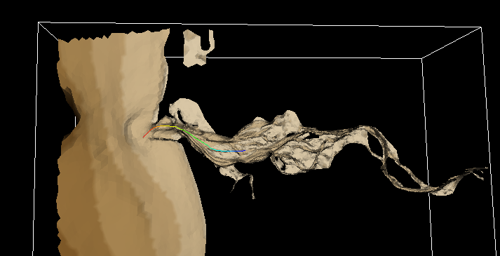
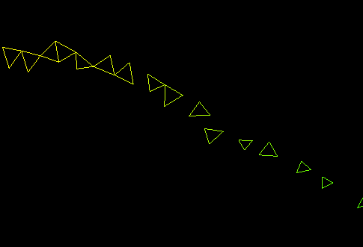
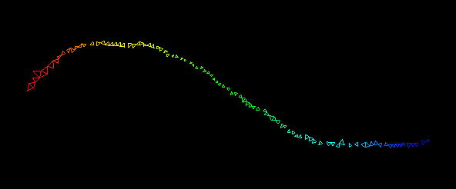
1) Find cells containing points in P

Slide 37
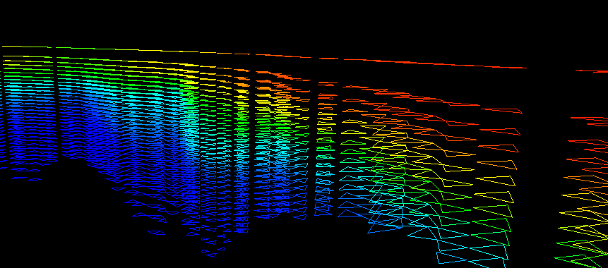
Find cells containing points in P
Construct “stacks” of cells
4) Join 2) with 3)
2)
1)
4)

Slide 38
Transect: Results
secs
800 MB
(1 timestep)

Slide 39
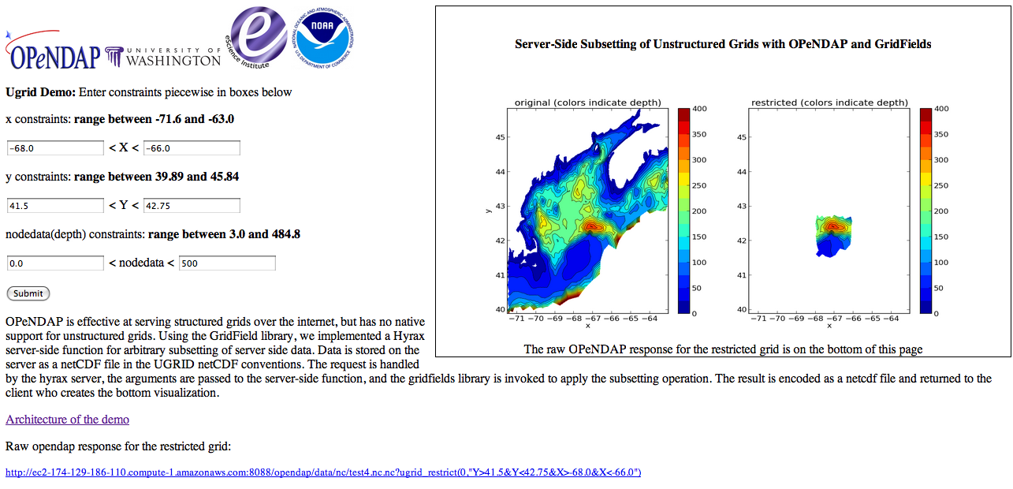
Screenshot of OPeNDAP demo
http://ec2-174-129-186-110.compute-1.amazonaws.com:8088/nc/test4.nc.nc?
ugrid_restrict(0,"Y>41.5&Y<42.75&X>-68.0&X<-66.0")

Slide 40
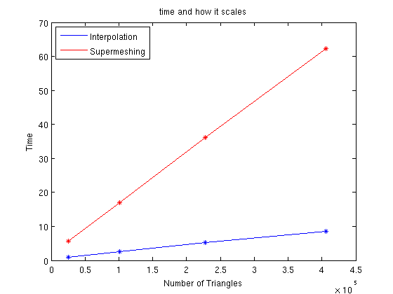

Slide 41
Commutative Law of Regrid and Restrict:
Restrict(Regrid(X,Y)) = Regrid(Restrict(X), Restrict(Y))
G₀ = Regrid(Restrict₀(X), Restrict₀(Y)))
G₁ = Regrid(Restrict₁(X), Restrict₁(Y)))
:
G_{N} = Regrid(Restrict₂(X), Restrict₂(Y)))
R = Stitch(G₀, G₁, G₂)

Slide 42
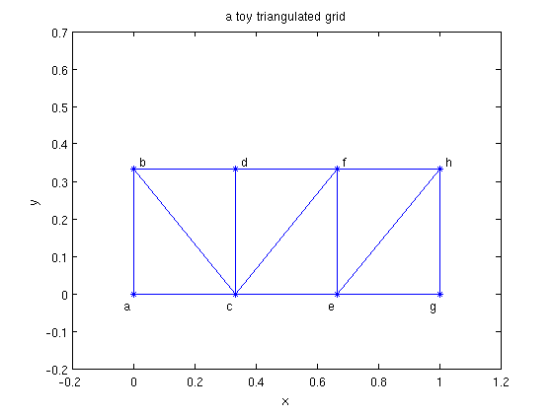

Slide 43
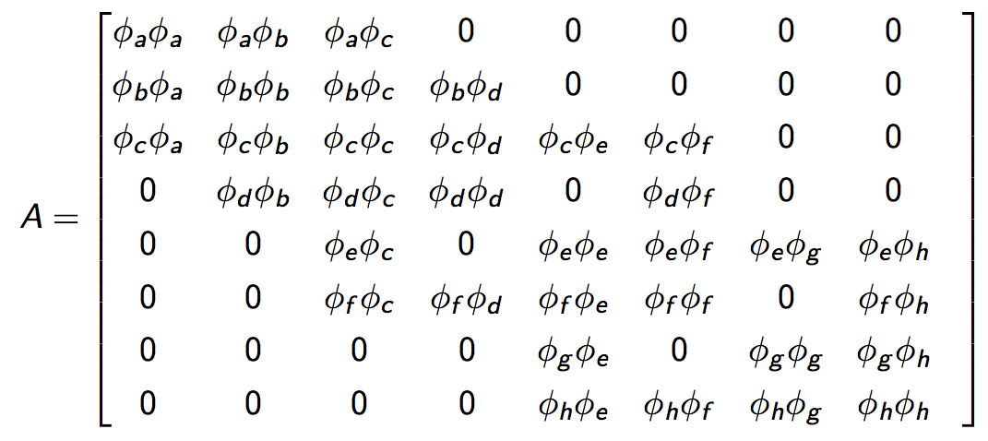

Slide 44
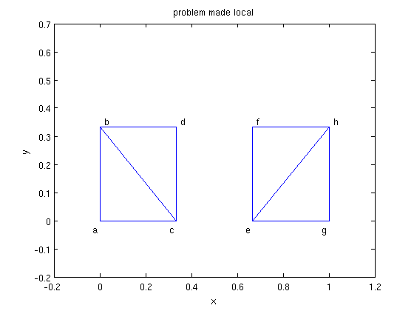

Slide 45
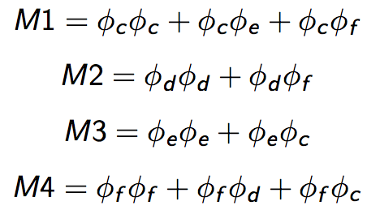

Slide 46
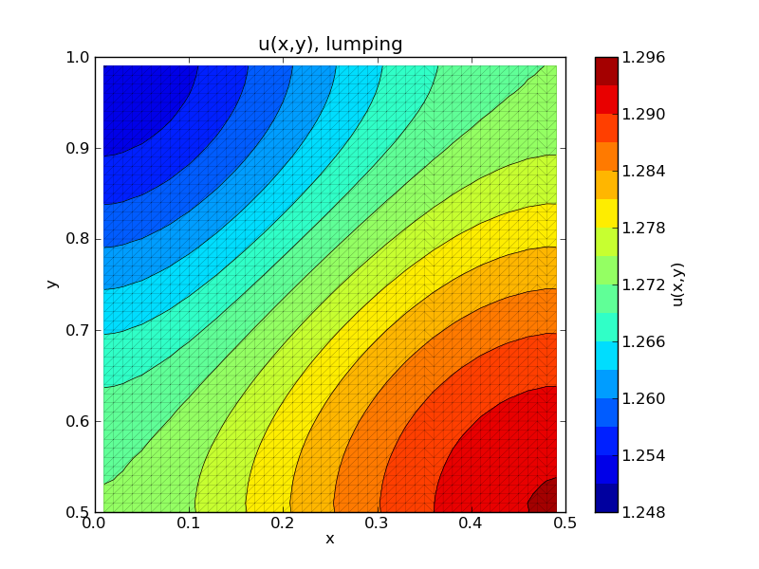
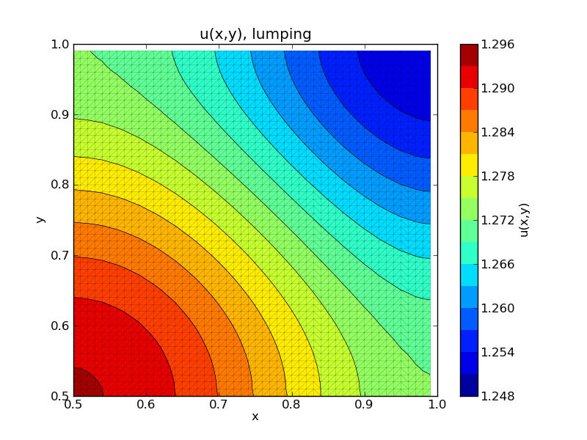
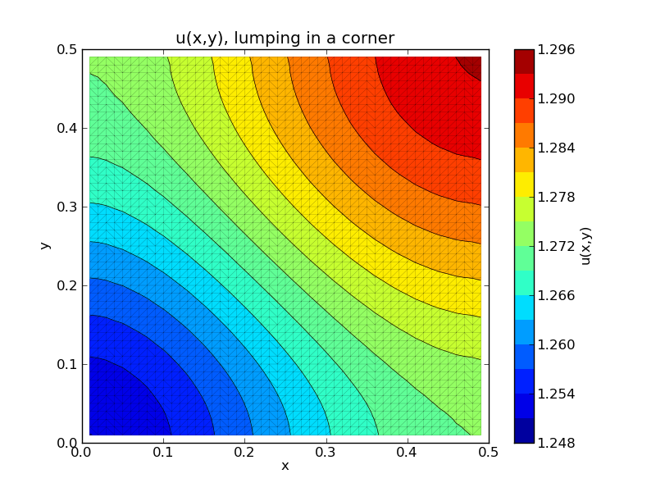
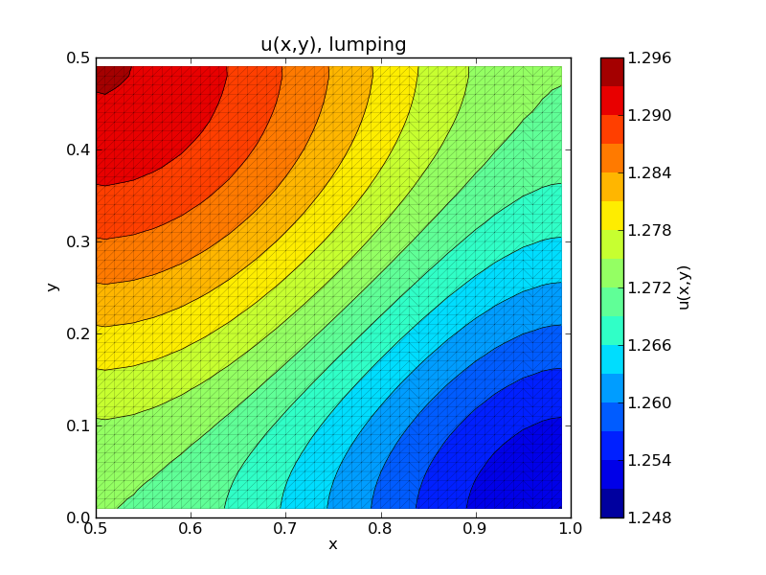
Globally conservative
Parallelizable
Commutes with user-selected restrictions
masking to handle mismatched domains
Todos:
Characterize the error relative to plain supermeshing
Universal Regridding-as-a-Service

Slide 47
Outreach and Usage
Code released
Search “gridfields” on google code
http://code.google.com/p/gridfields/
C++ with Python bindings
Integrated into the Hyrax Data Server
OPULS project funded by NOAA
Server-side processing of unstructured grids
Other users
US Geological Survey
NOAA
9/12/12
Bill Howe, UW
47

