Slide 1
STINGER: High Performance Data Structure for Streaming Graphs
David Ediger Rob McColl Jason Riedy David A. Bader

Slide 2
Main Contributions
High performance, scalable, and portable graph data structure for streaming graphs
Several approaches to manufacture parallelism in a stream of edges
2-3 orders of magnitude better performance for edge insertions and deletions
3 million updates per second
  Scale-free graph with 537 million edges
Target platforms: Cray XMT, Intel/AMD x86, IBM Power7
In use by: DARPA UHPC CP2, CMU, Sandia MTGL

Slide 3
Outline
Motivation
Data Structures
Target Architectures
Finding Parallelism in Updates
Performance Results
Conclusions

Slide 4
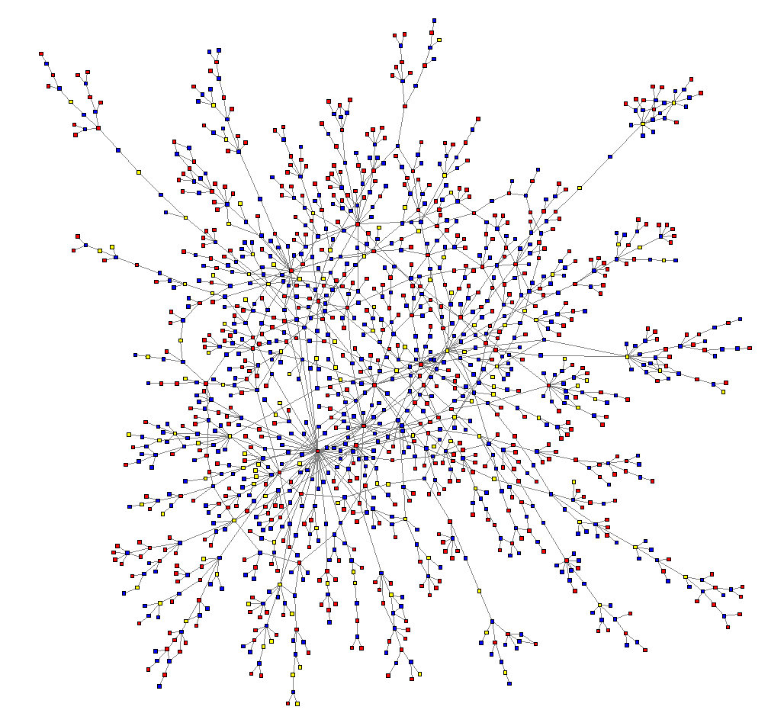

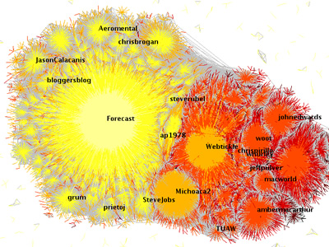
Motivation: Social Media
Immense volume of data
Facebook: ~1 billion users
  average 130 friends
  30 billion pieces of content shared / month
Twitter: 500 million active users
  340 million tweets / day
Goal: Use the interaction
network to understand
and characterize
information flow
Twitter social network using Large Graph Layout
Sources: Facebook, Twitter
Notes:
Really big, very active.

Slide 5





Current Example Data Rates
Financial:
  NYSE processes 1.5TB daily, maintains 8PB
Social:
  Facebook: 37,000 Likes per second
  Twitter: 13,684 Tweets per second (Barcelona v. Chelsea)
Google:
  “Several dozen” 1PB data sets
  Knowledge Graph: 500M entities, 3.5B relationships
Business:
  eBay: 17 trillion records, 1.5B new records per day
Shared features: All data is rich, semi-structured, and may
contain missing or inconsistent information.
Notes:
10,000 to 40,000 somethings per second across the board.
Facebook: Keep updated!

Slide 6
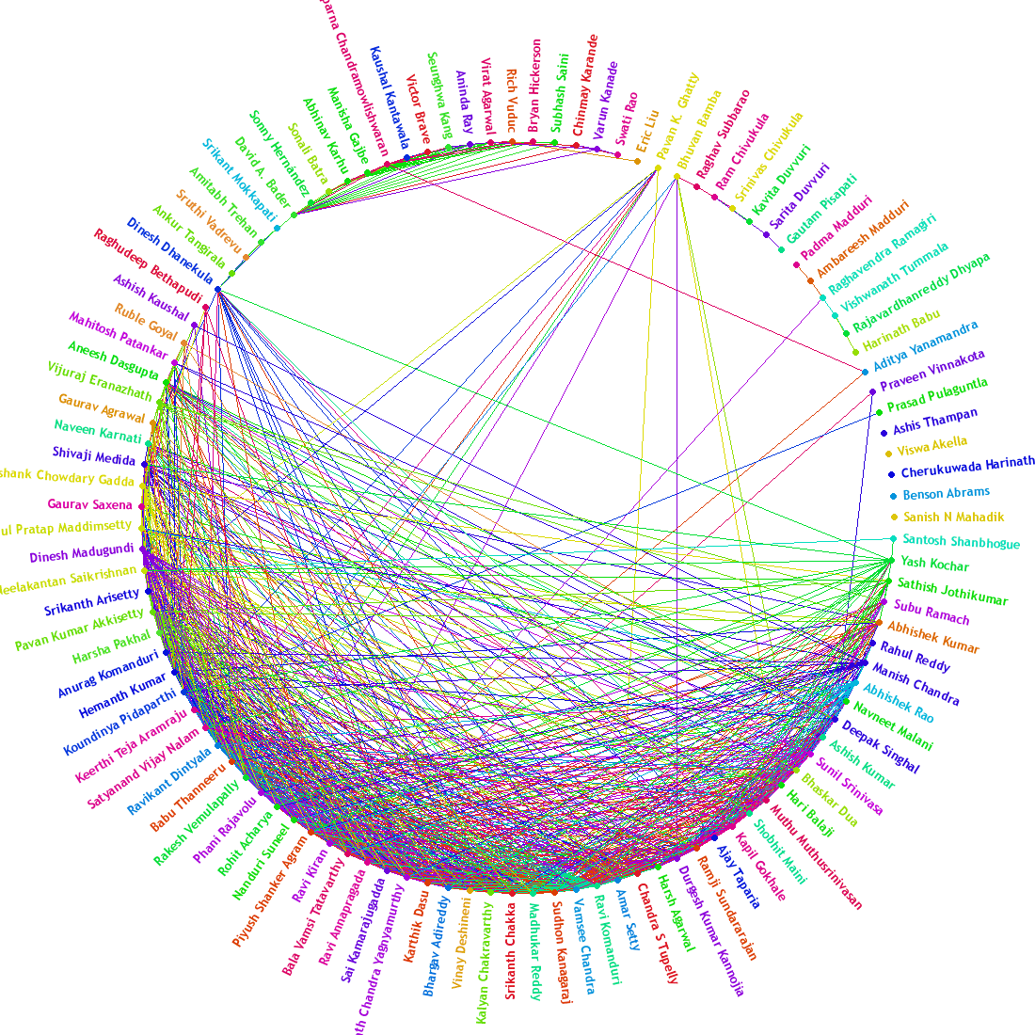
Characteristics of Social Networks
Very, very large
Power-law distribution
  Number of neighbors
Large clustering coefficient
Small diameter
“Small world” property
Implication: 3-hop neighborhood is most of the graph
Reflected in algorithm design, machine architecture
Image Source: Nexus (Facebook application)
Notes:
Power-law distribution, lots of structure, hard to partition well.

Slide 7
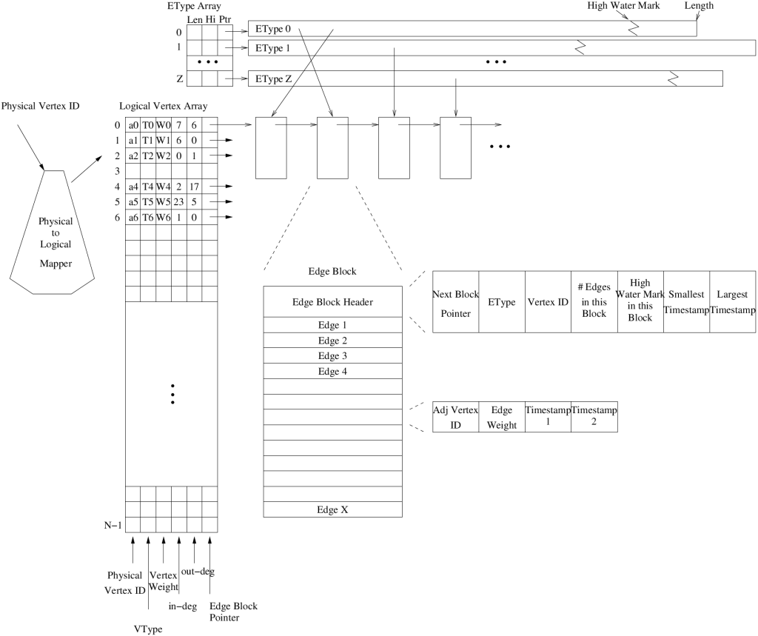
STINGER
D. Bader, J. Berry, A. Amos-Binks, D. Chavarría-Miranda, C. Hastings, K. Madduri, S. Poulos, "STINGER: Spatio-Temporal Interaction Networks and Graphs (STING) Extensible Representation"
Semi-dense edge list blocks with free space
Compactly stores timestamps, types, weights
Maps from application IDs to storage IDs
Deletion by negating IDs, separate compaction

Slide 8
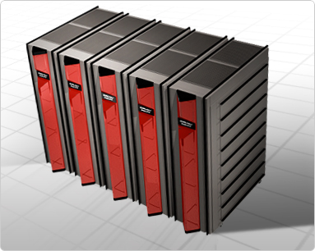
Cray XMT Operation
Tolerates latency by extreme multithreading
  Each processor supports 128 hardware threads
  Context switch in a single tick
  No cache or local memory
  Context switch on memory request
  Multiple outstanding loads
Remote memory requests do not stall processors
  Other streams work while the request
  gets fulfilled
Light-weight, word-level synchronization
  Minimizes access conflicts
Hashed global shared memory
  64-byte granularity, minimizes hotspots
  Cray XMT2 supports up to 64 TiB main memory
Notes:
Multithreading to tolerate latency. Low-cost sync.

Slide 9
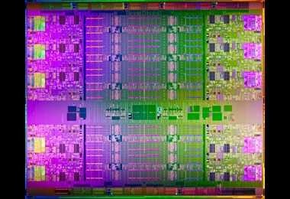
Intel E7-8870-based Platforms
Architecture supports up to 2 TiB, commercially available
Tolerates some latency by hyperthreading
  Hardware: 2 threads / core, 10 cores / socket, 4 sockets
  Fast cores (2.4 GHz), fast memory (1,066 MHz)
  Out-of-order execution, branch prediction
  Limited outstanding memory requests (60/socket), but large caches (30 MiB L3 per socket)
  Coherence-based atomics
Good system support
  4 MiB pages reduce TLB costs
  Fast, user-level locking
  Tuned libraries
Single motherboard solution
Credit: Intel Press Kit
Notes:
Relatively cheap. 80 hardware threads is quite unlike 8 hardware threads.

Slide 10
Insertion Performance
Inserting edges one by one yields
  Greatest time resolution
  Lowest performance
Test Input Graph: RMAT with 16 M vertices & 270 M edges
128-processor Cray XMT: 950 updates / second
40-core Intel Xeon: 12,000 updates / second
Conclusion: Not enough work / parallelism in a single edge insertion to fully utilize the memory
Notes:
Naïve approach not very good.

Slide 11
STINGER Batch Update Algorithm
Sort edge insertions/deletions by source vertex, destination vertex
Partition edge updates by source vertex
For each partition (in parallel)
  Process deletions serially
  Process insertions serially
  Update block metadata
Multiple parallel algorithms
Update block-level metadata safely
Cray XMT Updates / Sec
|V| = 16 M
|E| = 270 M
Batchsize = 100 K
Notes:
Traditional HPC approach…better.

Slide 12
Observations
After much tuning and measurement…
Choice of sorting algorithm had little effect on performance
  Actual data structure manipulation dominated
Increasing batch size yielded additional performance
  Increasing batch size = increasing parallelism
Hypothesis: Cray XMT can support additional parallelism
Corollary: Some vertices have many incident edges to be inserted
  long serial bottleneck
Solution: Parallelize all edge updates
Notes:
Big XMT thrives on lots of parallelism

Slide 13
Parallelizing Edge Insertions/Deletions
Solution: Parallelize all edge updates
Benefits
  No sorting
  No partitioning
  All actions in batch can be done in parallel
Requirements
  Safe parallel updates of edges and edge block metadata
  Accomplished using full-empty bit synchronization &
  atomic fetch-and-add
  On x86 systems, emulate with atomic compare-and-swap
  Deletions handled similarly, but separately from insertions
Notes:
Parallelizing technique works well for both platforms.

Slide 14
Insertion Protocol
Read all edge blocks
If existing edge found
Update edge
Read all edge blocks again
If existing edge found
Done!
If empty space found
No space in existing edge blocks
Acquire new empty edge block
Insert edge

Slide 15
Edge Block Example
Empty Edge
Num. Edges 4
Dest.
9
4
5
3
Small Time 0
1
2
-7
15
Large Time 2
Weight
High 6
Created
0
0
1
0
Vertex 6
Modified
1
0
2
1
Next NULL
Meta Data
Edge

Slide 16
Edge Insertion Example
Vertex 6’s
Edges
6,13 8
6,3 2
6,13 4
9
4
5
13
Num. Edges 5
13
3
Num. Edges 4
Num. Edges 5
Dest.
Small Time 0
12
4
12
17
1
2
-7
17
Weight
4
15
Large Time 3
Large Time 3
Large Time 2
0
0
1
X
0
3
3
High 6
Created
X
Vertex 6
3
3
1
0
2
1
Modified
3
3
Next NULL
Edge Block

Slide 17
Edge Insertion Protocol
For an insertion from u to v
3rd Pass: If u’s list has no empty space
  Lock the ‘next’ pointer of the last block
  If the pointer is NULL
    Atomically acquire an empty edge block
    Insert an edge into it
    Link it into the list and unlock. Return 1
  Otherwise, search the new block as in 2nd step

Slide 18
Edge Block Insertion Example
Vertex 6’s
Edges
6,13 4
9
4
5
16
1
3
Num. Edges 1
13
Num. Edges 6
Dest.
Num. Edges 0
Dest.
13
Num. Edges 1
Small Time 3
Small Time 0
Small Time 0
Weight
1
2
-7
3
5
15
Small Time 3
Weight
4
Large Time 3
4
Large Time 2
Large Time 0
Large Time 3
Created
0
0
1
2
2
0
High 1
Created
3
High 6
High 0
3
High 1
Vertex 6
Vertex 6
Vertex 0
1
0
2
1
2
1
Vertex 6
Modified
3
Modified
3
Next NULL
Next NULL
Next 0xF3
Next XXXX
Edge Block
Edge Block

Slide 19
Edge Insertion Protocol
For an insertion from u to v
1st Pass: Search u’s edge blocks for an existing edge to v.
  If found, update the weight and modified timestamp.
  If the search completes, go back to u’s first edge block.
2nd Pass: Search u’s edge blocks for an existing edge to v or empty space.
  If an existing edge is found, update the weight and modified timestamp.
  If an empty space is found, lock its first timestamp.
    If is has been filled with an edge to v, update the edge and unlock.
    If it’s still empty, fill it, update the block metadata and the degrees, and unlock.
    If the space has been filled with another edge, unlock it and keep searching.
3rd: If u’s list has no empty space, lock the next pointer of the last block.
  If the pointer is null, atomically acquire an empty edge block and link it in. Otherwise, search the new block for empty space.
  Insert the edge into the newly created block.

Slide 20
Fine-grained Synchronization
Locking first timestamp enables
  Safety between threads, correctness guaranteed
  Threads in 1st pass read past lock without waiting
  If edge already exists, no locking required
  Metadata kept consistent
Locking next pointer ensures no extra
edge block allocations
Simultaneously insert any edge
  Even the same edge
  Enables massive parallelism

Slide 21
Edge Deletion Protocol
For an deletion from u to v
    Search u’s edge blocks for an existing edge to v
  If found
    Atomically set the edge to empty
    Atomically update the vertex degrees
    Return 1
  If the search completes, return 0
Thread-safe & correctness guaranteed
All deletions can be processed simultaneously
Massively parallel

Slide 22
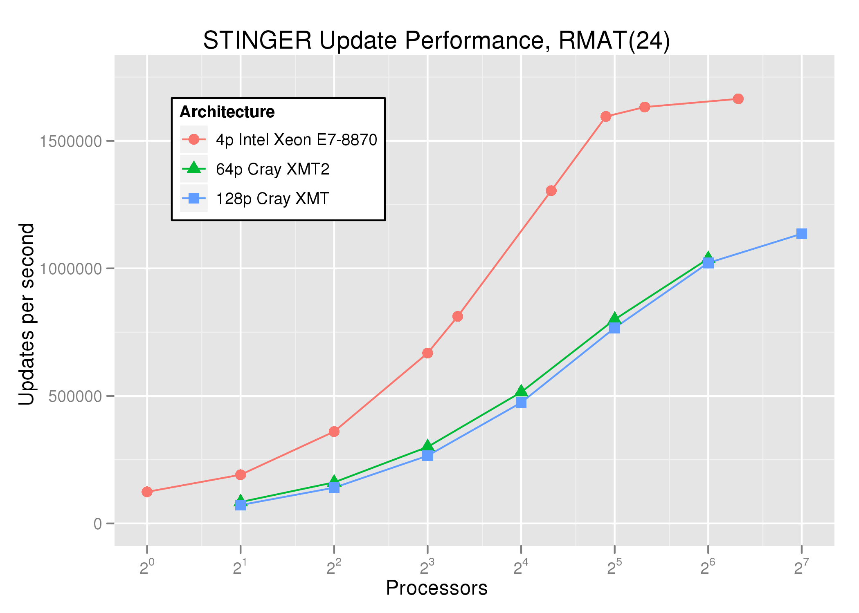
Update performance – Intel & Cray XMT/2
|V| = 16 M
|E| = 270 M
Batchsize = 100 K
10x faster on Intel
5x faster on Cray XMT
Notes:
Single motherboard vs. several racks of physically distributed memory

Slide 23
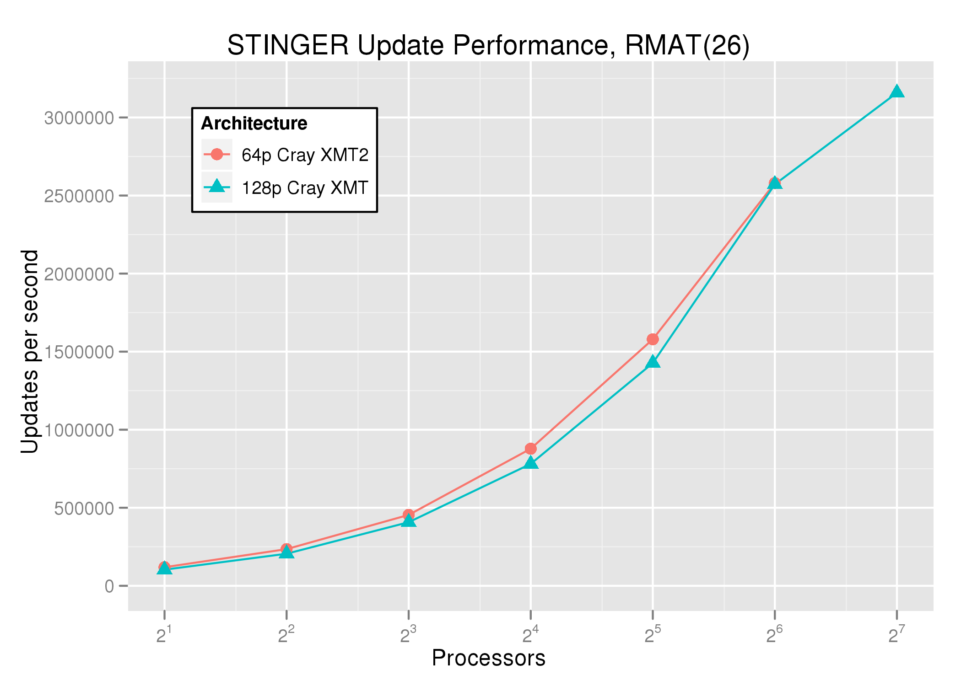
Larger graphs – Cray XMT/2
|V| = 67 M
|E| = 537 M
Batchsize = 1 M
Cray XMT: 3.1 million updates per second
Notes:
3.1 million speaks for itself.

Slide 24
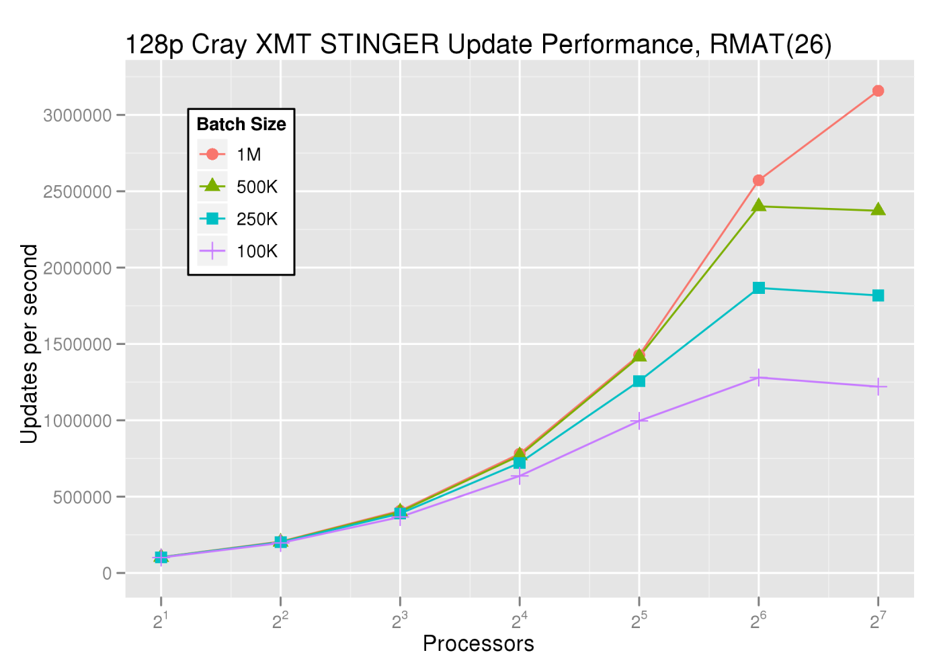
Increasing Batch Size
Batch size increases scalability, with diminishing returns
|V| = 67 M, |E| = 537 M

Slide 25
Optimization Summary
 | Cray XMT Updates / Sec | Speed-up | Intel E7-8870 Updates / Sec | Speed-up
Original | 950 |  | 12,000
Batch (100K) | 225,000 | 237.0x | 168,000 | 14.0x
Atomics | 1,140,000 | 5.0x | 1,600,000 | 9.5x
10x Batch Size | 2,610,000 | 2.3x | 1,800,000 | 1.1x
2x Graph Size | 3,100,000 | 1.2x
 |  | 3,263.0x |  | 150.0x
Fastest known parallel data structure for dynamic semantic graphs at this scale
Available at: http://www.cc.gatech.edu/stinger
Note: Our experimental results limited by available resources.
Notes:
Batching is a big win for both. Also use of atomics.
Bigger graph doesn’t suffer on the XMT.

Slide 26
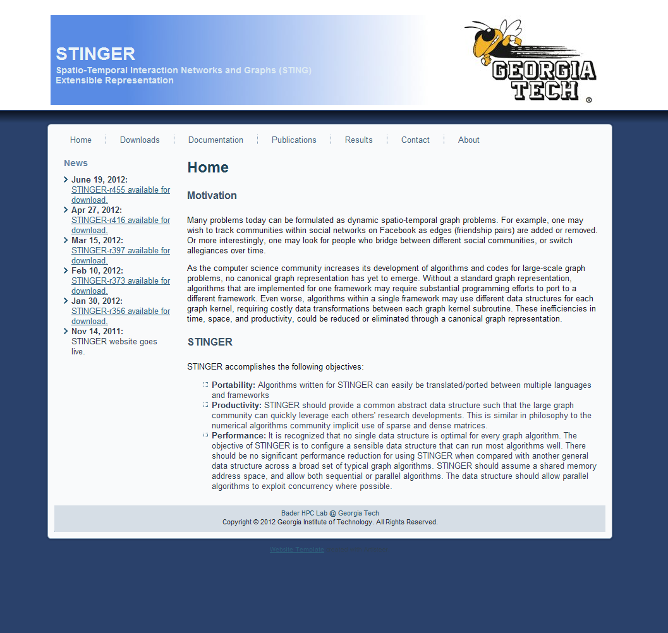
STINGER Website
http://www.cc.gatech.edu/stinger
Notes:
09/30/09
26
09/30/09
26

Slide 27
Conclusions
Several approaches to finding parallelism
in an edge update stream
100x to 3000x improvement over
single edge updates
Scalable, parallel data structure for dynamic, semantic graphs at over 3 million updates / sec
Portable code base runs on Cray XMT,
Intel/AMD x86 systems, & IBM Power7

Slide 28




















Acknowledgment of Support

Slide 30
Edge Insertion Protocol
For an insertion from u to v
1st Search u’s edge blocks for an existing edge to v
  If found
    Update the weight and modified timestamp
    Return 0
  If the search completes
    Go back to u’s first edge block
    Continue

Slide 31
Edge Insertion Protocol
For an insertion from u to v
2nd Search u for an edge to v or empty space
  If an existing edge is found:
    Update the weight and modified timestamp. Return 0
  If an empty space is found, lock its first timestamp
    If it’s been filled with an edge to v, unlock and see above.
    If it’s still empty
      Fill it, update the block metadata and vertex degrees
      Unlock the edge and return 1
    If the space has been filled with another edge
      Unlock the edge
      Keep searching until the end of the last block

