Slide 1
Optimizing Space Time Adaptive Processing Through Accelerating Memory-bounded Operations
Tze Meng Low, Qi Guo, Franz Franchetti
Notes:
Highlight text above with cursor and type in your new text. The university font style is already applied.
Your group name can be written out in the helvetica families as shown above.
School: 21 pt. Helvetica Bold
College: 21 pt. Helvetica Light
Main Title: 40 pt. Times
Presenter Name: 16 pt. Helvetica bold
Title: 16 pt. Helvetica oblique

Slide 2
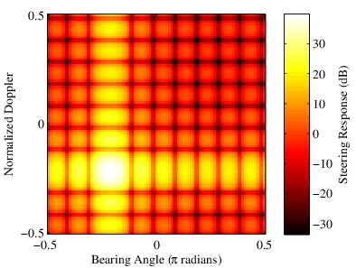
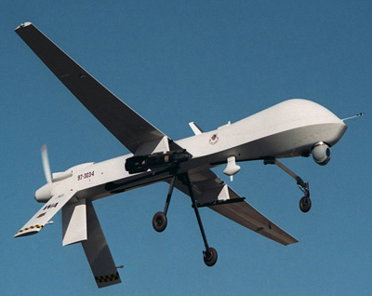
STAP – Target Detection Algorithm
Dense Data Cube
Input: 32M
Output: 128M
Millions of Math Ops
High Performance, Low Power

Slide 3
Stages of STAP
Doppler Transforms
DFTS +
Data Layout Transforms
Estimate Covariance Matrices
Outer-products
Compute Adaptive Weights
Matrix Factorization
Triangular Solve (vector)
Normalize & Apply Adaptive Weights
Inner-products
Vector Scaling
Based on PNNL’s Third-order Doppler STAP implementation

Slide 4
Stages of STAP
Doppler Transforms
DFTS +
Data Layout Transforms
O(10k)
Estimate Covariance Matrices
O(1M)
Outer-products
Compute Adaptive Weights
O(1M)
Matrix Factorization
Triangular Solve (vector)
Normalize & Apply Adaptive Weights
O(10M)
Inner-products
Vector Scaling
O(100k)
Many memory-bounded operations
Based on PNNL’s Third-order Doppler STAP implementation

Slide 7
Summary of Analysis
Doppler Transforms
Existing approaches improves compute-bound operations
Alternative means of estimation
Approximate the covariance matrices (reduced-rank algorithms)
Estimate Covariance Matrices
Compute Adaptive Weights
Normalize & Apply Adaptive Weights

Slide 8
Summary of Analysis
Doppler Transforms
Orthogonal approach
Targets memory-bounded operations
Two key approaches
Reduce memory-bounded operation
Acceleration in LiM 3D-stack system
Estimate Covariance Matrices
Compute Adaptive Weights
Normalize & Apply Adaptive Weights

Slide 9
Reducing Memory Operations
Convert memory-bound to compute bound operations
BLAS 2 to BLAS 3 operations
60-70% improvement in performance
~40% improvement in EDP
Only affects 2 of the 4 stages
1st and 4th stages still memory-bound
Need higher bandwidth (LiM-3D Stacked System)

Slide 10
3D Stacked LiM System
Accelerator below 3D-stacked DRAM
High bandwidth between LiM and DRAM
High-speed
Links
DRAM dies
Multicore
CPU
3D-stacked DRAM
TSV bus
DRAM logic die
LiM System
LiM die

Slide 11
LiM System Design
to Logic Die
4 accelerators
Compiler translates library calls into accelerator descriptions
Descriptor and control is passed to the Configuration Unit
LiM Layer
Interconnect
FFT
Reshape
DOT
SCAL
Configuration Unit
fftw_plan_guru_dft(….)

Slide 12
Optimization Needed
Functions | Accelerator Invocations
Data Layout Transform | 1
Batch FFT | 32,768
Data Extractions | 1
Batch inner product | 262, 144
Batch inner product | >16M
Batch inner product | 162,144

Slide 13
Optimization Needed
Functions | Accelerator Invocations
Data Layout Transform | 1
Batch FFT | 32,768
Data Extractions | 1
Batch inner product | 262, 144
Batch inner product | >16M
Batch inner product | 162,144
Batch multiple invocation into one descriptor

Slide 14
Experimental Setup
Hybrid evaluation methodology
Intel Haswell i4770k
Simulate LiM using simulation/design tools
4 implementations
MKL (BLAS 2) and FFTW (baseline)
MKL (BLAS 3) and FFTW
MKL (BLAS 3) and FFTW with OpenMP
MKL (BLAS 3) and FFTW with OpenMP + LiM

Slide 18
Conclusion
Orthogonal approach to optimizing STAP
Target memory-bounded operations
Leverage bandwidth of 3D-stacked LiM System
Improves performance (11.3x) and energy efficiency (77.6x)
Applicable to other STAP algorithms
Greater improvement expected as data increases implies more memory-bounded operations

Slide 19
Questions?

