Slide 1
Efficient Parallelization of Path Planning Workload on Single-chip Shared-memory Multicores
Masab Ahmad, Kartik Lakhsminrarsimhan, Omer Khan
University of Connecticut

Slide 2
Agenda
Motivation
Characterization Methodology
Characterization Results
Insights and Possible Improvements

Slide 3
Agenda
Motivation
Characterization Methodology
Characterization Results
Insights and Possible Improvements

Slide 4
Why parallelize at a finer granularity on a multicore?
These days every computer has a multicore processor
Trends to remain in favor of multicores as well
If a multicore is available and not used
Cores remain idle
Energy wasted
We focus on single chip shared memory multicores. Why?
On-chip communication faster than off-chip communication
Caches help further to parallelize efficiently
Prior works focus multiple node settings

Slide 5
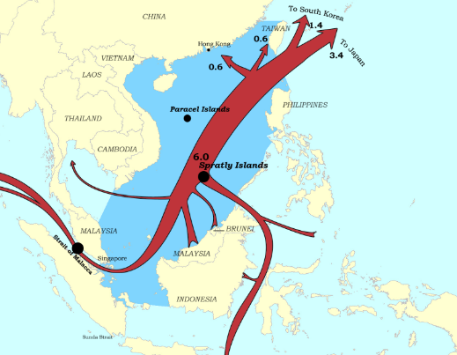
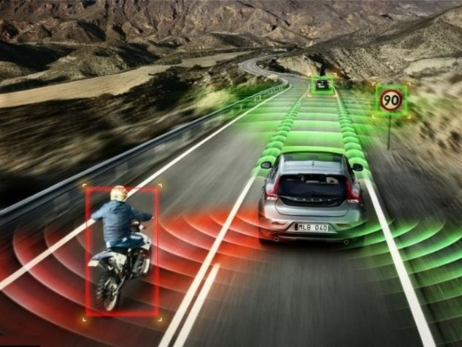
Why Analyze Path Planning?
The Shortest Path algorithm is used in many applications
Challenges :
Difficult to parallelize
Data dependencies
Input dependence
Self-Driving Cars
Ship Routing
UAVs

Slide 6
Dijkstra’s Algorithm for Shortest Paths
Consists of two loops
An outer loop that traverses the graph vertices (V)
An inner loop that traverses edges (E) of a vertex
Best sequential version has a complexity of O(E + V log V)
However this cannot be parallelized efficiently due to queue/heap reordering requirements
Parallelizations therefore optimize the basic algorithm to parallelize either the outer or inner loop
Outer Loop : Parallelization similar to the Bellman Ford algorithm[1], additional Yang’s optimization[2] to reduce redundant work
Inner Loop : Parallelization done on the original Dijkstra algorithm [3]
Initialize Nodes(), Edges()
For (each Node u) --Outer Loop visits each node once
For (each Edge of u) --Inner Loop
1. Calculates distance from current node to each neighbor
2. Checks for the next best node (u) among the neighbors
1. R. Bellman, On a Routing Problem, Quarterly of Applied Mathematics 16
(1958) 87–90
2. J. Y. Yen. An algorithm for finding shortest routes from all source nodes to a given
destination in general networks. Quarterly of Applied Mathematics 27:526–530, 1970.
3. T. H. Cormen, C. Stein, R. L. Rivest, C. E. Leiserson, Introduction to Algorithms,
2nd Edition, McGraw-Hill Higher Education, 2001.

Slide 7
Dijkstra Algorithm Parallelizations
0.9
1.3
0.8
Initialize Nodes(), Edges()
For (each Node u) --Outer Loop visits each node once
For (each Edge of u) --Inner Loop
1. Calculates distance from current node to each neighbor
2. Checks for the next best node (u) among the neighbors
1.5
1.2
0.5
1.2
1.1
1.25
1.3
1.25
1.3
1.3
O( V.logV + E )
Inner Loop parallelization
Each thread is assigned
a set of current
node’s edges to
relax
BARRIERS are applied to synchronize threads for each iteration
Work efficient due to no redundant computations compared to sequential
Hard to parallelize due to lack of edge-level parallelism (bi-directional search improves concurrency)
Outer Loop parallelization
Convergence based: Divide nodes among threads, then each thread relaxes its nodes iteratively until the distances converge (i.e., no change)
Range based: Dynamically distribute “range of nodes” among threads, then each thread relaxes its set of nodes one by one
LOCK each node to avoid potential races among threads relaxing shared nodes. Apply a BARRIER to synchronize threads after each iteration
Work inefficient due to many redundant relaxations for nodes that stabilize before convergence
Highly parallelizable due to node-level parallelism
Work efficient and exploits node-level parallelism (bi-directional search improves concurrency)
Needs intelligent scheduling for dynamic work balancing
Notes:
Range based visits each node once but may relax any given node multiple times

Slide 8
Why would one Parallelization be better than the other?
Input Dependence
Dense Graphs
Inner loop has more parallelism to exploit
Outer loop worsens due to communication caused by edge sharing
Sparse Graphs
Outer loop has more parallelism to exploit than inner loop
Outer loop has less communication, thus can scale more
The range based optimization to the outer loop removes redundant work, and thus is more work efficient
More Edge Sharing
Less Edge Sharing

Slide 9
Why Analyze Programming Language Variations?
Most performance code is written in C/C++
Low Level code guarantees performance and optimization
Vulnerable to programmer mistakes, security issues
However, many groups are shifting to Python
Python guarantees security
Easier to program
It is therefore important to analyze path planning in the context of these two languages
Performance Analysis

Slide 10
How does the Parallelization Work? Inner Loop Parallel SSSP_Dijkstra
Master Thread
(also participates as a Worker thread)
Worker Thread
(only one shown here, others do same work)
1. Create work
3. Wait and do the assigned work
while all nodes are not visited
Move to Next node
Calculate edge distribution among threads
Distribute edges among worker threads
while assigned edges are not visited (update Q array)
LOCK the edge to be relaxed
for all neighbor edges
Update the D array with new distance, if new distance is less than older distance (RELAX function)
UNLOCK the edge that was relaxed
BARRIER to synchronize all threads
2. Here is
work
4. Done
5. All Done
Neighboring edges divides amongst threads
Notes:
1. Fine grain communication
2. Data dependent memory accesses -> locality challenge

Slide 11
How does the Parallelization Work? Outer Loop Parallel SSSP_Dijkstra
Master Thread
(also participates as a Worker thread)
Worker Thread
(only one shown here, others do same work)
1. Create work
3. Wait and do the assigned work
while assigned nodes are not visited (update Q array)
LOCK the node to be relaxed
for all neighbor nodes
Update the D array with new distance, if new distance is less than older distance (RELAX function)
UNLOCK the node that was relaxed
BARRIER to synchronize all threads
while all nodes are not visited
Calculate node distribution among threads
Distribute nodes among worker threads
2. Here is
work
4. Done
5. All Done
Convergence based Outer loop statically distributes nodes among threads
Ranged based outer loop dynamically assigns nodes to threads
Notes:
1. Fine grain communication
2. Data dependent memory accesses -> locality challenge

Slide 12
Agenda
Motivation
Characterization Methodology
Characterization Results
Insights and Possible Improvements

Slide 13
Analysis Setup
A 4 core Intel Machine with 2-way Hyperthreading is used
C/C++
pthread Library
Python
Multi-threading
Multi-processing
Completion time and speedups observed

Slide 14
Measurements
Each parallelization compared to its own sequential version
Times measured using the clock() library for the main shortest path function/kernel only
SpeedUps computed by dividing the sequential time with the obtained parallel time for each run
This is done for the main shortest path function/kernel part only

Slide 15
Graph Datasets
Synthetic Graphs
Sparse graphs : 1M vertices, 16 edges per vertex
Dense graphs : 16K vertices, 8K edges per vertex
We also vary graph sizes and edges per vertex for a complete analysis
Real World Graphs (From the SNAP dataset[1]) (All Sparse)
Texas 1.4M vertices, ~ 1.39 edges per vertex
California 1.9M vertices, ~ 1.41 edges per vertex
Pennsylvania 1.1M vertices, ~ 1.42 edges per vertex

Slide 16
Agenda
Motivation
Characterization Methodology
Characterization Results
Insights and Possible Improvements

Slide 17
Dijkstra Parallelizations for Sparse Graphs (C/C++)
Speedup observed for each parallelization strategy
Range based works best
Less communication due to synchronization
More parallelism available in the outer loop
Convergence based Outer Loop does not perform as well
Redundant work due to additional edge relaxations
Sparse Graphs

Slide 18
Dijkstra Parallelizations for Dense Graphs (C/C++)
Inner Loop works best
More parallelism in the outer loop
Outer Loop parallelizations do not scale
More communication required in dense graphs due to high edge sharing
Dense Graphs

Slide 19
Scalability in Sparse Graphs (C/C++)
The Range based outer loop parallelization is used as it scales better
Scalability is seen for both vertex and edge variations

Slide 20
Scalability in Dense Graphs (C/C++)
The Inner loop parallelization is used as it scales better
Scalability is seen for both vertex and edge variations

Slide 21
Python Study for Sparse Graphs
Similar trend as C/C++ variations
Multi-threading does not scale due to Global Interpreter Lock (GIL) Problem
Serializes all threads
However scalability is less due to additional communication required in multi-processing

Slide 22
Python Study for Dense Graphs
Similar trend as C/C++ variations
Multi-threading does not scale again due to Global Interpreter Lock (GIL) Problem
Serializes all threads
However scalability is less due to additional communication required in multi-processing

Slide 23
L2 Miss rates for Sparse Graphs
Study done to view the parallelization problem via cache access
The L2 miss rate (L2 is private to a core), conforms with the scalability trends seen earlier
Range based has lower miss rates
However miss rates increase with thread count because more threads communicate more due to additional sharing

Slide 24
L3 Miss rates for Sparse Graphs
Study done to view the parallelization problem via cache access
The L2 miss rate (L3 is shared amongst all cores), conforms with the scalability trends seen earlier
Range based has lower miss rates
However miss rates increase again with thread count because more threads communicate more due to additional sharing

Slide 25
Python vs. C/C++ Study for Sparse Graphs
Completion times observed for sparse graphs (1M vertices, 16 edges per vertex) for both C/C++ and Python
Python ~200x slower
Due to additional overhead of multi-processing
Security guarantees provided by Python
Python as a higher level language

Slide 26
Agenda
Motivation
Characterization Methodology
Characterization Results
Insights and Possible Improvements

Slide 27
Insights
Scalability in path planning workloads is highly input dependent
Memory dependent as well
The right parallelization scales well
Python is much slower than C/C++ in terms of parallel performance code

Slide 28
Potential Future Improvements
Improve Python’s Parallel Programming Paradigm
Give the programmer the choice to release the GIL lock to allow multi-threading,
And rights to release security guarantees
Use hybrid Shared memory and Message Passing where possible
Will allow scalability on larger clusters
Future chips expected to have a hybrid interface

Slide 29
Thank You!

