Slide 1
Aparapi-UCores: A High Level Programming Framework for Unconventional Cores
Oren Segal, Philip Colangelo, Nasibeh Nasiri, Zhuo Qian, Martin Margala
Department of Electrical and Computer Engineering
University of Massachusetts Lowell
Lowell, MA, USA
[oren_segal@student.uml.edu]
HPEC2015
Notes:
Your first slide must be the Title Slide. The suggested format is shown above. (You may adapt this slide to suit your tastes.) It is recommended that your company or university logo appear on the title slide only. This is followed by your Outline Slide and the other slides mentioned in this template.

Slide 2
Presentation Outline
Motivation and Introduction
Overview of Aparapi-UCores
Results
Future Plans
Notes:
Outline the high points of the presentation you are giving. Don’t include the title or conclusions in your Outline Slide. You may want to state the purpose of the work described in your paper. If so, describe the big picture of why you did the work, not the detailed technical objectives your work accomplished.

Slide 3
Energy Cost of Computing
In 2013, U.S. data centers consumed an equivalent to the annual output of 34 large (500-megawatt) coal-fired power plants [1]
2020 U.S. Predictions:
50 power plants
$13 billion in annual electricity bills
Nearly a 100 million metric tons of carbon pollution emissions per year [1]

Slide 4
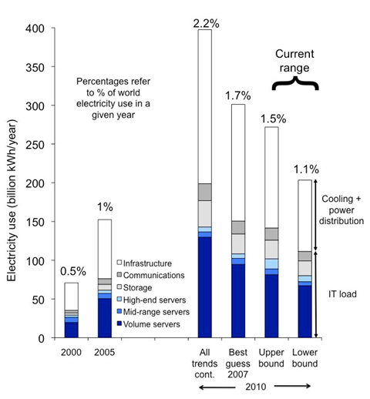
Worldwide Electricity Use for Data Centers (2000, 2005, And 2010)[6][7]
Servers represent the most significant component ranging from 50% to over 90% of IT device electricity demand
Volume servers dominate the server group

Slide 5
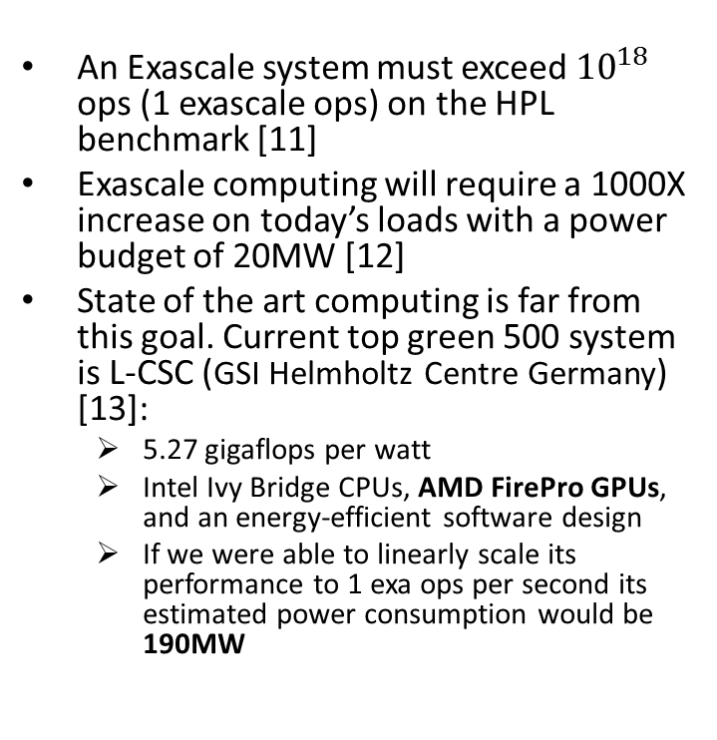
Peta Scale, Exascale and Beyond
An Exascale system must exceed ${10}^{18}$ ops (1 exascale ops) on the HPL benchmark [11]
Exascale computing will require a 1000X increase on today’s loads with a power budget of 20MW [12]
State of the art computing is far from this goal. Current top green 500 system is L-CSC (GSI Helmholtz Centre Germany) [13]:
5.27 gigaflops per watt
Intel Ivy Bridge CPUs, AMD FirePro GPUs, and an energy-efficient software design
If we were able to linearly scale its performance to 1 exa ops per second its estimated power consumption would be 190MW
Scale | OPS | Year Achieved
Gigascale | 10^9 | 1985
Terascale | 10^12 | 1997
Petascale | 10^15 | 2008
Exascale | 10^18 | 2015-2020?

Slide 6
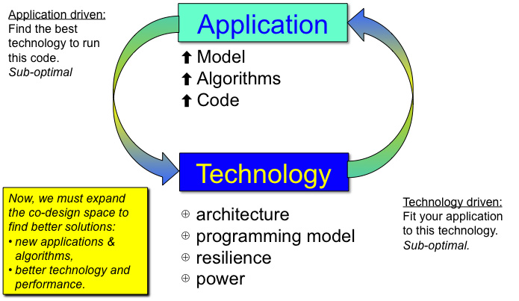
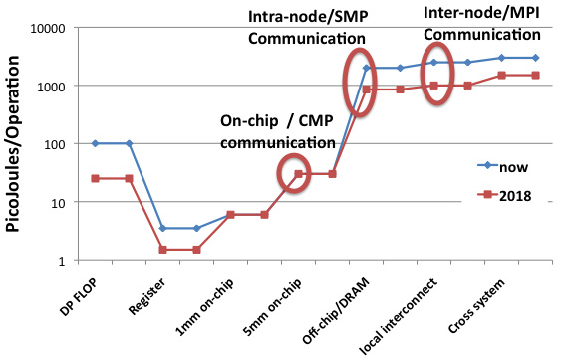
Future Exacale System Co Design
Key element is the co-design of applications, architectures and programming environments[12]
Manage locality to achieve performance[12]
Future exascale computing systems likely be built from hundreds of millions of computing elements[14]
Heterogeneity one of the key enhancers for exascale systems[14]

Slide 7
Homogenous vs Heterogeneous Computing
Homogenous computing refers to using a single type of computing device to achieve computation:
Normally a general purpose processing unit or CPU
Can be replicated to achieve better performance
All computing devices share the same architecture
Heterogeneous computing on the other hand refers to using multiple types of devices to achieve a computation task:
The architecture of the devices is different hence offers different types of abilities to the underlying system.

Slide 8
The Energy Efficiency Advantage of Heterogeneity
Using GPUs to accelerate computation has been shown to be more power efficient then using CPUs alone [16].
Today’s top twenty energy efficient super computers [13] are all heterogeneous computing systems.
While these systems currently employ GPUs as heterogeneous accelerators, recent research is suggesting that FPGAs [17] [18] [19]can be used as more efficient accelerators in some areas of high performance computing and for certain types of data-centric applications.

Slide 9
UCores
Unconventional cores (UCores) are computing resources such as GPUs, FPGAs and custom logic [15]
Unconventional cores (UCores) can offer a significant benefit in performance from improved energy efficiency
Bandwidth and computation complexity are important factors in the decision to utilize them

Slide 10
More on UCores and Heterogeneous Computing
Custom ASIC Solutions
Rigid
Potentially most power efficient
Expensive to produce
FPGA based solutions
Flexibility of software
Performance of hardware
Commercial off-the-shelf availability

Slide 11
Challenges associated with Heterogeneous systems
One of the biggest challenges for wide spread adoption of heterogeneous systems is that the complexity involved in programming and managing different types of computing resources can be prohibitive

Slide 12
The Unified Programming Model
Open Computing Language(OpenCL [20]):
Introduced in 2008
Offers an industry standard
A uniform C based framework for programming any parallel computing device

Slide 13
OpenCL for FPGAs
Altera released an OpenCL SDK for selected FPGA devices in 2013
Xilinx announced early access availability of its own version of OpenCL for FPGAs, in 2014

Slide 14
Advantages of OpenCL
An open standard managed by consortium of companies and organization (not tied to a single architecture or company).
C based framework
Gives low level fine grain control over the parallel programming environment.

Slide 15
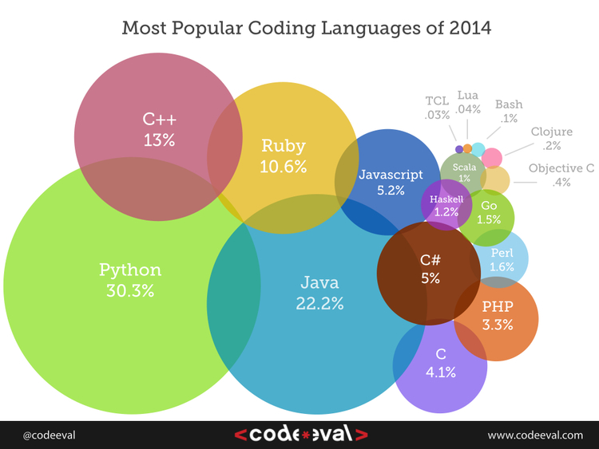
Disadvantages of OpenCL
A complicated low level standard
C based framework
Beyond the reach of many programmers

Slide 16
Aparapi-UCores
Fork of the Aparapi Java framework that was developed by AMD for AMD architectures.
Aparapi-Ucores adds support for :
FPGA devices (for now only Altera OpenCL is supported)
Multiple platforms (platform selection support through ICD)
OpenCL binary file format and flow
Accelerator type
Built against OpenJDK (to allow more control/flexibility in future Java/OpenCL integration)

Slide 17
Supported OpenCL SDKs and Devices
The framework has been tested and known to work on the following device types/OpenCL SDKs:
CPUs (AMD/Intel)
GPUs (AMD/NVidia)
APUs (AMD)
FPGAs(Altera - Nallatech/Terasic boards)
In addition the framework was tested on the following operating systems - CentOS 6.3/4/5/6.

Slide 18
Aparapi-UCores Architecture

Slide 19
Aparapi-UCores Development Flows

Slide 20
Case Study: N-Body Simulation
Investigate the performance of the framework across multiple architectures
N-body simulations are prevalent across scientific applications from drug exploration to stellar physics [15].
Much research has been done accelerating N-body simulations using dedicated hardware and GPUs [15, 16, 18].
Standard N-body algorithm distributed with the original aparapi framework [5]

Slide 21
Case Study: N-Body Simulation(cont)
N particles and N^2 particle interactions
Target different architectures (CPU/APU/GPU/FPGA) with the same Java-OpenCL algorithm to see the out of the box performance of the algorithm on each platform

Slide 22
Hardware Level Experiment Design
Devices used to test execution and power efficiency of the same code base:
CPU/APU - AMD Kabini A4-500, 4-Cores, 1.5Ghz
GPU 1- NVIDIA K40C
GPU 2 – NVIDIA GTX 780
FPGA – Terasic DE5, Altera Stratix V

Slide 23
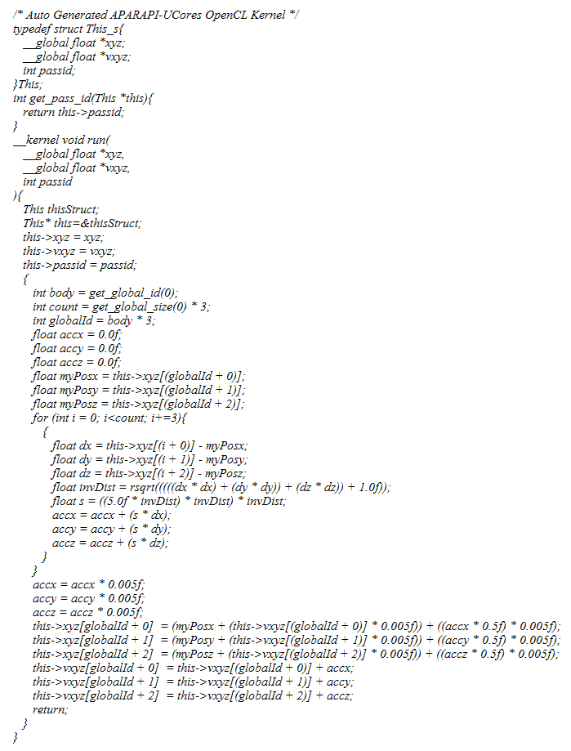
Kernel Code

Slide 24
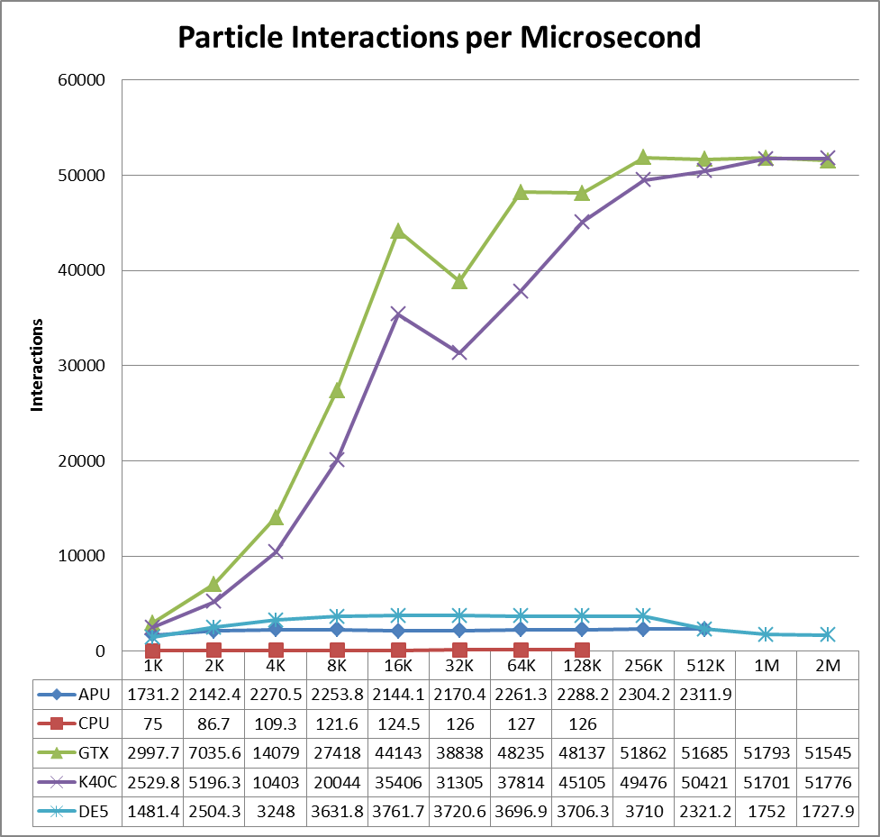
Results

Slide 25
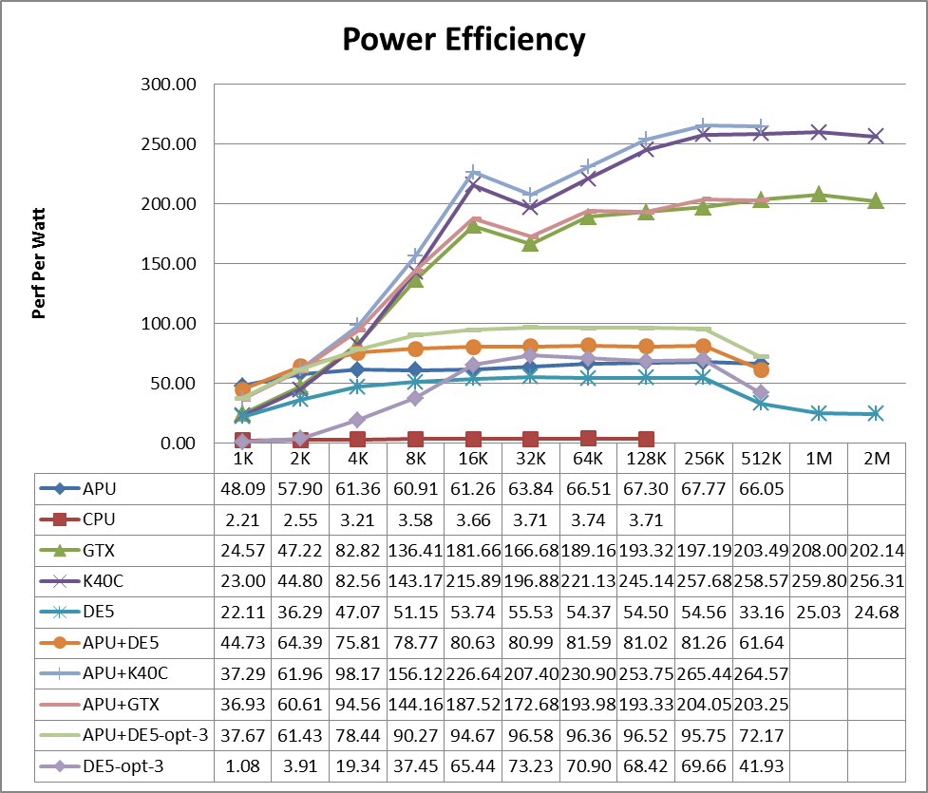
Results (cont)

Slide 26
Binary Development Flow Example
Add two simple directives/pragmas to the auto generated code:
Restrict keyword to help the compiler optimize memory access:
__kernel void run(
__global float * restrict xyz,
__global float * restrict vxyz,
int passid)
Pragma loop unroll (value=24) to the loop body:
#pragma unroll 24
for (int i = 0; i<count; i+=3)
{
…
}

Slide 27
Combining Multiple Devices in order to Increase Power Efficiency
Fully Utilizing hardware through consolidation and virtualization [17] is a practice well known in large data centers
Consolidating devices increases the overall power efficiency of a system
A standard system carries a lot overhead in power usage from disks networking equipment and other peripheral devices
if a system is not fully utilized its overall system performance per watt degrades

Slide 28
Results with Binary flow and Device Combinations

Slide 29
Current Status
Latest version 0.1.31 (3rd release)
Recently released patches and bug fixes
Main development focus is on improved integration with SparkCL

Slide 30
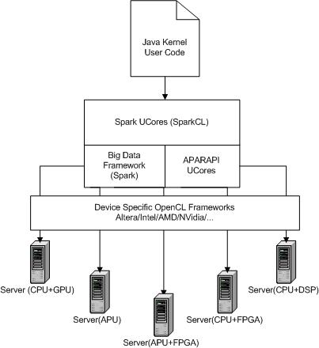
Spark-UCores (SparkCL)
Code name SparkCL
Fork of Apache Spark for heterogeneous clusters
Uses Aparapi UCores as its OpenCL code engine

Slide 31
Future Plans
General auto optimization of OpenCL generated code
Platform specific optimizations that can be employed automatically using OpenCL extensions etc.
Improved memory allocation schemes
Integration into big data frameworks (SparkCL etc.)

Slide 32
Acknowledgments
We would like to thank Altera, NVidia, Nallatech and Terasic for their hardware donations so that we can develop and test the framework on different architectures
We would also like to thank Altera and HP for supporting various stages of this research over the past several years

Slide 33
Questions?

Slide 34
References
Chung, Eric S., et al. "Single-chip heterogeneous computing: Does the future include custom logic, FPGAs, and GPGPUs?." Proceedings of the 2010 43rd Annual IEEE/ACM International Symposium on Microarchitecture. IEEE Computer Society, 2010.
The Green500 List (11/2014). http://www.green500.org/news/green500-list-november-2014
Oren Segal, Sai Rahul Chalamalasetti, Mitch Wright and Martin Margala. “High Level Programming Framework for FPGAs in the Data Center”, Field Programmable Logic and Applications (FPL), 2014 24th International Conference on. IEEE, 2014.
Segal, Oren, Martin Margala, Sai Rahul Chalamalasetti, and Mitch Wright. “High Level Programming for Heterogeneous Architectures.” arXiv preprint arXiv:1408.4964 (2014).
Aparapi. API for data parallel Java, http://code.google.com/p/aparapi/
Open JDK, Project Sumatra. http://openjdk.java.net/projects/sumatra/
Auerbach, Joshua, et al. LIME: The Liquid Metal Programming Language; Language Reference Manual. Technical report, IBM Research Division, 2010.
Max Compiler. https://www.maxeler.com/products/software/maxcompiler/
JavaCL. http://code.google.com/p/javacl/
J. a. D. S. a. M. J. Shalf, "Exascale computing technology challenges," in High Performance Computing for Computational Science--VECPAR 2010, Springer, 2011, pp. 1--25.
S. a. X. S. a. F. W.-c. Huang, "On the energy efficiency of graphics processing units for scientific computing," in Parallel & Distributed Processing, 2009. IPDPS 2009. IEEE International Symposium on, 2009.
Altera SDK for OpenCL. http://www.altera.com/literature/lit-opencl-sdk.jsp
TIOBE Index. http://www.tiobe.com/index.php/content/paperinfo/tpci/index.html
Khronos OpenCL Working Group. "OpenCL-The open standard for parallel programming of heterogeneous systems." On line] http://www. khronos. org/opencl (2011).
Elsen, Erich, et al. "N-body simulations on GPUs." arXiv preprint arXiv:0706.3060 (2007).
Stock, Mark J., and Adrin Gharakhani. "Toward efficient GPU-accelerated N-body simulations." AIAA paper 608 (2008): 7-10.
R. a. o. Brown, "Report to congress on server and data center energy efficiency: Public law 109-431," Lawrence Berkeley National Laboratory, 2008.
Capuzzo-Dolcetta, Roberto, and Mario Spera. "A performance comparison of different graphics processing units running direct N-body simulations." Computer Physics Communications 184.11 (2013): 2528-2539.
Aparapi for Unconventional Cores. https://gitlab.com/mora/aparapi-ucores
Spark for Unconventional Cores (SparkCL). https://gitlab.com/mora/spark-ucores
Altera SDK for OpenCL Best Practices Guide. https://www.altera.com/content/dam/altera-www/global/en_US/pdfs/literature/hb/opencl-sdk/aocl_optimization_guide.pdf
Bianchini, Ricardo, and Ramakrishnan Rajamony. "Power and energy management for server systems." Computer 37.11 (2004): 68-76.

