Slide 1
Accelerating Fully Homomorphic Encryption on GPUs
Wei Wang, Yin Hu, Lianmu Chen, Xinming Huang, Berk Sunar
ECE Dept.,
Worcester Polytechnic Institute

Slide 2
Fully Homomorphic Encryption
Introduced by Gentry in 2009
Powerful!
Arbitrary depth circuits evaluated on fixed sized ciphertexts
Impractical, for now..
Very Slow (~30 sec for reencryption)
Large Public Keys (100’s Mbytes)
Lampson (CryptDB): “I don’t think we’ll see anyone using Gentry’s solution in our lifetimes.” (Forbes, Dec 2011)

Slide 3
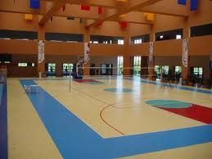
If history teaches us anything..
RSA was introduced in 1978
Intel 8086 was introduced 4-10 Mhz
1024-RSA enc. would take at least 10 minutes (est.)
RSA circuit layed out in MIT basketball court (Shamir & Rivest)

Slide 4
Today
RSA is used in >90% of secure connections (Intel Whitepaper)
Runs in ~100’s msec on cell phones
Moore’s Law and algorithmic improvements!
Question:
Can we expect the same for FHE?

Slide 5
What is FHE?
A Fully homomorphic encryption scheme refers to a form of encryption which support both addition and multiplication to be carried out on the ciphertext and obtain and encrypted result which is the ciphertext of the result of operations performed on the plaintext.
$$E\left(x_{1}\right)∗E\left(x_{2}\right)=E\left(x_{1}∗x_{2}\right)$$
$$E\left(x_{1}\right)+E\left(x_{2}\right)=E\left(x_{1}+x_{2}\right)$$

Slide 6
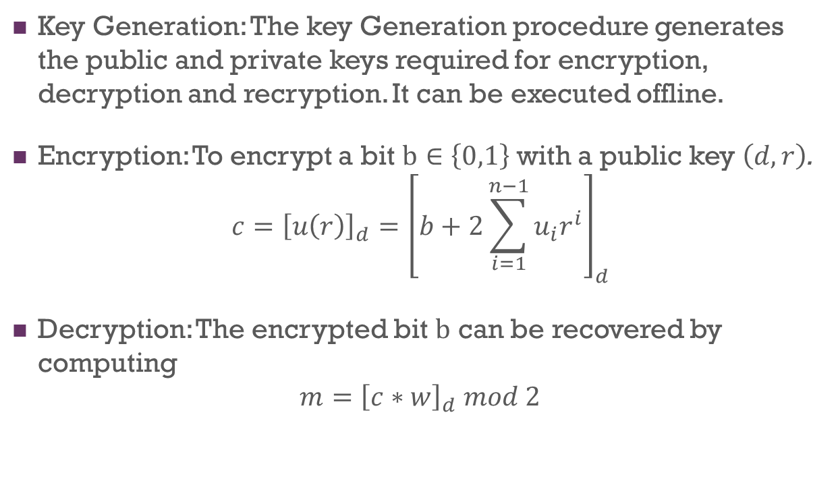
The Gentry-Halevi FHE Scheme
Key Generation: The key Generation procedure generates the public and private keys required for encryption, decryption and recryption. It can be executed offline.
Encryption: To encrypt a bit $b∈\left\{0,1\right\}$ with a public key $\left(d,r\right)$.
$$c={\left[u\left(r\right)\right]}_{d}={\left[b+2\sum_{i=1}^{n−1}{u_{i}r^{i}}\right]}_{d}$$
Decryption: The encrypted bit $b$ can be recovered by computing
$$m={\left[c∗w\right]}_{d} mod 2$$

Slide 7
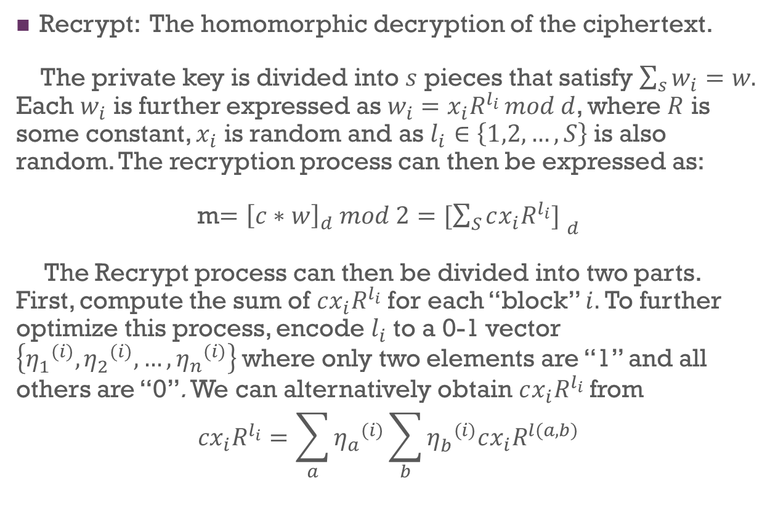
The Gentry-Halevi FHE Scheme
Recrypt: The homomorphic decryption of the ciphertext.
The private key is divided into $s$ pieces that satisfy $\sum_{s}{w_{i}}=w.$ Each $w_{i}$ is further expressed as $w_{i}=x_{i}R^{l_{i} }mod d$, where $R$ is some constant, $x_{i}$ is random and as $l_{i}∈\left\{1,2,…,S\right\}$ is also random. The recryption process can then be expressed as:
m$={\left[c∗w\right]}_{d} mod 2={[\sum_{S}{cx_{i}R^{l_{i}}}] }_{d}$
The Recrypt process can then be divided into two parts. First, compute the sum of $cx_{i}R^{l_{i}}$ for each “block” $i.$ To further optimize this process, encode $l_{i}$ to a 0-1 vector $\left\{{η_{1}^{}}_{}^{(i)},{η_{2}^{}}_{}^{(i)},…,{η_{n}^{}}_{}^{(i)}\right\}$where only two elements are “1” and all others are “0”. We can alternatively obtain $cx_{i}R^{l_{i}}$ from
$${cx}_{i}R^{l_{i}}=\sum_{a}{{η_{a}^{}}_{}^{(i)}}\sum_{b}{{η_{b}^{}}_{}^{(i)}cx_{i}R^{l(a,b)}}$$

Slide 8
Parameters of Gentry’s Homomorphic Scheme
Dimension | d | Encrypt | Decrypt | Recrypt
512 | 195764 | 0.19 sec | --- | 6 sec
2048 | 785006 | 1.8 sec | 0.02 sec | 32 sec
8192 | 3148249 | 19 sec | 0.13 sec | 2.8 min
32768 | 12628800 | 3 min | 0.66 sec | 31 min
Gentry’s implementation was running on an IBM System x3500 server, featuring a 64-bit quad-core Intel Xeon E5450 processor, running at 3GHz, with 12 MB L2 cache and 24GB of RAM.

Slide 9
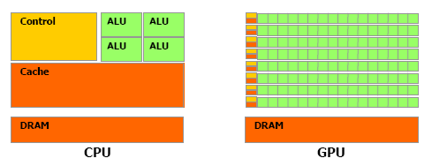
CPU vs. GPU Hardware
GPUs are ideal for FHE
Multiple ALUs
Fast onboard memory
High throughput on parallel tasks

Slide 10
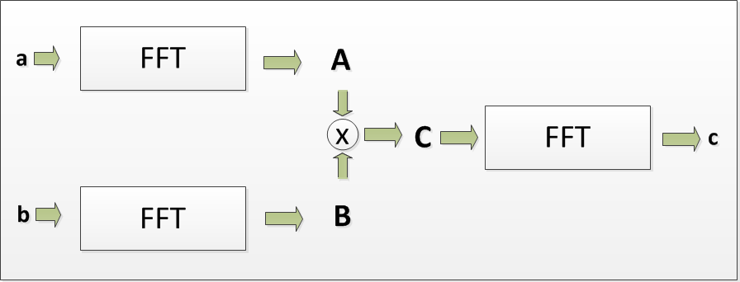
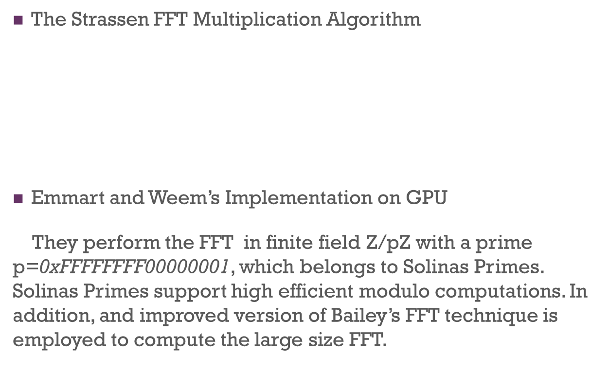
Fast Multiplications on GPUs
The Strassen FFT Multiplication Algorithm
Emmart and Weem’s Implementation on GPU
They perform the FFT in finite field $\text{Z}\text{/}\text{pZ}$with a prime $\text{p}\text{=0}\text{xFFFFFFFF}\text{00000001}$, which belongs to Solinas Primes. Solinas Primes support high efficient modulo computations. In addition, and improved version of Bailey’s FFT technique is employed to compute the large size FFT.

Slide 11
Fast Multiplications on GPUs
 | CPU | GPU
Size in K bits | Intel Xeon X5650 processor running at 2.67GHz with 24GB RAM Build with NTL/GMP | NVIDIA Tesla C2050, 448 CUDA cores, 1.15 GHz, 3GB GDDR5* memory
1024 x 1024 | 8.1 ms | 0.765 ms
2048 x 2048 | 18.8 ms | 1.483 ms
4094 x 4096 | 42.0 ms | 3.201 ms

Slide 12
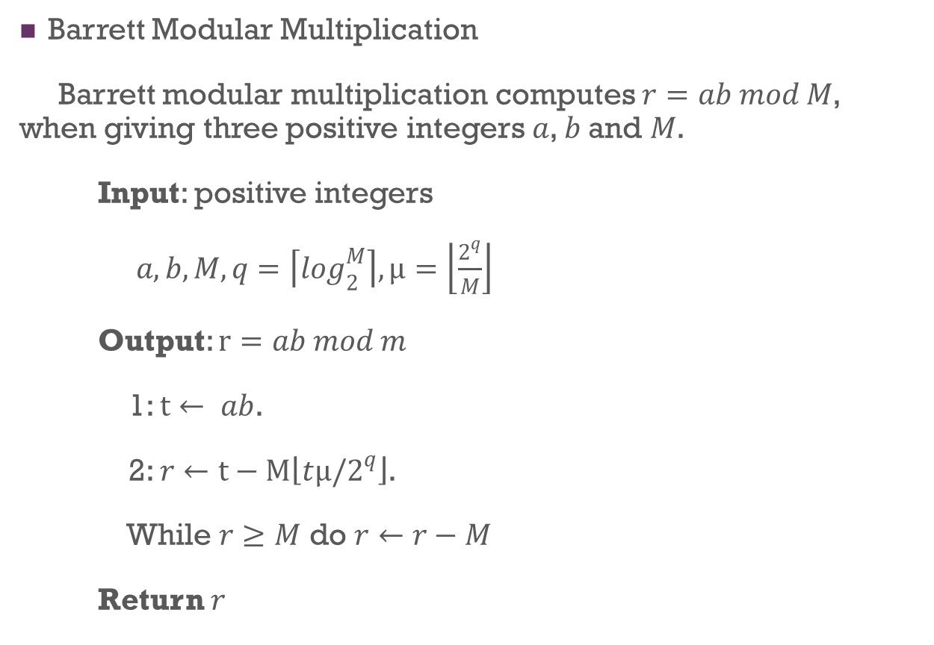
Modular Multiplication
Barrett Modular Multiplication
Barrett modular multiplication computes $r=ab mod M$, when giving three positive integers $a$, $b$ and $M$.
Input: positive integers
$a, b, M, q=\left\lceil \log_{2}^{M}\right\rceil , µ=\left\lfloor \frac{2^{q}}{M}\right\rfloor$
Output: $r=ab mod m$
1: $t← ab$.
2: $r←t−M\left\lfloor tµ/2^{q}\right\rfloor$.
While $r≥M$ do $r←r−M$
Return $r$

Slide 13
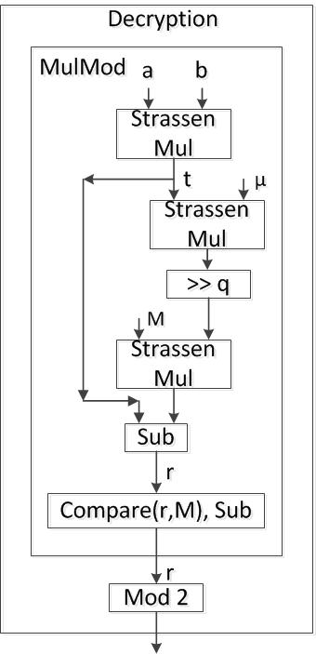
GPU Implementation of FHE
The Decrypt process
The most computation-intensive part is the large-number modular multiplication. Applying the FFT based Strassen algorithm and Barrett reduction results significant speedup.

Slide 14
GPU Implementation of FHE
Implementing Encrypt
For the Encrypt process, the most complex operation is the evaluation of the degree-(n-1) polynomial. In the Gentry-Halevi implementation, a recursive approach is applied.
In our implementation, we apply the sliding window technique to compute the polynomial evaluations. Suppose the window size is $w$ and we need $t=n/w$ windows, so we have
$$\sum{\left(u_{i}r^{i}\right)}=\sum_{j=0}^{t−1}{\left[r^{w∗j}∗\sum_{i=0}^{w−1}{(u_{i+wj}r^{i})}\right].}$$
We can precompute $r^{i}, i=0,1,…,w$. These precomputed values can be pre-loaded into GPU memory before the Encrypt process starts. In our implementation, we choose the window size $w$=64.

Slide 15
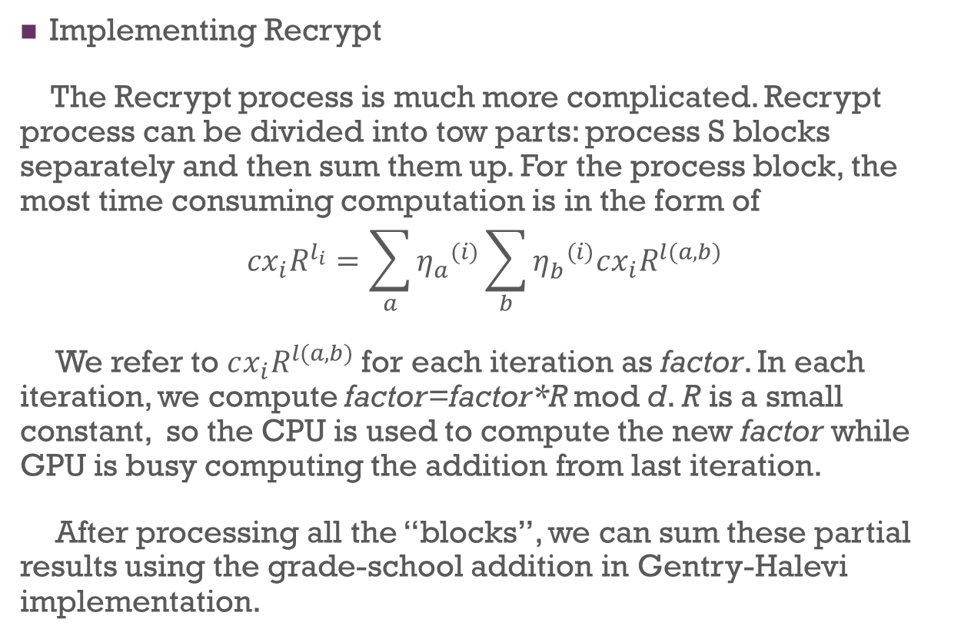
GPU Implementation of FHE
Implementing Recrypt
The Recrypt process is much more complicated. Recrypt process can be divided into tow parts: process S blocks separately and then sum them up. For the process block, the most time consuming computation is in the form of
$${cx}_{i}R^{l_{i}}=\sum_{a}{{η_{a}^{}}_{}^{(i)}}\sum_{b}{{η_{b}^{}}_{}^{(i)}cx_{i}R^{l(a,b)}}$$
We refer to $cx_{i}R^{l(a,b)}$ for each iteration as factor. In each iteration, we compute factor=factor*R mod d. R is a small constant, so the CPU is used to compute the new factor while GPU is busy computing the addition from last iteration.
After processing all the “blocks”, we can sum these partial results using the grade-school addition in Gentry-Halevi implementation.

Slide 16
Performance FHE Primitives
*Based on small setting (dimension n=2048).
 | CPU | GPU | Speedup
Platform | Intel Xeon X5650 processor running at 2.67GHz with 24GB RAM Build with NTL/GMP | NVIDIA Tesla C2050, 448 CUDA cores, 1.15 GHz, 3GB GDDR5* memory
Encryption | 1.69 sec | 0.22 msec | x7.7
Decryption | 18.5 msec | 2.5 msec | x7.5
Recryption | 27.68 sec | 4.2 sec | x6.6

Slide 17
Thanks!

