Slide 1
Integration, Development and Results of the 500 Teraflop Heterogeneous Cluster (Condor)
11 September 2012
Mark Barnell
Air Force Research Laboratory

Slide 2
Agenda
Mission
RI HPC-ARC & HPC Systems
Condor Cluster
Success and Results
Future Work
Conclusions

Slide 3
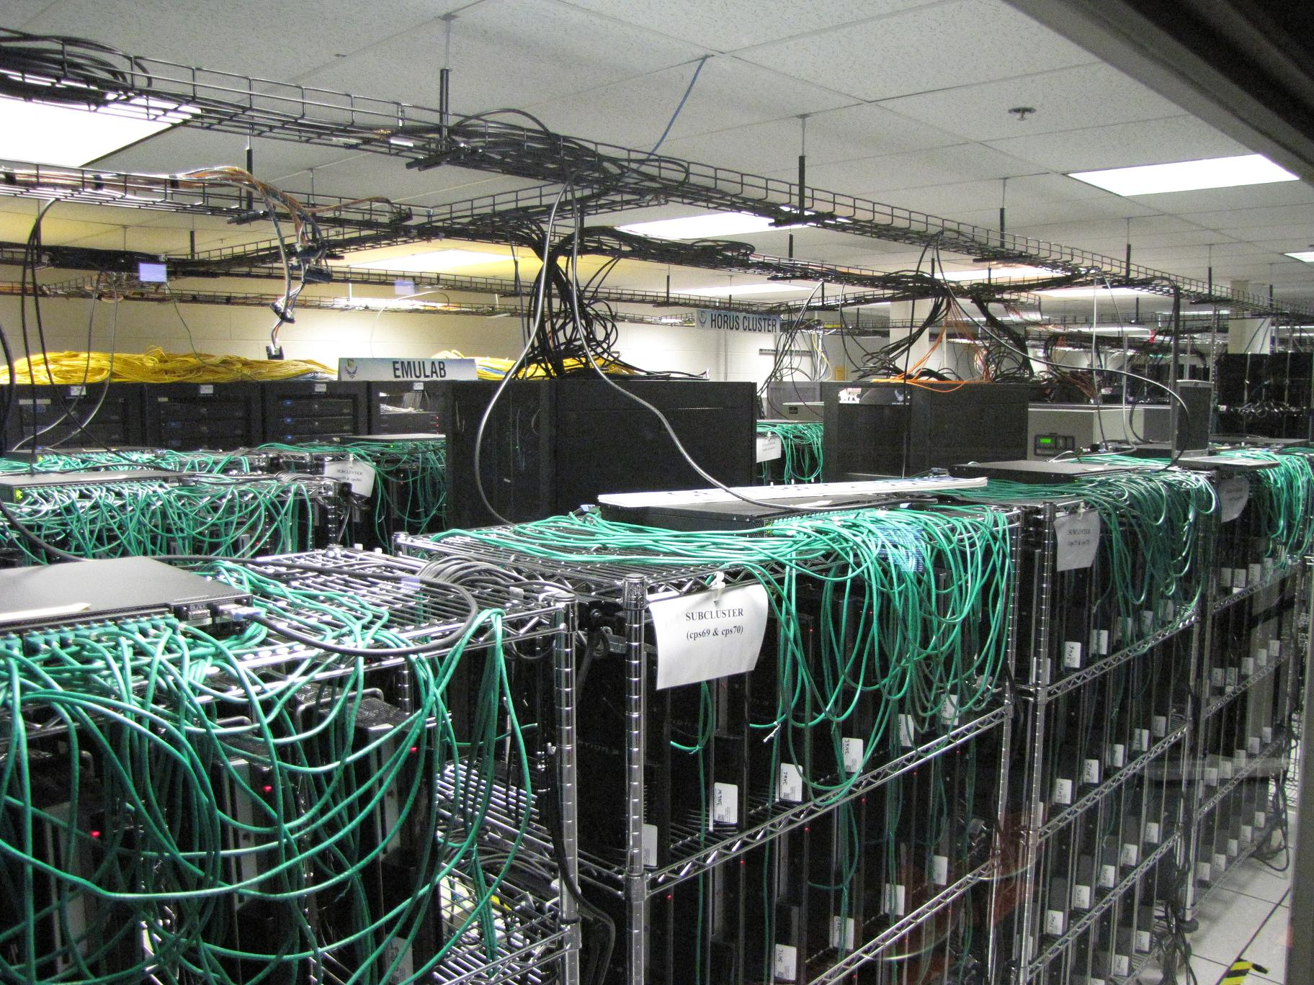
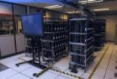
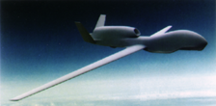
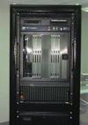
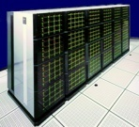

Exponentially Improving Price-Performance
Measured by AFRL-Rome HPCs
15 years, 20,000X
Roughly 2^{n}
500 TFLOP Cell-GPGPU
250 TFLOPS/$M
1M
53 TFLOP Cell Cluster
147 TFLOPS/$M
100,000
Heterogeneous HPC
XEON + FPGA
81 TOPS/$M
Multicore
GPGPU
10,000
SKY (PowerPC)
Gaming
200 GFLOPS/$M
1,000
Servers
FPGAs
INTEL PARAGON (i860) 12 GFLOPS/$M
100
Embedded
10
Commodity
1995
2000
2005
2010

Slide 4
Agenda
Mission
RI HPC-ARC & HPC Systems
Condor Cluster
Success and Results
Future Work
Conclusions

Slide 5
Mission
Objective: To support CS&E R&D along with HPC to the Field experiments by providing interactive access to hardware, software and user services with special attention to applications and missions supporting C4ISR.
Technical Mission: Provide classical and unique, real-time, interactive HPC resources to the AF and DoD R&D community.

Slide 6
Mission
RI HPC-ARC & HPC Systems
Condor Cluster
Success and Results
Future Work
Conclusions

Slide 7
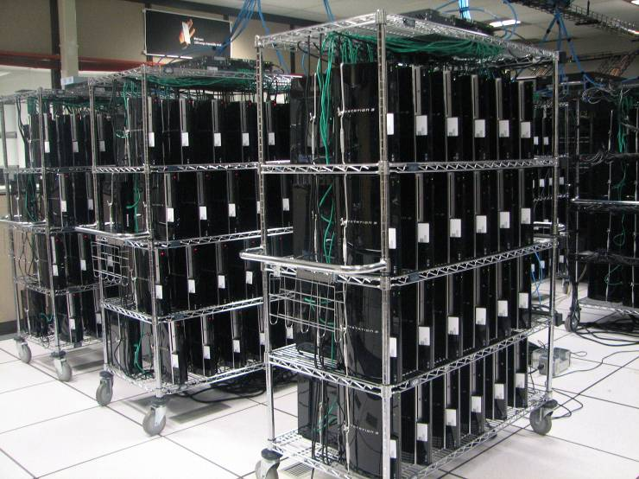
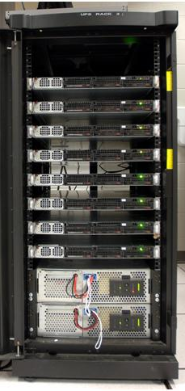
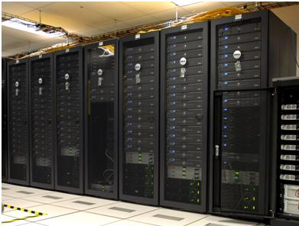
HPC Facility Resources
53 TFLOPS Peak
Performance
CONDOR CLUSTER
500 TFLOPS
Funding: $2M HPCMP DHPI
Urban Surveillance
Cognitive Computing
Quantum Computing
Cell BE Cluster
Legend:
HPC SDREN Assets
May 2012
1 GbE
HPC Assets on
HPC DREN Network
1
Dual 10 GbE
1 GbE
Infiniband
40 Gb/s
HORUS
22TFLOPS TTCP
Field Experiments
2
Dual 10 GbE
1 GbE
EMULAB
Network Emulation
Testbed
Infiniband
40 Gb/s
3
Dual 10 GbE
Infiniband
40 Gb/s
1 GbE
84
Dual 10 GbE
Online: Nov 2010

Slide 8
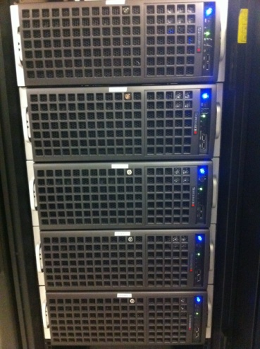
HPC Facility Resources
GPGPU Clusters
Legend:
CONDOR CLUSTER
500 TFLOPS
Funding: $2M HPCMP DHPI
Urban Surveillance
Cognitive Computing
Quantum Computing
ATI Cluster
32 TFLOPS ATI
FirePro 8800
HPC GPGPU Assets on DREN Network
1 GbE
HORUS
22TFLOPS TTCP
Field Experiments
1
Dual 10 GbE
1 GbE
Infiniband
40 Gb/s
2
Dual 10 GbE
1 GbE
Infiniband
40 Gb/s
Online: Jan 2011
3
Dual 10 GbE
Infiniband
40 Gb/s
1 GbE
Upgrade all Nvidia GPGPUs to C2050s & C2070s Tesla cards June 2012
30 Kepler cards ~90K will have a 3x improvement (1.5Tflop DP) 220W
  Condor among the greenest HPC in the world (1.25 Gflop/W DP&SP)
Redistribute 60 C1060 Tesla cards to other HPC and research sites
  ASIC, UMASS, & ARSC
84
Dual 10 GbE
Online: Nov 2010

Slide 9
Mission
RI HPC-ARC & HPC Systems
Condor Cluster
Success and Results
Future Work
Conclusions

Slide 10
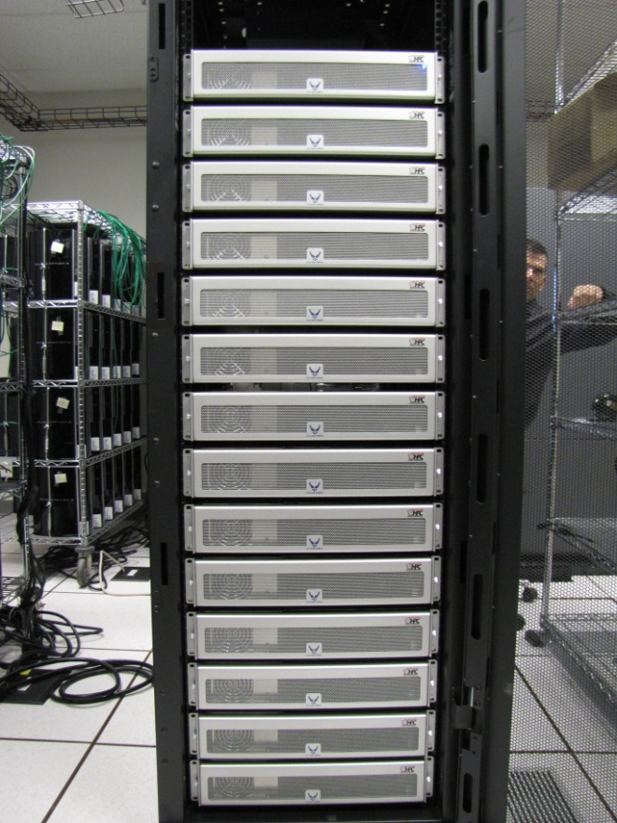
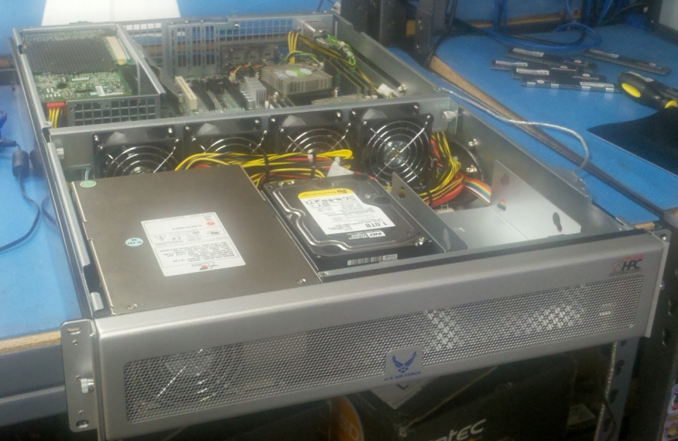
The Condor Cluster
FY10 DHPI
Key design considerations: Price/performance & Performance/Watt
1716 SONY Playstation3s
STI Cell Broadband Engine
  PowerPC PPE
  6 SPEs
  256 MB RAM
84 head nodes
6 gateway access points
78 compute nodes
  Intel Xeon X5650 dual-socket hexa-core
  (2) NVIDIA Tesla GPGPUs
    54 nodes – (108) C2050
    24 nodes – (48) C2070/5
  24-48 GB RAM

Slide 11
Condor Cluster (500 Tflops)
Online: November 2010
263 Tflops from 1,716 PS3s
    153 GFLOPS/PS3
    78 subclusters of 22 PS3s
225 Tflops from server nodes
    84 sever nodes (Intel Westmere 5650 dual socket Hexa (12 cores))
    Dual GPGPUs in 78 server nodes
    Firebird Cluster (~32 Tflops)
Cost: Approx. $2M
Sustained throughput benchmarks/appications YTD: Xeon X5650: 16.8 Tflops, Cell 171.6 Tflops, C2050 : 68.2 Tflops, C2070: 34 Tflops….CONDOR TOTAL 290.6 Tflops
1 GbE
1
Dual 10 GbE
1 GbE
Infiniband
40 Gb/s
2
Dual 10 GbE
1 GbE
Infiniband
40 Gb/s
3
Dual 10 GbE
Infiniband
40 Gb/s
1 GbE
84
Dual 10 GbE

Slide 12
Condor Cluster Networks
10 GbE STAR-Bonded HUB
CS1
x22
CPS1
CS2
S
W
I
T
C
H
S
CPS2
CS3
CPS3
CS4
CPS4
Server
CS5
Server
CS71
CS6
CPS5
CS72
CS7
CPS6
CS15
CS73
CS8
x13
CPS7
CS16
CS74
CS9
Switch
CPS8
CS17
Server
CPS9
CS18
CS75
CS10
x14
BOND
CPS10
Server
CS76
CS11
Switch
CPS11
CS19
CS77
CS12
Rack1
CPS12
CS20
CS78
CS13
CPS13
CS21
CS79
CS14
CS22
CS80
CS23
CS81
x14
CS24
CS82
x14
CS25
CS83
Switch
Switch
CS26
CS84
Rack6
Rack2
CS27
BOND
BOND
CS28
CPS66
x22
x13
x13
x22
CPS67
Switch
Switch
S
W
I
T
C
H
S
CPS14
CPS68
CPS15
CPS69
CPS16
Server
CPS70
CPS17
CPS71
Server
CPS72
CPS18
CPS73
CPS19
CPS74
CPS20
CPS75
CPS21
CPS76
DELL RACK
CPS22
CPS77
CPS23
CPS78
CPS24
CPS25
CPS26
CS57
CS58
CS29
CS59
CS30
CS60
CS31
Server
CS61
CS32
CS62
Server
CS63
CS33
CS64
CS34
CS65
CS35
CS66
CS36
CS67
CS37
CS68
x14
x14
CS38
CS69
Switch
Switch
CS39
CS70
Rack5
Rack3
CS40
CS41
x22
BOND
BOND
CS42
CPS53
x13
x13
x22
CPS54
Switch
Switch
S
W
I
T
C
H
S
CPS27
CPS55
CPS28
CPS56
Rack4
CPS29
Server
CPS57
CPS30
CPS58
x22
Server
CPS59
CPS40
CS43
CPS31
CPS60
CPS41
S
W
I
T
C
H
x14
CS44
CPS32
CPS61
CPS42
CS45
CPS33
CPS62
CPS43
Switch
CS46
CPS34
CPS63
Server
CPS35
CPS44
x13
BOND
Server
CPS64
CPS45
Switch
CS47
CPS36
CPS65
CPS46
CS48
CPS37
CPS47
CS49
CPS38
CPS48
CS50
CPS39
CPS49
CS51
CPS50
CS52
CPS51
CS53
CPS52
CS54
CPS53
CS55
CS56

Slide 13
Condor Cluster Networks
Infiniband Mesh Non-Blocking 20Gb/s
(5) 12200 & (1) 12300 Qlogic 40Gb/s Infiniband (36 port) switches
Rack 1
14
servers
A
24
Rack 6
14
servers
14
14
3
28
6
6
6
32
6
6
4
Rack 2
14
servers
4
6
Rack 5
14
servers
4
32
6
5
36
10
6
B
24
6
14
14
Rack 3
14
servers
Rack 4
14
servers

Slide 14
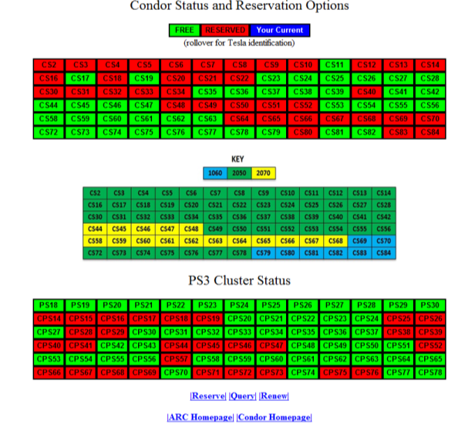
Condor Web Interface

Slide 15
Mission
RI HPC-ARC & HPC Systems
Condor Cluster
Success and Results
Future Work
Conclusions

Slide 16

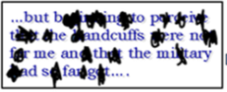
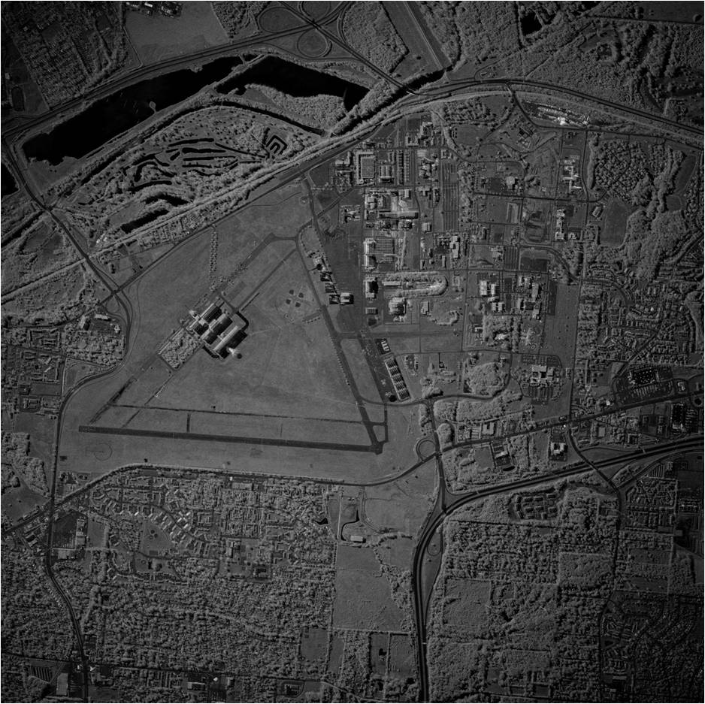
Solving Demanding,
Real-Time Military Problems
Occluded text recognition
Radar processing for high resolution images
…but beginning to perceive that the handcuffs were not for me and that the military had so far got….
Space object identification

Slide 17
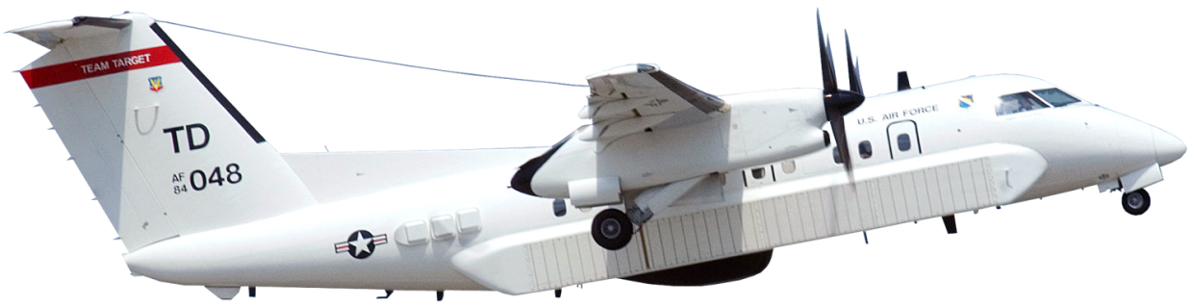
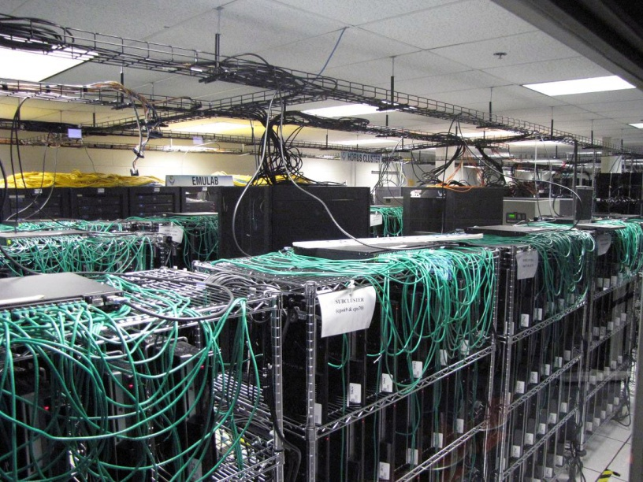
RADAR Data Processing for
High Resolution Images
Radar processing for high resolution
images in real-time

Slide 18
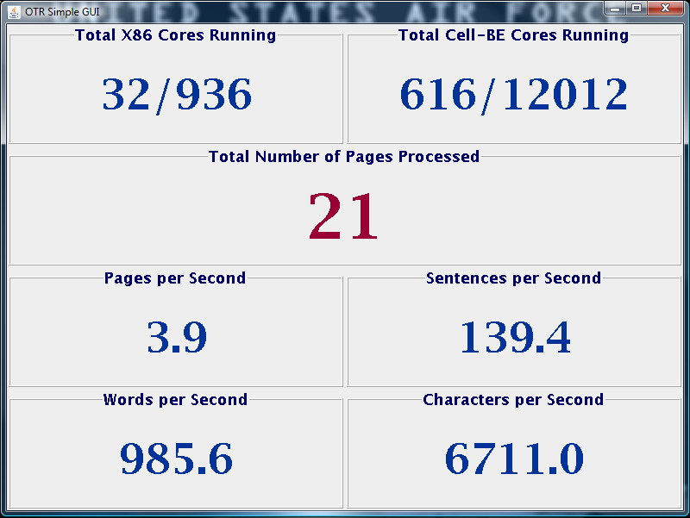
Optical Text Recognition Processing Performance
Computing resources involved in this run
  4 Condor servers – 32 Intel Xeon processor cores
  88 PlayStation 3’s – 616 IBM Cell-BE processor cores
  40 Condor servers – 320 Intel Xeon processor cores
  880 PS3s – 6160 IBM Cell-BE Processor cores (21 pages/sec)

Slide 19
Space Object Identification
Combining frames to create high quality
images in real-time
High resolution image
Low resolution frames

Slide 20
Matrix Multiply
MAGMA-only, one-sided matrix factorization
GFLOPS
Matrix-matrix multiplication test
C2050 (MAGMA vs CUBLAS)
GFLOPS
Matrix Size
Matrix Size

Slide 21

LAMMPS on GPUs
Condor/Firebird provides access to next-generation hybrid CPU/GPU architectures
  Critical for understanding the capability and operation prior to larger deployments
  Opportunity to study non-traditional applications of HPC, e.g., C4I applications
CPU/GPU compute nodes provides significant raw computing power
  OCL N-Body benchmark with 768K particles sustained performance ~ 2 TFLOPS using 4 Tesla C2050s or 3 FireBird V8800s
Production chemistry code (LAMMPS) shows speedup with minimal effort
  Original CPU code ported to OpenCL with limited source code modifications
  Exact double-precision algorithm runs on Nvidia and AMD nodes
  Overall platform capability increased by 2x (2.8x) without any GPU optimization
OpenCL N-Body Benchmark¹
1
LAMMPS-OCL EAM Benchmark²
(Absolutely no GPU optimizations)
Tesla C2050
FirePro V8800
(cores)
2
(GPUs)
(GPUs)
4
1
8
2
1
3
4
2
3
1 GPU
2 GPUs
3 GPUs
4 GPUs
Xeon X5660
Tesla C2050
FirePro V8800
¹MPI-modified BDT N-Body benchmark distributed with COPRTHR 1.1
²LAMMPS-OCL is a modified version of the LAMMPS molecular dynamics code ported to OpenCL by Brown Deer Technology

Slide 22
Mission
RI HPC-ARC & HPC Systems
Condor Cluster
Success and Results
Future Work
Conclusions

Slide 23
Future Work
Improved OTR applications
  Multiple languages
Space Situation Awareness
  Heterogeneous algorithms
Persistent Wide Area Surveillance

Slide 24
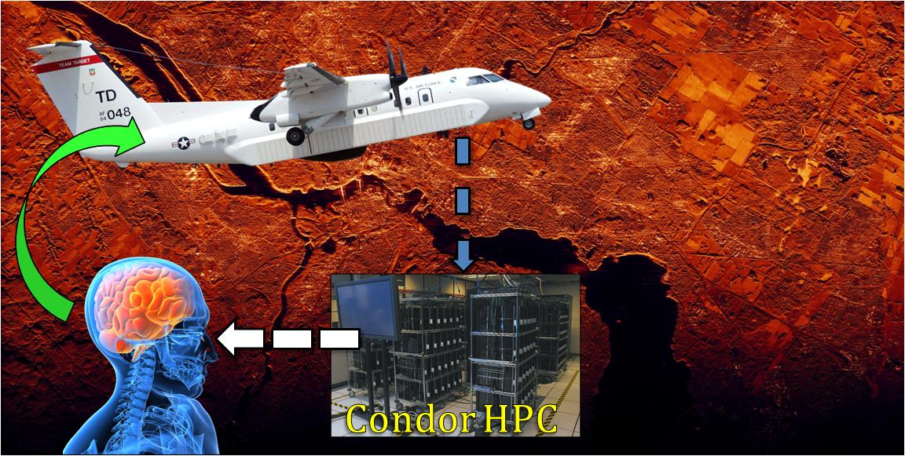
Autonomous Sensing in Persistent Wide-Area Surveillance
Cross-TD effort
  Investigate scalable, real-time and autonomous sensing technologies
  Develop a neuromorphic computing architecture for synthetic aperture radar (SAR) imagery information exploitation
  Provide critical wide-area persistent surveillance capabilities including motion detection, object recognition, areas-of-interest identification and predictive sensing

Slide 25
Conclusions
  Valuable resource to support entire AFRL/RI, AFRL and tri-service RDT&E community.
  Leading large GPGPU development and benchmarking tests.
  This investment is leveraged by many (130+) users
  Technical benefits – Faster, higher fidelity problem solution; multiple parallel solutions, heterogeneous application development

Slide 26
Questions?

