Slide 1
Floating Point Vector Processing using 28nm FPGAs
HPEC Conference, Sept 12 2012
Michael Parker Altera Corp
Dan Pritsker Altera Corp

Slide 2
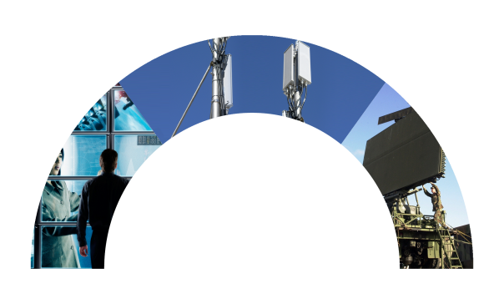
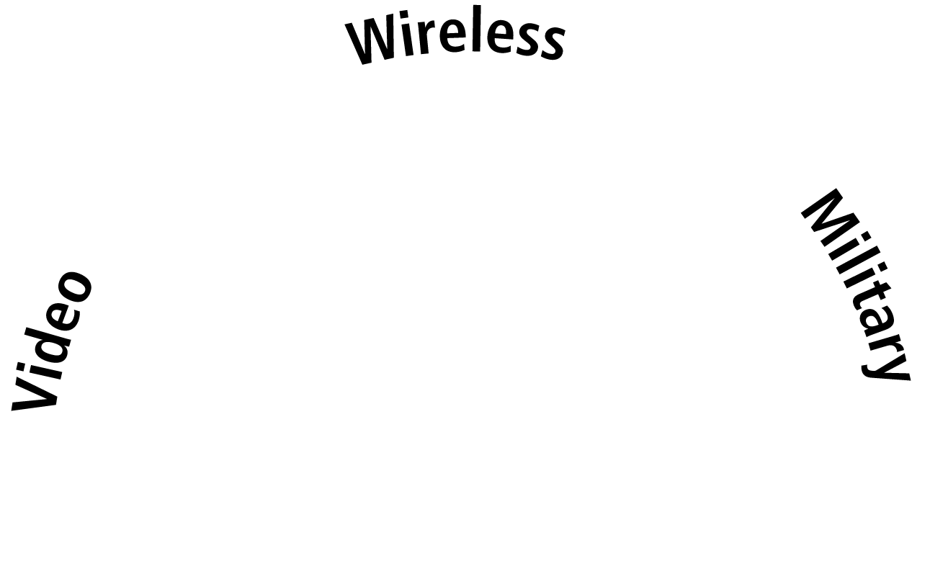
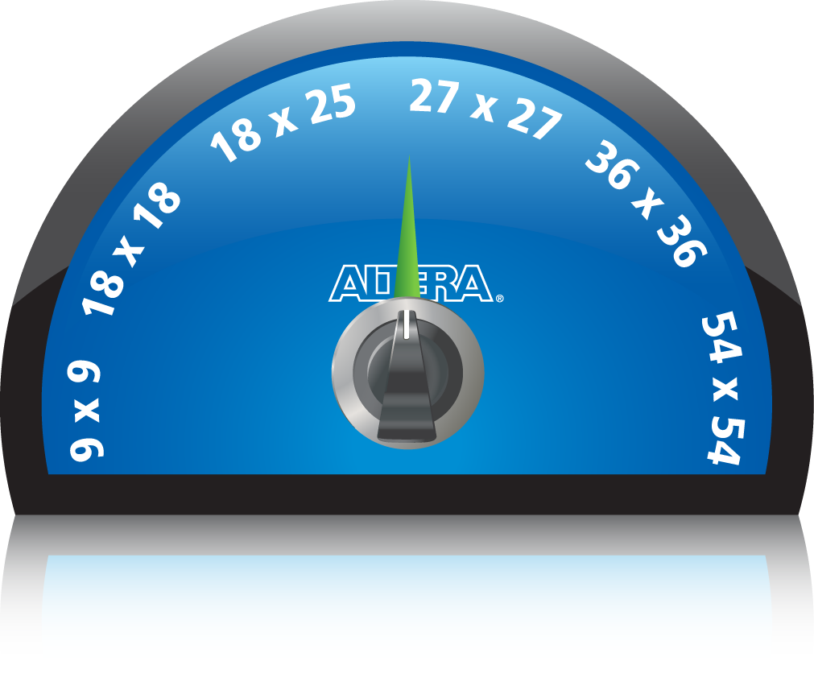
28-nm DSP Architecture on Stratix V FPGAs
User-programmable variable-precision signal processing
Optimized for single- and double-precision floating point
Supports 1-TFLOP processing capability
2
Notes:
2
Altera’s 28-nm DSP block, integrated into our Stratix V FPGAs, is the only FPGA DSP architecture that combines best-in-class implementation of 18-bit DSP – important for many video applications – as well as the most efficient implementation for high-precision DSP – required for many radar, electronic warfare, high-precision medical and other applications.
As DSP applications grow more demanding in terms of both performance as well as precision – an architecture that combines implementation efficiency of common DSP structures such as FFT and FIR with the best support for higher precision and floating point signal processing – provides the best solution.
As you will see, this efficiency is key to hitting 1 Teraflop processing rate.

Slide 3
Why Floating Point at 28nm ?
Floating point density determined by hard multiplier density
Multipliers must efficiently support floating point mantissa sizes
3.2x
1.4x
6.4x
1.4x
4x
5SGSB8
65nm 40nm 28nm

Slide 4
Floating Point Multiplier Capabilities
Floating point density determined by hard multiplier density
Multipliers must efficiently support floating point mantissa sizes
3.2x
1.4x
6.4x
1.4x
4x
5SGSD8
65nm 40nm 28nm

Slide 5
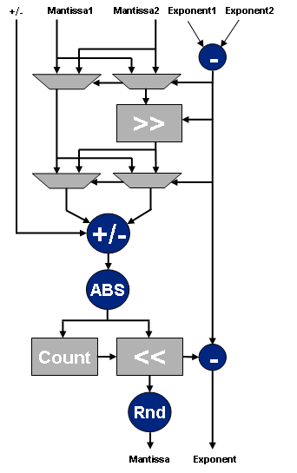
Floating-point Methodology
Processors – each floating-point operation supports IEEE 754 format
Inefficient format for FPGAs
Not 2’s complement
Special cases, error conditions
Exponential normalization for each step
Excessive routing requirement resulting in low performance and high logic usage
Result: FPGAs restricted to fixed point
Denormalize
Normalize
Notes:
In a microprocessor, the input and output data structure for each floating point instruction conforms to a standard called “IEEE754”. This representation of floating point numbers is very inefficient to implement within an FPGA. The standard “twos complement” representation, which is well suited to digital hardware implementation, is not used. Instead, the sign bit is separated, and there is an implicit “one” which must be added to each mantissa value. Specially designed circuitry is necessary to accommodate all this, which is why you will typically see a microprocessor or DSP device optimized for either fixed or floating point, but usually not both. Furthermore, in a microprocessor, there is no knowledge of the floating point operations before or after the current instruction, so no optimization can be performed in this regard. This means the circuit implementation must assume that the logic intensive normalization or denormalization must be performed on each instruction data input and output.
Because of the inefficiency resulting from these issues, virtually all FPGA based designs today are done in fixed point, even when the algorithm being implemented would work much better with the high dynamic range of floating point.

Slide 6
New Floating-point Methodology
Processors – each floating-point operation supports IEEE 754 format
Inefficient format for FPGAs
Not 2’s complement
Special cases, error conditions
Exponential normalization for each step
Excessive routing requirement resulting in low performance and high logic usage
Result: FPGAs restricted to fixed point
Novel approach: fused datapath
IEEE 754 interface only at algorithm boundaries
Signed, fractional mantissa
Increases mantissa precision → reduces need for normalization
Result: 200-250 MHz performance with large complex floating-point designs
Slightly Larger – Wider Operands
Denormalize
True Floating Mantissa
(Not Just 1.0 – 1.99..)
Normalize
Remove
Normalization
Do Not Apply Special and Error Conditions Here
Notes:
To enable FPGAs to support floating-point operations, Altera has developed the fused datapath.
An FPGA can use larger size mantissas than IEEE754 representation. This is possible because the variable-precision DSP blocks support 27x27 and 36x36 multiplier sizes, which can be used for 23-bit single precision floating point datapaths. The rest of the circuits, using configurable logic, can by definition be made in the desired mantissa size.
Using a mantissa size of a few extra bits, for example 27 bits compared to 23 bits, allows for extra precision to be carried from one operation to the next, which will significantly reduce normalization and denormalization. The fused datapath tool will analyze the need for normalization in the design, and insert these stages only where necessary. This leads to a dramatic reduction in logic, routing, and multiplier-based shifting resources. It also results in much higher Fmax, or achievable clock rates, even in very large floating point designs. This performance has been in benchmarked, and is available on the Altera website.

Slide 7
Vector Dot Product Example
X
+
X
+
X
+
X
+
X
+
Normalize
X
+
X
+
X
DeNormalize
Notes:
Here we can see these optimizations in a few more details. IEEE754 mantissas are 23 bits (single precision), are unsigned, and have an explicit one implied (from 1.0 to 1.999). This is replaced by standard signed two’s complement number of 27 or 36 bits (we can expand the mantissa width since this is configurable logic), and we can use 27x27 or 36x36 multipliers for both mantissa normalization and multiplication.
Since we have extra bits, the decimal need not be in the left most position, but we can tolerate leading zeros incurred during floating point operations. Furthemore, special conditions, such as invalid numbers or infinities, are applied only at the boundary, not at each operation.

Slide 8
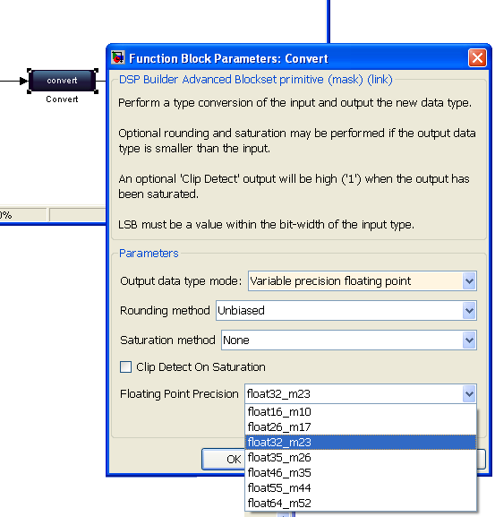
Selection of IEEE Precisions
IEEE format
7 precisions (including double and single)
float16_m10
float26_m17
float32_m23 (IEEE single)
float35_m26
float46_m35
float55_m44
float64_m52 (IEEE double)
Precision | DSP usage compared to single precision |  | Logic usage compared to single precision
f16m10 |  | 0.6 | 0.3
f26m17 |  | 0.9 | 0.6
f32m23 |  | 1 | 1
f35m26 |  | 1.2 | 1.4
f46m35 |  | 2.2 | 2.2
f55m44 |  | 3.7 | 3.4
f64m52 |  | 5.0 | 4.6

Slide 9
Elementary Mathematical Functions
Selectable Precision Floating Point
Round | Trigonometric | Math | Sqrt | Min Max | LdExp
floor(x) ceil(x) round(x) rint(x) | sin(a) cos(a) sincos(a) tan(a) cot(a) sin(pi*x) cos(pi*x) tan(pi*x) cot(pi*x) asin(a) acos(a) atan(a) atan2(y,x) asin(x)/pi acos(x)/pi atan(x)/pi | exp(x) log(x) recip(x) hypot(x,y) mod(x,y) | sqrt(x) recipSqrt(x) cbrt(x) | min(a,b) max(a,b) dim(a,b) sat(a,hi,lo) | ldexp(x,b) ilogb(x)
The new fn(pi*x) and fn(x)/pi trig functions are particularly logic efficient when used in floating point designs
Highlighted functions are limited to IEEE single and double

Slide 10
QR Decomposition Algorithm Implementation
Notes:
10
In this section, we will look at the floating point IP released in 2009, and some of the benchmarks. This demonstrates that the fused datapath technology has been working, has been used internally by Altera IP development teams for several years, and is a very robust.

Slide 11
QR Decomposition
QR Solver finds solution for Ax=b linear equation system using QR decomposition, where Q is ortho-normal and R is upper-triangular matrix. A can be rectangular.
Steps of Solver
Decomposition: A = Q · R
Ortho-normal property: Q^{T} · Q = I
Substitute then mult by Q^{T}: Q · R · x = b R · x = Q^{T} · b = y
Backward Substitution: Q^{T} · b = y solve R · x = y
Decomposition is done using Gram-Schmidt derived algorithms. Most of computational effort is in “dot-product”

Slide 12
Block Diagram
Stimulus
QR Decomposition
+
Q Matrix^{T} * Input Vector
Backward
Substitution
[m x n]
A
R
x
[m]
b
y
Solve for x in Ax = b where A is non-symmetric, may be rectangular

Slide 13
QR Decomposition Algorithm
for k=1:n
r(k,k) = norm(A(1:m, k));
for j = k+1:n
r(k, j) = dot(A(1:m, k), A(1:m, j)) / r(k,k);
end
q(1:m, k) = A(1:m, k) / r(k,k);
for j = k+1:n
A(1:m, j) = A(1:m, j) - r(k, j) * q(1:m, k);
end
end
Standard algorithm, source: Numerical Recipes in C
Possible to implement as is, but changes make it FPGA friendly and increase numerical accuracy and stability

Slide 14
Algorithm - Observations
for k=1:n
r(k,k) = sqrt(dot(A(1:m, k), A(1:m,k));
for j = k+1:n
r(k, j) = dot(A(1:m, k), A(1:m, j)) / r(k,k);
end
q(1:m, k) = A(1:m, k) / r(k,k);
for j = k+1:n
A(1:m, j) = A(1:m, j) - r(k, j) * q(1:m, k);
end
end
k sqrt, k*m cmults
k²/2 divides, m*k²/2 cmults
k divides
m*k²/2 cmults
Replaced norm function with sqrt and dot functions, as they are available as hardware components.
k sqrt
k²/2 + k divides
m*k² complex mults

Slide 15
Algorithm - Data Dependencies
for k=1:n
r(k,k) = sqrt(dot(A(1:m, k), A(1:m,k));
for j = k+1:n
r(k, j) = dot(A(1:m, k), A(1:m, j)) / r(k,k);
end
q(1:m, k) = A(1:m, k) / r(k,k);
for j = k+1:n
A(1:m, j) = A(1:m, j) - r(k, j) * q(1:m, k);
end
end
r(k,k) required at this stage
r(k,k) required at this stage
q(1:m,k) required at this stage
Floating point functions may have long latencies
Dependencies introduce stalls in data flow
Neither r(k,j) nor q can be calculated before r(k,k) is available
A(1:m,j) cannot be calculated before q is available

Slide 16
Algorithm - Splitting Operations
for k=1:n
%% r(k,k) = sqrt(dot(A(1:m, k), A(1:m,k));
r2(k,k) = dot(A(1:m, k), A(1:m,k);
r(k,k) = sqrt(r2(k,k));
for j = k+1:n
%% r(k, j) = dot(A(1:m, k), A(1:m, j)) / r(k,k);
rn(k, j) = dot(A(1:m, k), A(1:m, j));
r(k, j) = rn(k,j)/ r(k,k);
end
q(1:m, k) = A(1:m, k) / r(k,k);
for j = k+1:n
A(1:m, j) = A(1:m, j) - r(k,j) * q(1:m,k);
end
end

Slide 17
Algorithm - Substitutions
for k=1:n
r2(k,k) = dot(A(1:m, k), A(1:m,k);
r(k,k) = sqrt(r2(k,k));
for j = k+1:n
rn(k, j) = dot(A(1:m, k), A(1:m, j));
r(k, j) = rn(k,j)/ r(k,k);
end
q(1:m, k) = A(1:m, k) / r(k,k);
for j = k+1:n
A(1:m, j) = A(1:m, j) - r(k,j) * q(1:m,k);
end
end
Replace q(1:m,k) with A(1:m,k) / r(k,k)
Replace r(k,j) with rn(k,j)/ r(k,k)

Slide 18
Algorithm - After Substitutions
for k=1:n
r2(k,k) = dot(A(1:m, k), A(1:m,k);
r(k,k) = sqrt(r2(k,k));
for j = k+1:n
rn(k, j) = dot(A(1:m, k), A(1:m, j));
r(k, j) = rn(k,j)/ r(k,k);
end
q(1:m, k) = A(1:m, k) / r(k,k);
for j = k+1:n
A(1:m, j) = A(1:m, j) - rn(k,j)/ r(k,k) * A(1:m,k) / r(k,k) ;
end
end

Slide 19
Algorithm - Re-Ordering
for k=1:n
r2(k,k) = dot(A(1:m, k), A(1:m,k);
for j = k+1:n
rn(k, j) = dot(A(1:m, k), A(1:m, j));
end
for j = k+1:n
A(1:m, j) = A(1:m, j) – (rn(k,j) / r2(k,k)) * A(1:m,k);
end
end
for k=1:n
r(k,k) = sqrt(r2(k,k));
for j = k+1:n
r(k, j) = rn(k,j)/ r(k,k);
end
q(1:m, k) = A(1:m, k) / r(k,k);
end

Slide 20
Algorithm - Flow Advantages
for k=1:n
r2(k,k) = dot(A(1:m, k), A(1:m,k);
for j = k+1:n
rn(k, j) = dot(A(1:m, k), A(1:m, j));
end
for j = k+1:n
A(1:m, j) = A(1:m, j) - rn(k,j) * A(1:m,k) / r2(k,k) ;
end
end
for k=1:n
r(k,k) = sqrt(r2(k,k));
for j = k+1:n
r(k, j) = rn(k,j)/ r(k,k);
end
q(1:m, k) = A(1:m, k) / r(k,k);
end
No sqrt
Less operations in critical path
calculation of “A”
Split out:
Operations can
be scheduled as data
becomes available

Slide 21
Algorithm - Number of Calculations
for k=1:n
r2(k,k) = dot(A(1:m, k), A(1:m,k);
for j = k+1:n
rn(k, j) = dot(A(1:m, k), A(1:m, j));
end
for j = k+1:n
A(1:m, j) = A(1:m, j) – (rn(k,j)/r2(k,k)) * A(1:m,k);
end
end
for k=1:n
r(k,k) = sqrt(r2(k,k));
for j = k+1:n
r(k, j) = rn(k,j)/ r(k,k);
end
q(1:m, k) = A(1:m, k) / r(k,k);
end
k*m complex mults
m*k²/2 complex mults
k²/2 divides, m*k²/2 complex mults
k sqrts
k²/2 divides
k divides
k sqrt
k² + k divides - twice as many as original, but still only 1 divider per m complex mults
m*(k²+k) complex mults

Slide 22
QRD Structure
A_{k}
v
A
mult/add unit
div/sqrt unit
m/v
m
n
control
Addresses,
instructions
instr | In 1 | In 2 | In 3
mag | A | ---
dot | A | A_{k}
div |  | A_{k} | rk
sub | A | A_{k} | r_{k,j}/r²_{k,k}
r_{k,j}
r²_{k,k}
Fifo (“leaky bucket”)

Slide 23
Stratix V Floating Point QRD Benchmarks
Notes:
Now, lets talk about the key new technology enabling high performance floating point in FPGAs.

Slide 24
Altera 28nm high end FPGAs
Stratix V “GS” Family
Part Number | LEs / ALUTs | ALUTs / Registers | DSP Multiplier Count | Mbits / M20 memory blocks | 14 GBps TransceiverCount
5SGSD3 | 236K | 178K / 356K | 1200 | 13 / 688 | 24
5SGSD4 | 360K | 272K / 543K | 2088 | 19 / 957 | 36
5SGSD5 | 457K | 345K / 690K | 3180 | 39 / 2014 | 36
5SGSD6 | 583K | 440K / 880K | 3550 | 45 / 2320 | 48
5SGSD8 | 695K | 525K / 1050K | 3926 | 50 / 2567 | 48

Slide 25
Performance and FPGA Resources
QR Decomposition Parameterizable Core using 5SGSD5
Complex Input Matrix Size | Vector Size | ALUTs / Memory blocks / 27x27s | % ALUTs / % Memory blocks / % 27x27s | Latency @ Operating frequency | GFLOPS per core (complex single precision)
50x100 | 50 | 105K 230 M20K 227 DSP | 30% 11% 14% | 45 us @ 250 MHz | 43.8
100x200 | 50 | 106K 304 M20K 228 DSP | 31% 15% 14% | 213 us @ 250 MHz | 64.3
100x200 | 100 | 202K 504 M20K 428 DSP | 58% 25% 27% | 173 us @ 200 MHz | 91.9
250x400 | 100 | 200K 858 M20K 428 DSP | 58% 43% 27% | 1586 us @ 200 MHz | 106
400x400 | 100 | 203K 1566 M20K 428 DSP | 59% 78% 27% | 4029 us @ 200 MHz | 106

Slide 26
GFLOPs and GFLOPs/Watt
QR Decomposition Parameterizable Core using 5SGSD5
Complex Input Matrix Size (n x m) | Vector Size | Through-put (Matrix per second) | GFLOPS per core (complex single precision) | Core power consumption as measured using Altera 5SGSD5 eval board | GFLOPs/Watt
50x100 | 50 | 31,681 | 43.8 | 10.8 W | 4.1
100x200 | 50 | 5,920 | 64.3 | 13.9 W | 4.6
100x200 | 100 | 8,467 | 91.9 | 21.0 W | 4.4
400x400 | 100 | 310 | 106 | 25.2 W | 4.2
450x450 | 75 | 165 | 80.0 | 20.2 | 4.0
Complex QRD FLOPs = 5.33mn² + 8mn – 2n + 4n²

Slide 27
Verification and Accuracy
Notes:
Now, lets talk about the key new technology enabling high performance floating point in FPGAs.

Slide 28
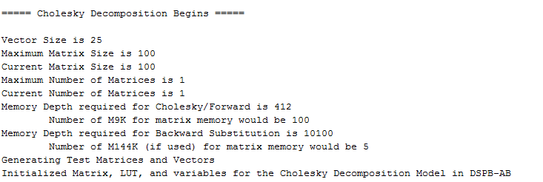
Running the Design
Initialization feedback in Matlab window

Slide 29
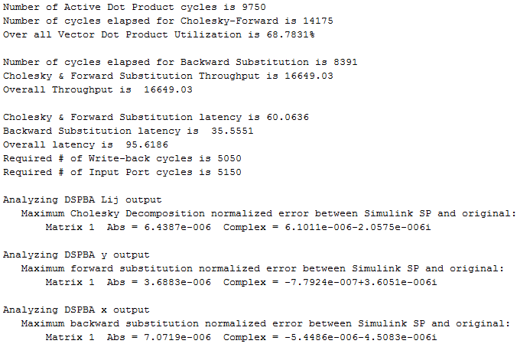
Running the Design
After simulation run analyze_DSPBA_out.m

Slide 30
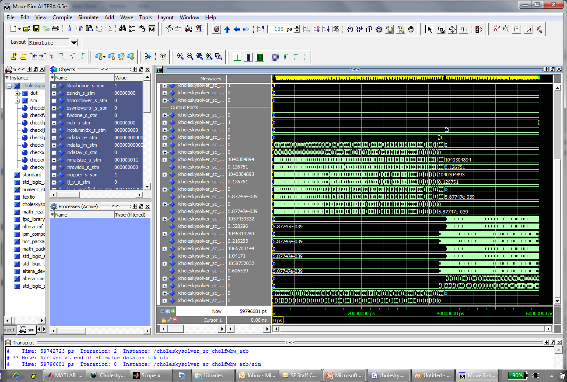
Simulating the RTL

Slide 31
Computational error analysis
QR Decomposition Accuracy
Complex Input Matrix Size (n x m) | Vector Size | MATLAB using computer Norm/Max | DSPBA generated RTL Norm/Max
50x100 | 50 | 5.01e-5 / 6.42e-6 | 4.87e-5 / 6.02e-6
100x200 | 100 | 2.3e-5 / 1.24e-6 | 1.68e-5 / 9.97e-7
400x400 | 100 | 8.8e-5 / 4.81e-6 | 7.07e-5 / 4.03e-6
using Frobenius norm
Using Single Precision Floating Point

Slide 32
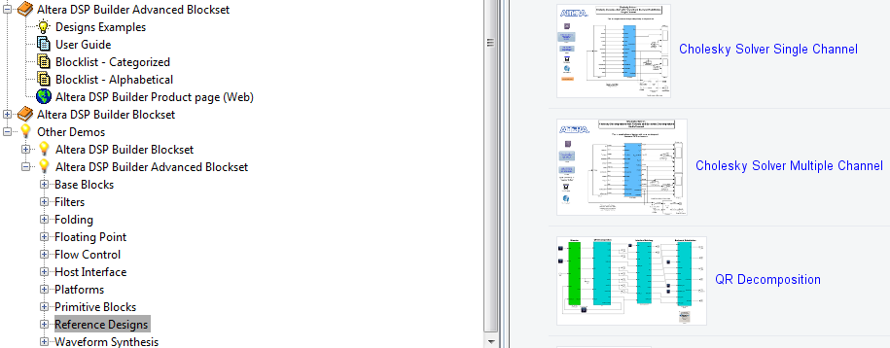
Shipping today as reference designs

Slide 33
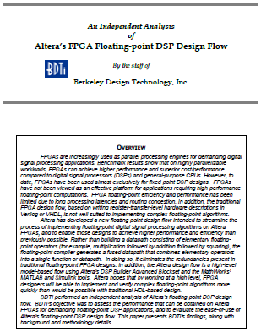
Third party benchmarking by BDTI

Slide 34
Thank you

