Slide 1
Large Scale Network Situational Awareness via 3D Gaming Technology
2012 IEEE
High Performance Extreme Computing Conference
10 - 12 September 2012
Matthew Hubbell and Jeremy Kepner
This work is sponsored by the Department of the Air Force under Air Force Contract #FA8721-05-C-0002. Opinions, interpretations, recommendations and conclusions are those of the authors and are not necessarily endorsed by the United States Government.
Notes:
1
Title slide

Slide 2
Outline
Introduction
Approach
Results
Summary
Notes:
Outline slide

Slide 3
Network Situational Awareness
Network SA
Who/What is on the Network?
Staff/Visitors
What machines are operating on the Network?
Physical desktops/servers
Virtual Machines
Wireless Devices
Remote VPN Sessions
What do we know about the machines?
Operating systems and version/patch level
MAC Address
IP Address
Network Activity
Where are the machines located?
Geo Location of the physical machine
Notes:
Our approach to Network SA – what questions are we trying to answer by obtaining SA.
1
2
3 Browser information, amount of data transferred, web traffic
4 rogue devices on a face plate – can we find the machine

Slide 4
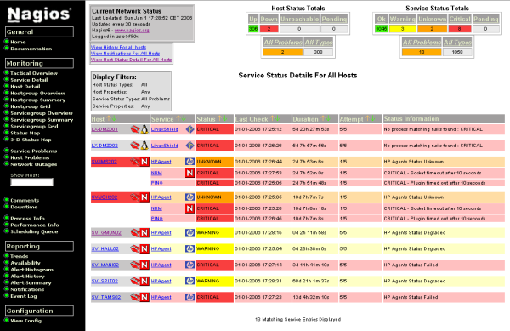
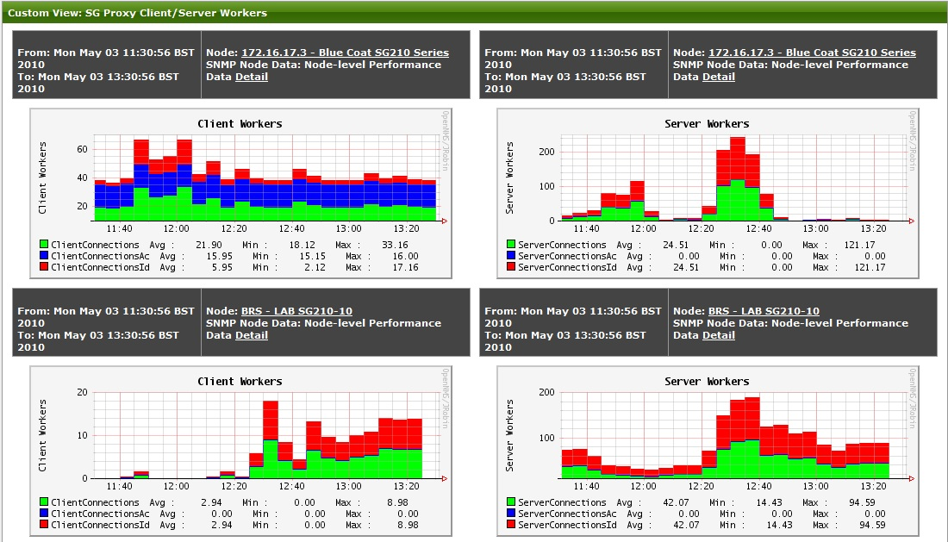
Problem: Too Much Information Too Many Sources
SA process requires many data sources
Different vendor supplied interfaces
Disconnected data complicates analyst’s job to make associations
Charts, Plots, Graphs, and Stats are not sustainable interfaces for persistent monitoring
Notes:
The current tools available for network analysis are not comprehensive enough. Requires using multiple tools delaying response.
Information from – Switch information
Proxy Web traffic
Vulnerability Information
Intrusion Detection
Virus Scans
Log servers or traps
2 – Associations into actionable information
3 scatter plots, histograms, pie charts, are effective however not sustainable interfaces for prolonged analysis.

Slide 5
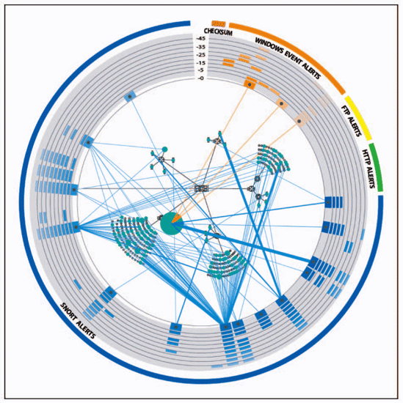
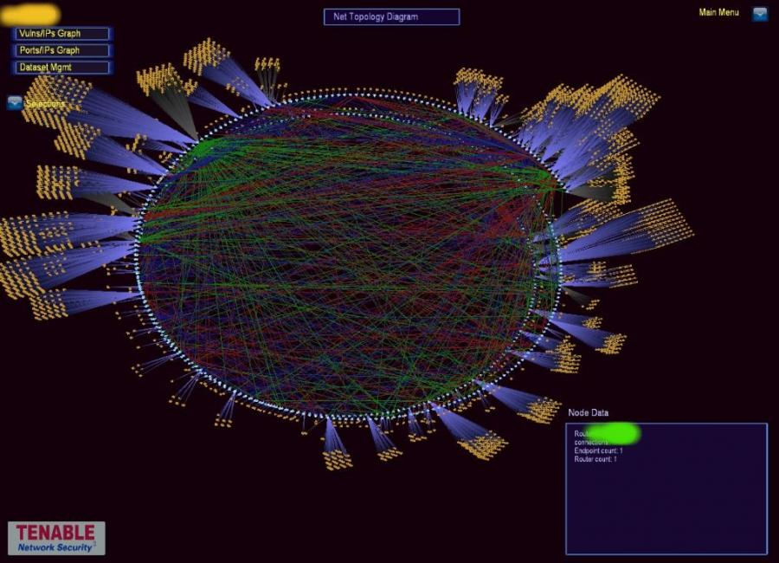
Visualizing Situational Awareness
Visualization is the most efficient method for people to absorb large amounts of data
VisAlert
SecViz
Notes:
Examples of current research efforts to visualize network activity, vulnerabilities, and provide the answers to analyst’s questions.
Fish eye displays do a great job of identifying line of communication, top talkers, active networks
Addition of multiple widget like interfaces to accommodate variety of data sources – HUD

Slide 6
3D Gaming Platform
3D video games are able to display vast amounts of data to the player in a quickly digestible format
Proven platform for sustainable interaction
“…a 21-year-old has spent 10,000 hours gaming, close to about the same amount of time spent in school from 5th to 12th grade” McGonical, Jane, “Reality Is Broken: Why Games Make Us Better and How They Can Change the World”
Provides the ability to apply almost infinite visual cues to indicate events
Take advantage of features natural to video game world
- multi-player environments, collision detection, spatial recognition, asset tracking
Notes:
Identify some of the benefits and features of a 3D gaming environment that make it an ideal platform to host a SA tool.
1 Data absorption is almost instantaneous
2 Integral part of young analysts experiences
3 Explosions, sounds, environment
4 collaboration on a single platform

Slide 7
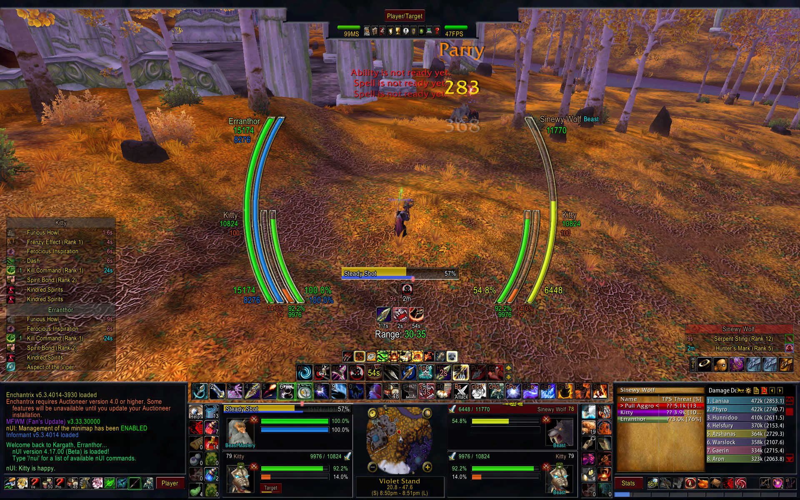
3D Gaming Platform
World of Warcraft
Notes:
Demonstrate a very popular game that is played around the world to show how heads up displays (hud) are being implemented and just how much information a player is able to absorb during extended game play.

Slide 8
Outline
Introduction
Approach
Results
Summary
Notes:
Outline slide

Slide 9
Unity3D
Game Engine options
3D Panda - Disney
UDK - Unreal
Blender – Opensource
Unity3D
Actively developed
Multi Platform support
- OSX, Windows, iOS, Android,
Web Player, Flash
Flexible scripting environment
- Java, C#, boo
- Large user community and well documented API
Notes:
Describing Unity3D, and identifying some of the other game engines we examined and the reasoning for choosing Unity3D

Slide 10
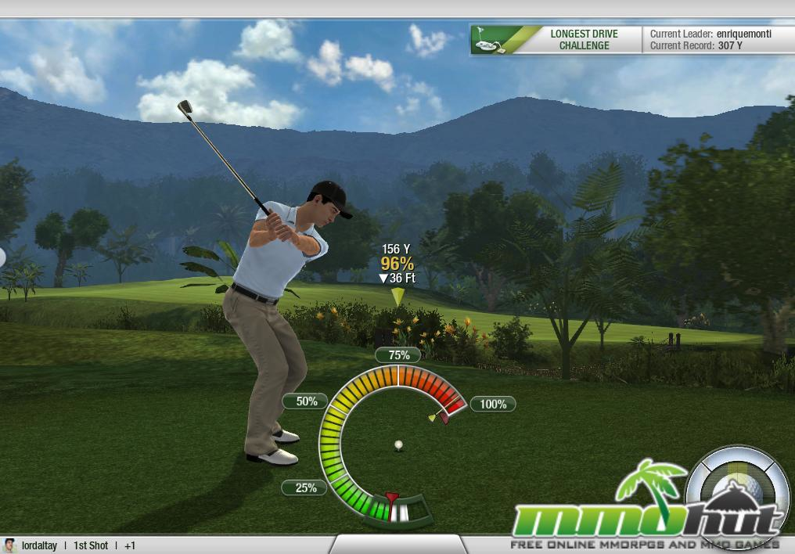
3D Gaming Platform
Notes:
Demonstrate a wildly popular game built on the Unity3D platform

Slide 11
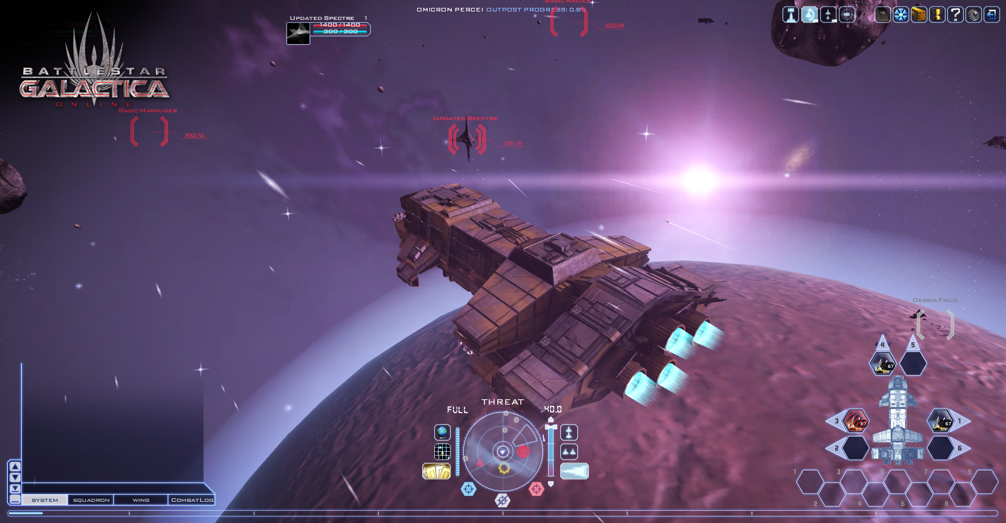
3D Gaming Platform
Battle Star Galactica
Notes:
Demonstrate a wildly popular game that requires the player to internalize their environment and respond quickly to events based on visual cues within the game interface.

Slide 12
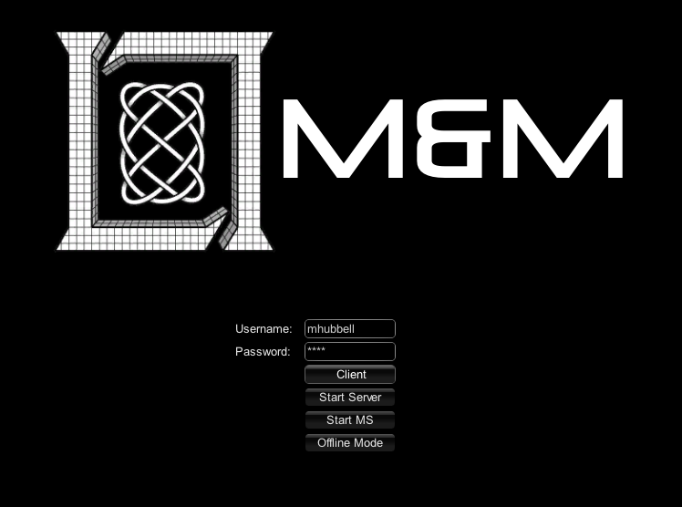
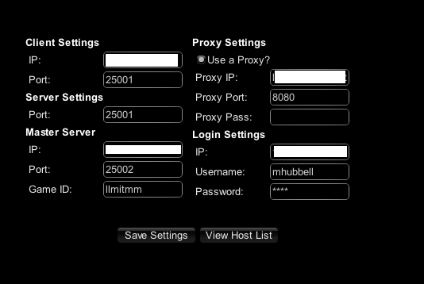
Approach
Fully networked multiplayer First Person Shooter (FPS) environment
Tiered user access allows for differentiated player abilities based on organizational role
Managers – View Only
Analysts – View and alert
Operators – View, alert, take action
Notes:
Show our login and settings scenes to demonstrate how we authenticate users, the benefits of using tiered logins, as well as show how you can customize the connection settings to accommodate different versions of the Game running from a Master Server.

Slide 13
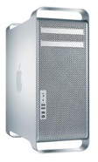
Data Flow
Unity3D runs Master game server; able to host multiple authoritative games
Clients run a local binary to connect and authenticate to Master game server over LAN to hosted game on authoritative server
Connect to Server over LAN
Unity3D/Master Server
Notes:
13
Show how the data flows from the data gathering stage to the Unity3D master server and distributes content over the network to connected clients. The master server is the single point of data distribution.
1 Utilize emerging technology to drive the game big data/big table

Slide 14
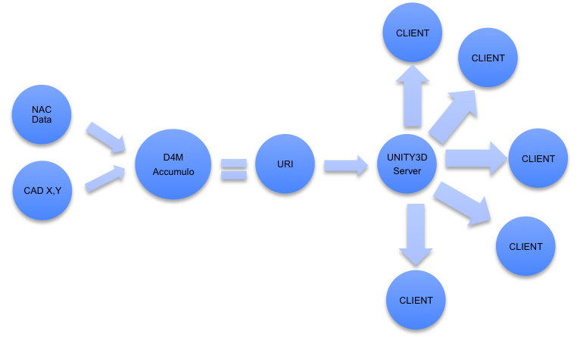
Data Flow
External data is collected and ingested into Accumulo via D4M
Data is processed and enriched to generate URI
URI is read by Master Server updating the environment for all clients
Notes:
14
Show the data flow from a more granular level, identify different data sources and how they are refined and distributed throughout the data pipeline.
D4M associations generate the Uniform Resource Identifier

Slide 15
Outline
Introduction
Approach
Results
Summary
Notes:
Outline slide

Slide 16
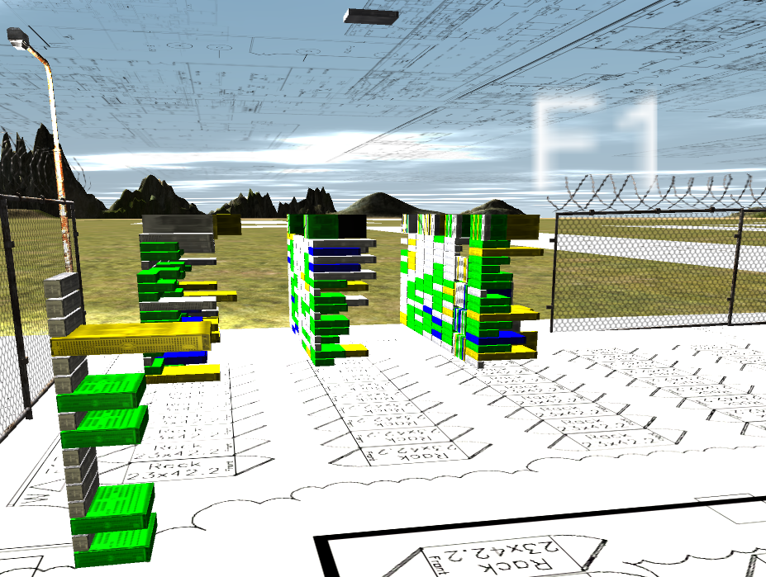
TX2500 Cluster View
View status of 600+ nodes in a single frame
Able to see machines as they exist
Visualize the equivalent of 5 vendor status pages
Notes:
LLGrid’s first implementation of using Unity3D to visualize the SA of our production compute cluster.
Eat our own dog food
Similar challenges to obtaining SA on a large network –
Network
Scheduler
Storage
Node Image
General Node health
Orientation is familiar to Sys Admins

Slide 17
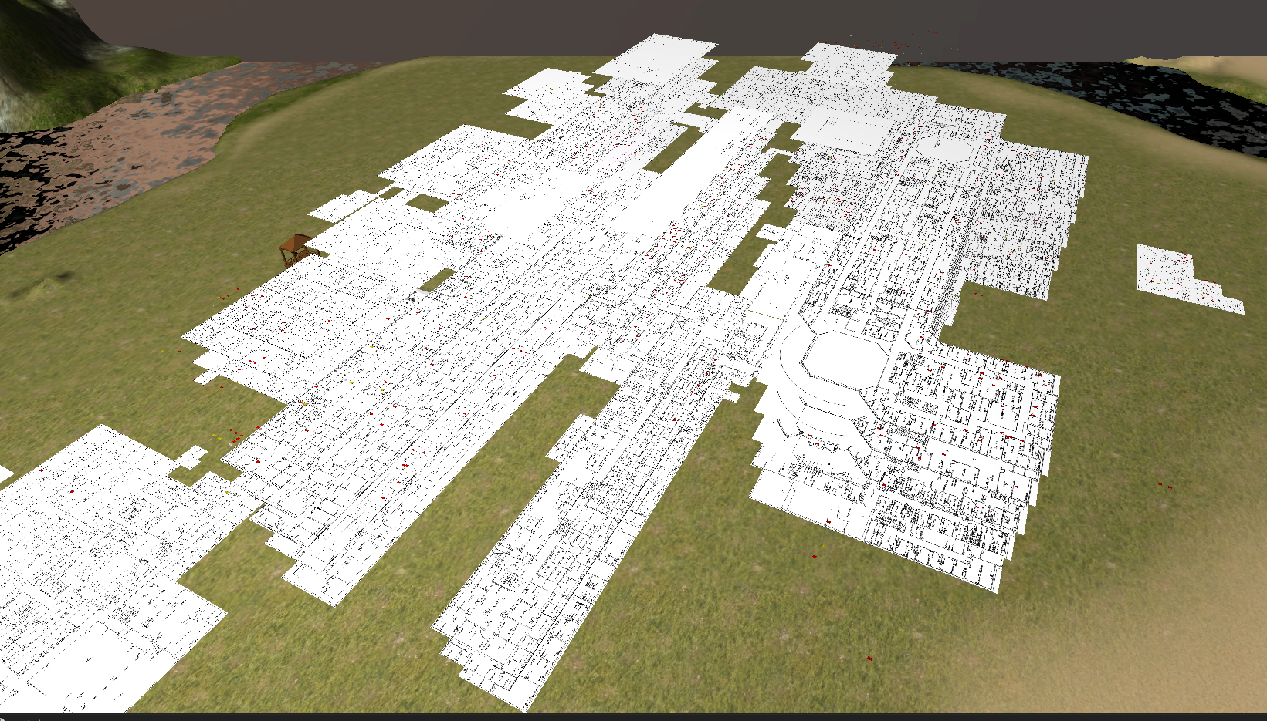
Network Situational Awareness
Virtualized the Lincoln physical plant
Created a world familiar to an analyst
All current network assets are geo-located
Notes:
Overall birds eye view of Lincoln facility virtualized in a 3D environment.
Scale is accurate to building locations and their relative location
Geolocate assets against the floor plan

Slide 18
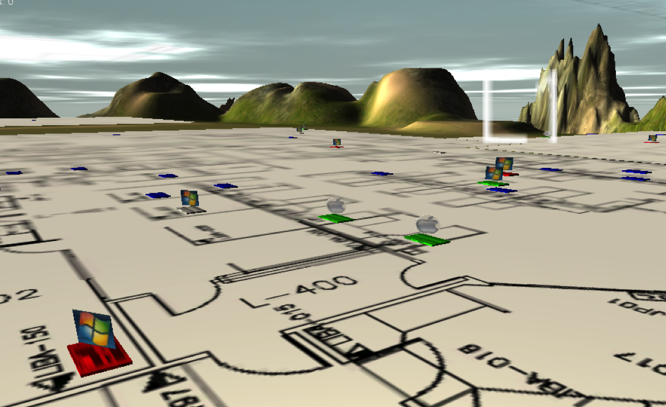
Network Situational Awareness
A single view provides immediate insight to network activity
Quickly assess actionable information
Patrol mode
Notes:
A standard view when walking down a virtual hallway showing machines on the network their compliance status, OS, physical location, and current network activity.
What do we see?

Slide 19
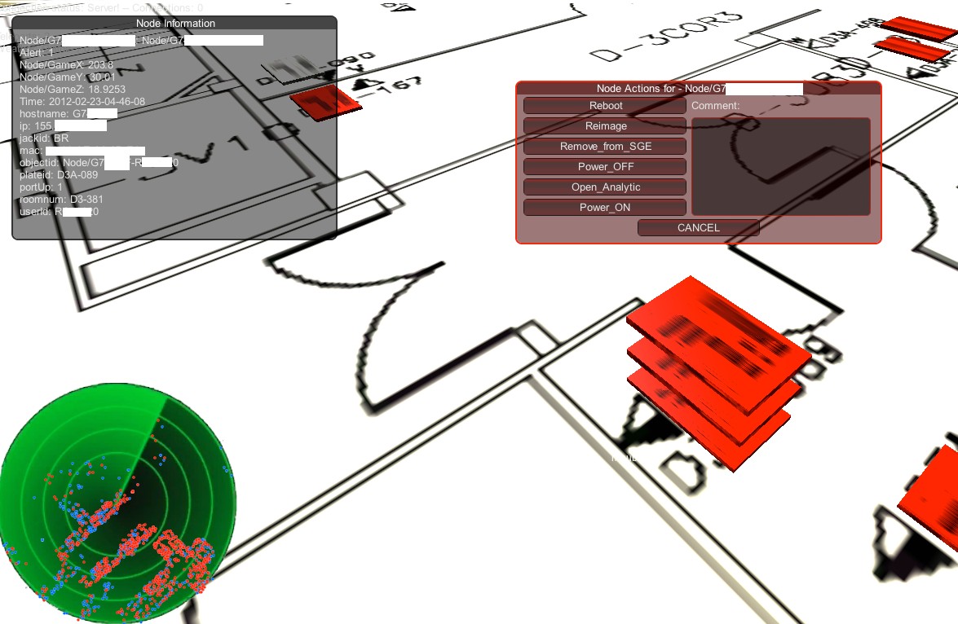
Network Situational Awareness
Collision detection easily identifies hubs, switches, VM’s
Radar plots network assets not in player view
Mouseover to show assets detail
Mouseup events provide potential actions
Notes:
An analyst’s view when interacting with an asset of interest (AOI). Collecting information or possibly performing an action against the AOI.
Collision detection easily identifies hubs, switches, VM’s
Radar plots network assets not in player view
Mouseover to show assets detail
Mouseup events provide potential actions
In game actions generate real world results

Slide 20
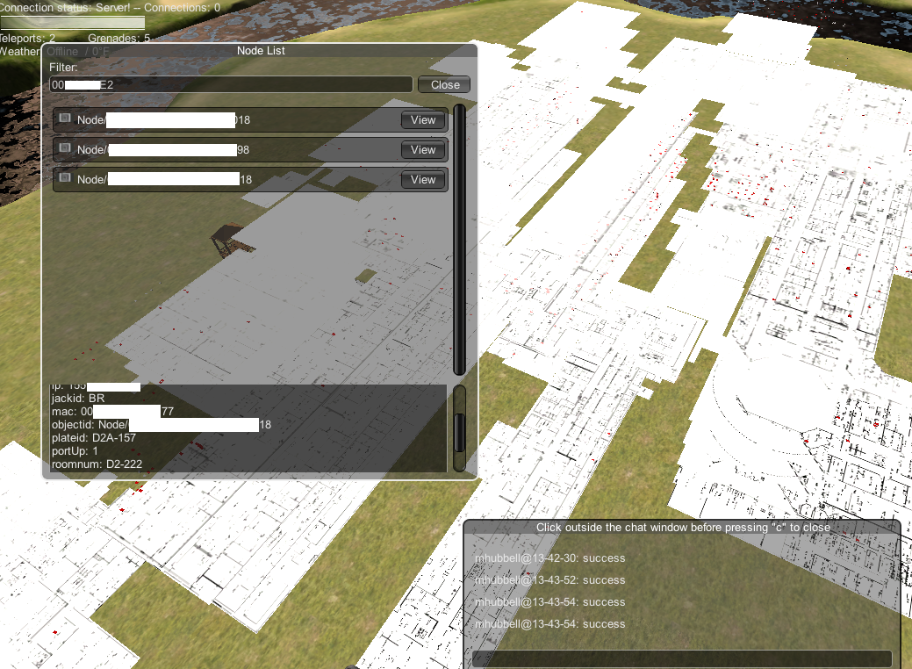
Network Situational Awareness
Filter window for targeted approach
Chat/Command window for in game communication and game actions
Notes:
Showing the targeted approach from an analyst’s perspective when looking for specific assets as well as the in-game communication and command window.
In game communication
Terminal
Locations
Teleport to assets

Slide 21
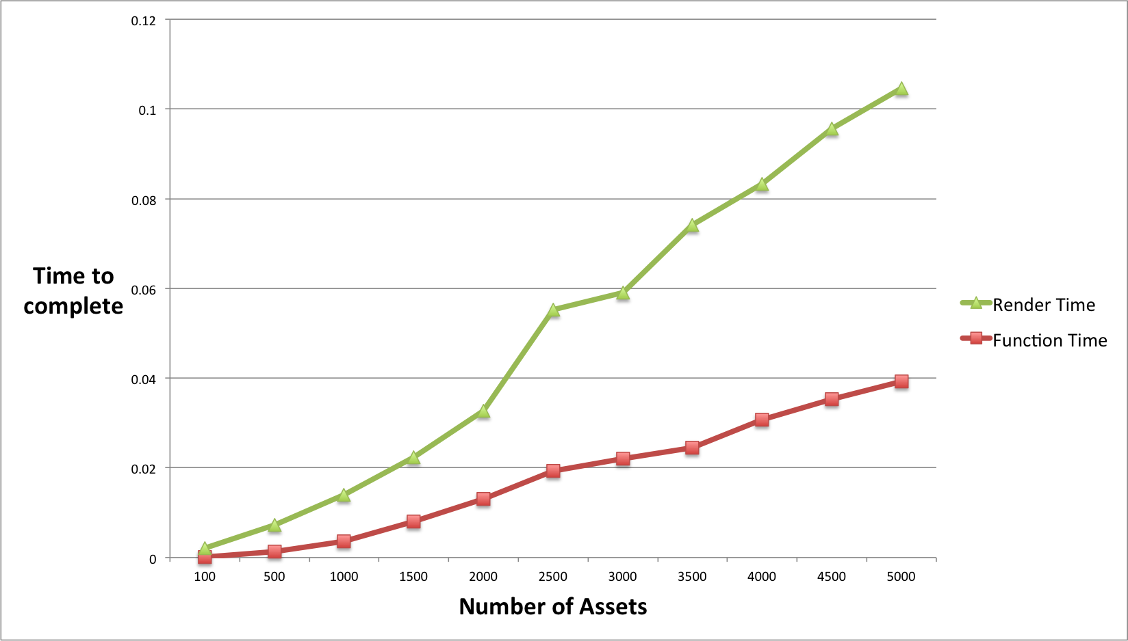
Scaling Results
Notes:
Game performance results as the network assets being rendered increase as a proportion of total update time.
As we would expect as the number of assets in the game increased the time to render the assets in the 3D world scaled linearly
Represented only a fraction of the total time to complete a full network update.

Slide 22
Future Development
Performance and scalability Improvement
Occlusion layers
Leveling
Spatial recognition
Asset management
Resource allocation
Incorporate more data from network collectors
Experiment with different visual cues
Wireless Devices
VPN devices
Mobile platforms
Leverage GPS in devices merged with CAD data
Notes:
Identify areas for research within the Unity3D environment to improve upon and expand the visual capabilities.

Slide 23
Summary
Goal
Achieve network situational awareness
Overcome vendor determined views and traditional web interface
Approach
Utilize proven 3D Gaming platform
Leverage big data / big table / 3D gaming technologies
Results
Dynamic visually appealing virtual environment
Visualize thousands of network assets in a single interface
Actionable capability to interact and respond to game events
Future Work
Performance enhancements
Data enrichment
Mobile platform
Notes:
Summary

