Slide 1
Benchmarking Parallel Eigen Decomposition for Residuals Analysis of Very Large Graphs
Edward Rutledge, Benjamin Miller, Michelle Beard
HPEC 2012
September 10-12, 2012
This work is sponsored by the Intelligence Advanced Research Projects Activity (IARPA) under Air Force Contract FA8721-05-C-0002. The U.S. Government is authorized to reproduce and distribute reprints for Governmental purposes notwithstanding any copyright annotation thereon.
Disclaimer: The views and conclusions contained herein are those of the author and should not be interpreted as necessarily representing the official policies or endorsements, either expressed or implied, of IARPA or the U.S. Government.
Notes:
Title

Slide 2
Outline
Introduction
Algorithm description
Implementation
Benchmarks
Summary
Notes:
Outline

Slide 3

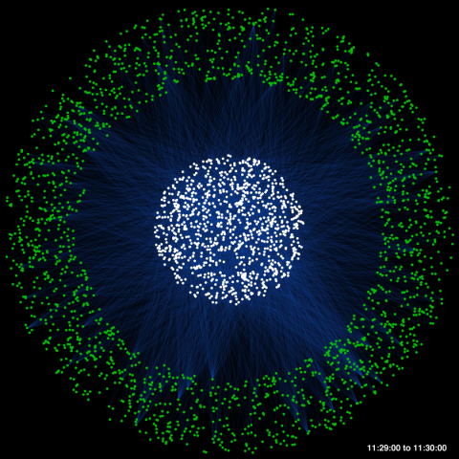

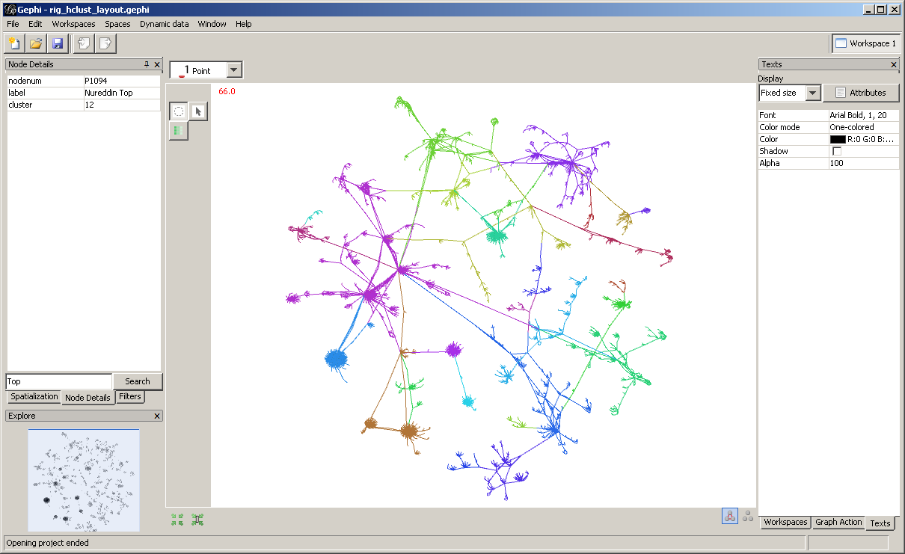
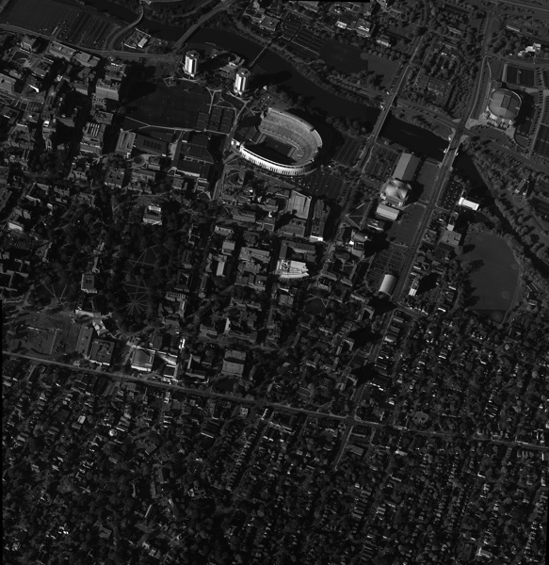

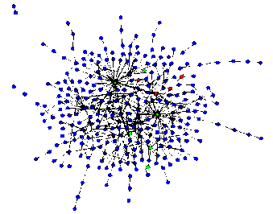
Application of Very Large Graph Analysis
ISR
Social
Cyber
Graphs represent entities and relationships detected through multi-INT sources
1,000s – 1,000,000s tracks and locations
GOAL: Identify anomalous patterns of life
Graphs represent relationships between individuals or documents
10,000s – 10,000,000s individual and interactions
GOAL: Identify hidden social networks
Graphs represent communication patterns of computers on a network
1,000,000s – 1,000,000,000s network events
GOAL: Detect cyber attacks or malicious software
Cross-Mission Challenge:
Detection of subtle patterns in massive multi-source noisy datasets
Notes:
Graphs analysis has proven to be useful in a number of different application areas. This reason for this is likely due to graph analytics proclivity for being able to identify patterns of coordination. The application of graph analytics grows harder as the patterns of coordination grow more subtle and the background graph grows larger and noisier.

Slide 4
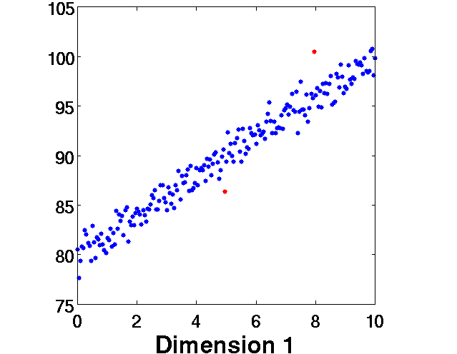
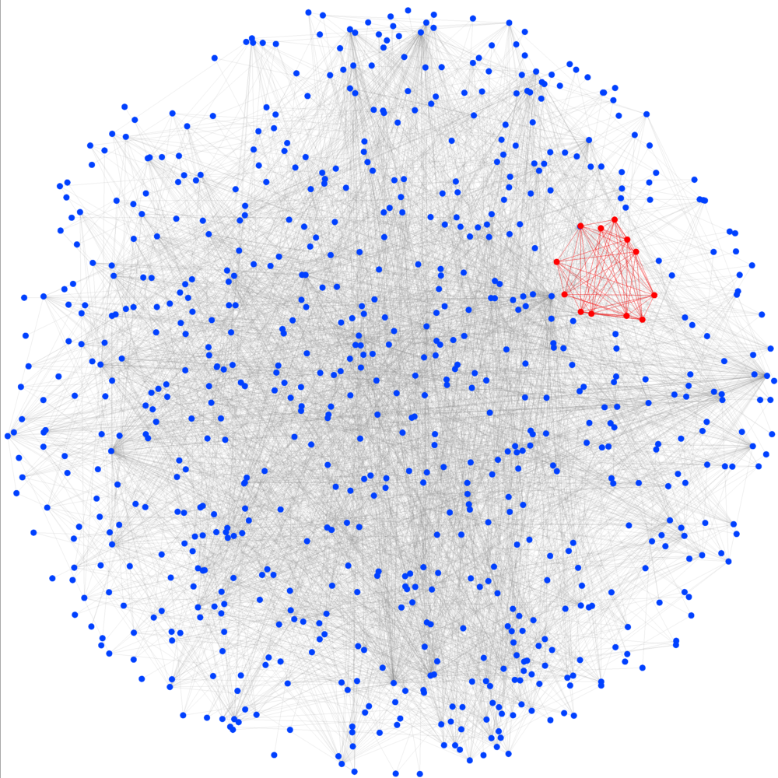
Approach: Analysis of Graph Residuals
Linear Regression
Graph Regression
Notes:
Our approach to graph analysis is to analyze graph residuals. This can be thought of as an extension of linear regression to the graph domain. In linear regression, we model expected results as a line and identify points that are far from that line. In graph regression, we model an expected graph structure and identify sub-graphs that deviate significantly from that structure.

Slide 5
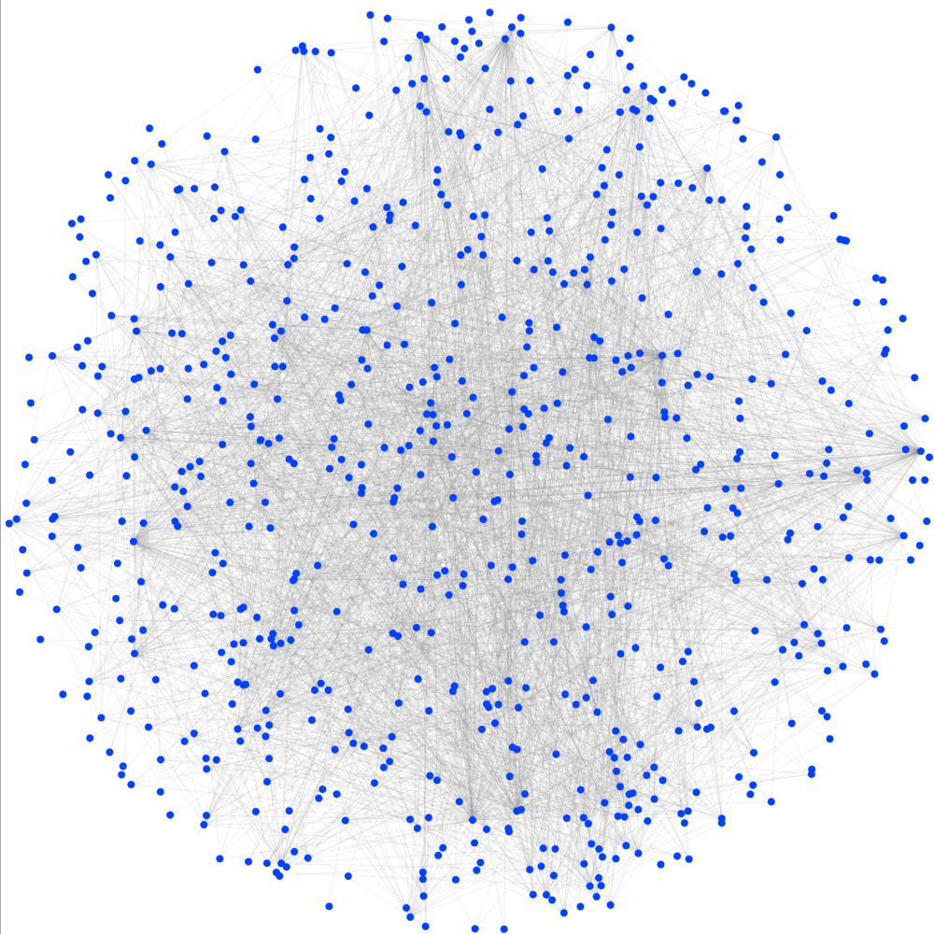
Processing Chain
DIMENSIONALITY REDUCTION
Graph Model Construction
Residual Decomposition
Component Selection
Anomaly Detection
Identification
Input
Output
Graph
No cue
Statistically anomalous subgraph(s)
Notes:
The graph processing chain is uncued. The goal of the processing chain is to determine if an input dynamic graph has any subgraphs that are statistically anomalous. If the dynamic graph has anomalous subgraphs then the processing chain will identify what subgraphs of the graph are anomalous.

Slide 6
Focus: Dimensionality Reduction
DIMENSIONALITY REDUCTION
Graph Model Construction
Residual Decomposition
Component Selection
Anomaly Detection
Identification
Computational driver for graph analysis method
Dominant kernel is eigen decomposition
Parallel implementation required for large problems
Benchmark parallel eigen decomposition for dimensionality reduction of graph residuals
Notes:
In order to run detection processes on the residual matrix formed during Graph Model Construction, we look to reduce the dimensions of the data. This is done by decomposing the residual matrix through eigen- or singular vector decomposition. Typically we reduce the n-dimensional residual matrix to 2-dimensions. This is done by selecting the 2-decomposition vectors that point towards the strongest residual. This step, and in particular the eigen-decomposition, is the computational driver for the algorithm. In this talk, we present benchmarking results for parallel eigen-decomposition.

Slide 7
Outline
Introduction
Algorithm description
Implementation
Benchmarks
Summary
Notes:
Outline

Slide 8
Directed Graph Basics
1
2
3
4
5
6
7
8
1
2
1
0
1
0
0
0
0
1
1
2
1
0
0
0
0
0
0
0
7
8
3
0
1
0
0
0
0
0
0
4
0
0
1
0
0
0
0
0
3
5
0
0
0
1
0
0
1
1
6
0
0
0
0
1
0
0
1
4
7
0
0
0
0
0
1
0
1
6
5
8
0
1
1
0
0
0
0
0
Graph G
Adjacency Matrix A
G = (V, E)
V = vertices (entities)
E = edges (relationships)
A(i,j) ≠ 0 if
Edge exists from
vertex i to vertex j
Notes:
A graph consists of two sets: a set of vertices V, and a set of edges E connecting those vertices. In a directed graph, an edge is uni-directional. I.e., the presence of an edge from vertex i to vertex j does not imply an edge from j to i. A graph can be represented by an adjacency matrix A. A is an NxN matrix, where N is the number of vertices. If A(i,j) is non-zero, then there is an edge from vertex i to vertix j. For unweighted graphs, non-zero entries of A are equal to one.

Slide 9
Modularity for Directed Graphs*
DIMENSIONALITY REDUCTION
Graph Model Construction
Residual Decomposition
Component Selection
Anomaly Detection
Identification
ADJACENCY MATRIX (A)
OUT-DEGREE
VECTOR (k_{out})
1
2
3
4
5
6
7
IN-DEGREE VECTOR (k_{in})
EXAMPLE:
GRAPH G
1
2
*
1
1
3
2
2
2
1
1
2
2
2
3
1
1
4
5
4
–
2
7
5
12
1
3
6
6
NUMBER OF EDGES (|E|)
1
7
3
Our baseline residuals model for directed graphs
*E.A. Leicht and M.E.J. Newman, “Community Structure in Directed Networks,” Phys. Rev. Lett., vol. 100, no. 11, pp. 118703-(1-4), Mar 2008.
Notes:
9
In this talk, we consider the symmetrized modularity matrix for directed graphs as described in the reference shown at the bottom of the slide. In this model, the likelihood of an edge from vertex i to vertex j is a function of the out-degree of vertex i, the in-degree of vertex j, and the number of edges in the graph. The modularity matrix B is the difference between the observed edges (A) and the edge likelihoods. The modularity matrix is symmetrized to simplify eigenvalue/eigenvector computation, and to produce real eigenvalues.

Slide 10
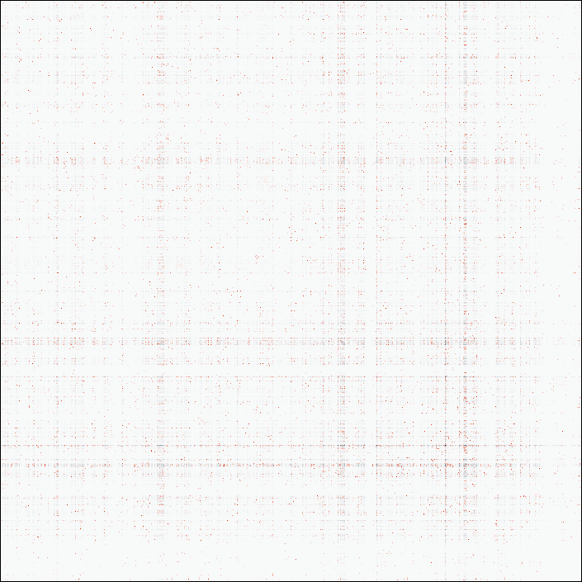
Dimensionality Reduction
DIMENSIONALITY REDUCTION
Graph Model Construction
Residual Decomposition
Component Selection
Anomaly Detection
Identification
λ₁
λ₂
=
λ_{N}
Select vectors pointing towards the strongest residuals
Notes:
In order to run detection processes on the residual matrix, the processing chain looks to reduce the dimensions of the data. This is done by decomposing the residual matrix through eigen- or singular vector decomposition. In this presentation, we consider eigen decomposition. Typically we reduce the n-dimensional residual matrix to 2-dimensions. This is done by selecting the 2-decomposition vectors that point towards the strongest residual.

Slide 11
Computational Scaling
Matrix-vector multiplication is at the heart of eigensolver algorithms
dense matrix-vector
product: O(|V|²)
dot product: O(|V|)
scalar-vector product: O(|V|)
sparse matrix-vector
product: O(|E|)
Bx can be computed without storing B (modularity matrix)
Notes:
11
Practically all efficient methods for performing eigen decomposition access the matrix being decomposed only through matrix-vector multiplication. The structure of the dense modularity matrix B is such that it does not need to be stored in order to implement the matrix-vector product Bx. Only the sparse adjacency matrix, the degree vectors, and the edge count need to be stored. The matrix-vector product can be implemented as 2 sparse matrix-vector products, 2 vector dot products, 3 scalar-vector multiplications, and 3 vector additions.

Slide 12
Outline
Introduction
Algorithm description
Implementation
Benchmarks
Summary
Notes:
Outline

Slide 13
SLEPc Overview
Application
SLEPc
(Scalable Library for Eigen Problem Computations)
PETSc
(Portable, Extensible Toolkit for Scientific Computation)
MPI
(Message Passing Interface)
LAPACK
(Linear Algebra Package)
BLAS
(Basic Linear Algebra Subprograms)
  SLEPc: Scalable Library for Eigen Problem Computations. http://www.grycap.upv.es/slepc/
  PETSc: Portable, Extensible Toolkit for Scientific Computation. http://www.mcs.anl.gov/petsc/
MPI: Message Passing Interface. http://www.mcs.anl.gov/research/projects/mpi/
LAPACK: Linear Algebra Package. http://www.netlib.org/lapack/
BLAS: Basic Linear Algebra Subprograms. http://www.netlib.org/blas/
“matrix shell”
Free parallel eigen solver ‘C’ library based on widely available software
Notes:
SLEPc (the Scalable Library for Eigen Problem Computations) is a ‘C’ library layered on top of PETSc (the Portable, Extensible Toolkit for Scientific Computation). It provides eigensolver and SVD solvers, among other capabilities. Since SLEPc is layered on top of PETSc, it is capable of operating on distributed matrices and vectors, and can make use of the distributed computations implemented in PETSc. In turn, PETSc is layered on top of the MPI (Message Passing Interface) library standard for inter-processor communication, and the LAPACK and BLAS numerical computation libraries. All of these libraries are freely available and can be easily installed on clusters such as our LLGrid cluster. The SLEPc and PETSc capabilities directly used by our benchmarking application are circled in red. More details on how we use these capabilities are contained in the next slide.

Slide 14
Implementing Eigen Decomposition of the Modularity Matrix using SLEPc
SLEPc Eigensolver
Krylov-Schur
Eigensolver
Application
SLEPc
(Scalable Library for Eigen Problem Computations)
Operates on
PETSc “matrix shell”
Modularity Matrix
PETSc
(Portable, Extensible Toolkit for Scientific Computation)
PETSc sparse matrix
User-defined operation
Adjacency
matrix
Matrix-vector multiplication
PETSc “matrix shell” enables efficient modularity matrix implementation
Used default PETSc/SLEPc build parameters and solver options
  Compressed Sparse Row (CSR) matrix data structure
  Double precision (8 byte) values for matrix and vector entries
  Krylov-Schur eigensolver algorithm
Limitation: current implementation will not scale past 2³² vertices
  Uses 32 bit integers to represent vertices
  Only tested up to 2³⁰ vertices
PETSc vector
PETSc vector
In-degree
vector
Out-degree vector
Key:
= operation
= data object
italics
= type
SLEPc/PETSc supports efficient implementation of modularity matrix eigen decomposition
Notes:
This slide shows how our benchmarking application uses SLEPc and PETSc objects and operations. We use the Krylov-Schur eigensolver from SLEPc, operating on a modularity matrix type that we implemented using the PETSc “matrix shell” construct. This construct allows a programmer to define a matrix with custom storage and operations. Internal to the modularity matrix, we store the adjacency matrix as a PETSc sparse matrix that uses the Compressed Sparse Row (CSR) format. The in- and out-degree vectors are represented by standard PETSc vectors. We also defined a matrix-vector multiplication operation that implements efficient multiplication of a vector by a modularity matrix (Bx), as described earlier. A limitation of our current implementation is that it will not scale past about 4 billion vertices, since it uses a 32 bit integer to represent a vertex label. Note that our application can be distributed by building the adjacency matrix and degree vectors with a distributed mapping.

Slide 15
PETSc y = Bx Parallel Mapping
4 Processor Example
y
=
B
x
Processor 1
Processor 2
Processor 3
Processor 4
= local part of data object
= buffer for non-local part of data object
Each processor begins receiving non-local parts of x it needs.
Each processor computes partial results from its local part of x and B, and stores in y.
Each processor finishes receiving non-local parts of x it needs.
Each processor computes partial results from non-local part of x and B, and
adds to partial result in y.
Notes:
This slide shows how PETSc distributed sparse matrix-vector multiplication is implemented to overlap communication and computation. The sparse matrix-vector multiplication dominates the execution time for directed modularity matrix eigen decomposition. In this example mapping, the rows of the matrix (B) are block distributed by row, and both the vector being multiplied (x) and the result vector (y) have the same block distribution. In the first step of the computation, each processor begins receiving the non-local parts of x into a local buffer (and sending the local part of x to the other processors), as shown by the red arrows.

Slide 16
PETSc y = Bx Parallel Mapping
4 Processor Example
y
=
B
x
Processor 1
Processor 2
Processor 3
Processor 4
= local part of data object
= buffer for non-local part of data object
Each processor begins receiving non-local parts of x it needs.
Each processor computes partial results from its local part of x and B, and stores in y.
Each processor finishes receiving non-local parts of x it needs.
Each processor computes partial results from non-local part of x and B, and
adds to partial result in y.
Notes:
In the second step, while the data movement initiated in the first step is still underway, each processor computes partial results from the local parts of x and B, and stores them in the local part of y. The parts of the data objects involved in this computation are highlighted in red.

Slide 17
PETSc y = Bx Parallel Mapping
4 Processor Example
y
=
B
x
Processor 1
Processor 2
Processor 3
Processor 4
= local part of data object
= buffer for non-local part of data object
Each processor begins receiving non-local parts of x it needs.
Each processor computes partial results from its local part of x and B, and stores in y.
Each processor finishes receiving non-local parts of x it needs.
Each processor computes partial results from non-local part of x and B, and
adds to partial result in y.
Notes:
Next, each processor waits to receive the non-local parts of x.

Slide 18
PETSc y = Bx Parallel Mapping
4 Processor Example
y
=
B
x
Processor 1
Processor 2
Processor 3
Processor 4
= local part of data object
= buffer for non-local part of data object
Each processor begins receiving non-local parts of x it needs.
Each processor computes partial results from its local part of x and B, and stores in y.
Each processor finishes receiving non-local parts of x it needs.
Each processor computes partial results from non-local part of x and B, and
adds to partial result in y.
Notes:
When the non-local parts of x are received, each processor computes partial results from the non-local parts of x and the local part of B, and add these partial results to the local part of y. Again, the parts of the data objects involved in this computation are highlighted in red.

Slide 19
Outline
Introduction
Algorithm description
Implementation
Benchmarks
Summary

Slide 20
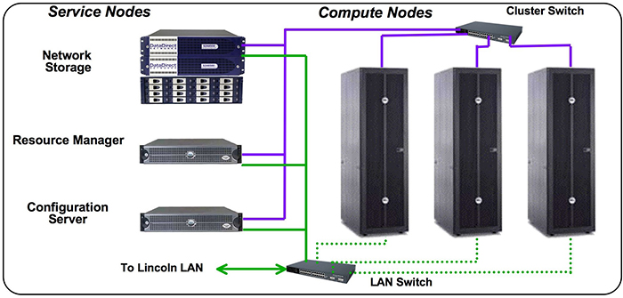
Overview of Experiments
Parameter Space
Hardware: LLGrid
1B
# Graph
Vertices
512M
256M
128M
64M
32M
16M
8M
4M
# Processors
2M
1M
1
1
2
4
8
16
32
64
Limited to 64 nodes per job
Per node:
  2x 3.2 GHz Intel Xeon processors
  8GB RAM
Gigabit Ethernet network
10
100
# Computed
Eigenvectors
Data Sets
Generated with parallel R-MAT generator
  Single process R-MAT runs out of memory for larger data sets
  Parameters:
    Average in- (out-) degree = ~8 (does not iterate if there is a collision)
    Probabilities = 0.5, 0.125, 0.125, 0.25
    Randomizes vertices to make load balancing easier
Notes:
For each experiment, we computed the eigen decomposition of a directed graph modularity matrix of a randomly generated graph. The graphs were generated using the R-MAT algorithm. Each graph was constructed with an average in (and out) degree of 8 (although the actual average degree was slightly less since our R-MAT implementation did not iterate upon a collision). The R-MAT probabilities were .5 for the upper left quadrant, .125 for the upper right and lower left quadrants, and .25 for the lower right quadrant. We randomly permuted vertices of the R-MAT adjacency matrix so that block distributing it would result in good load balancing. We constructed graphs with 2²⁰ and 2³⁰ vertices, and each power of two between. For each of these graphs, we computed 1, 10, and 100 eigenvalues and eigenvectors. For each graph size and number of eigenvectors, we distributed the computation across 1 compute node, 64 compute node, and every power of 2 between. Each compute node contained 2 3.2 GHz Intel Xeon processors and 8 GB of RAM, although we only used one processor per node in these experiments.

Slide 21
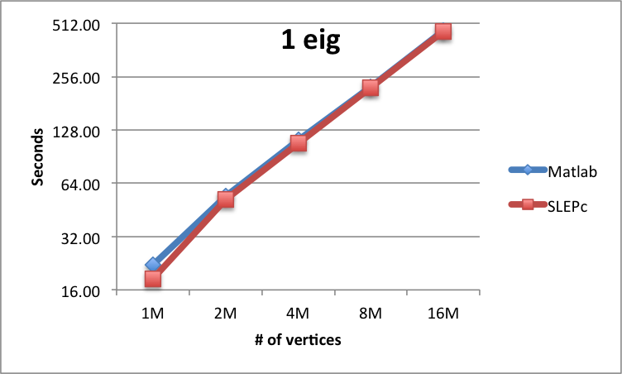
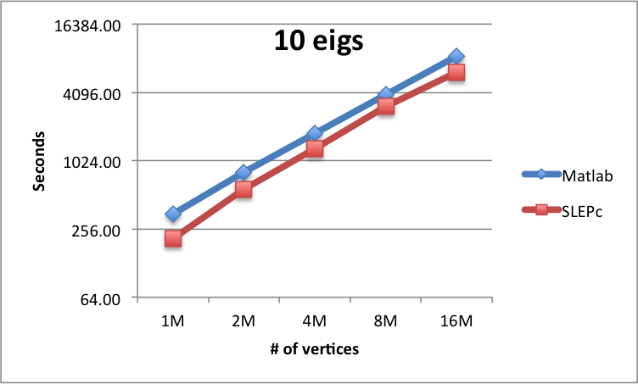
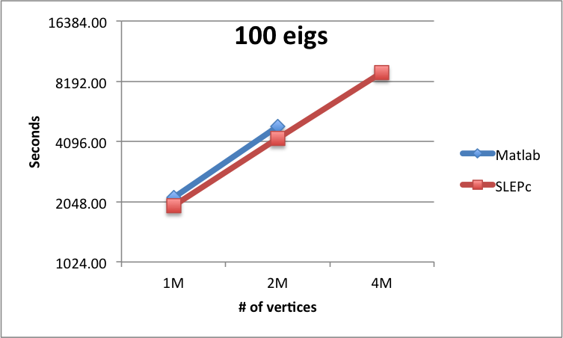
Results
SLEPc vs. MATLAB Average Execution Time
Iterations of the method
Iterations of the method
(2)
(23)
(2)
(25)
(2)
(21)
(20)
(2)
(19)
(2)
Iterations of the method
(7)
Single-processor SLEPc and Matlab have similar performance
Problem size limited by node memory
(7)
(6)
Note: on workstation with 96GB memory,
Matlab implementation was 2-3x faster for
100 eigenvector computation than on LL Grid
Notes:
We compared SLEPc to Matlab on a single compute node to ensure that the SLEPc implementation was not substantially slower on a single compute node. We found that MATLAB and SLEPc perform similarly; SLEPc has slightly better performance for some problem sizes. The plots above show the average execution time of the Matlab and SLEPc implementations for computing 1, 10, and 100 eigenvalues/eigenvectors of various size matrices. The number of iterations of the krylov-schur method for each experiment is shown beneath the data points. (This is for the SLEPc implementation; the number of iterations for the Matlab implementation is not known). Both the horizontal and vertical axes are log(2) scale.

Slide 22
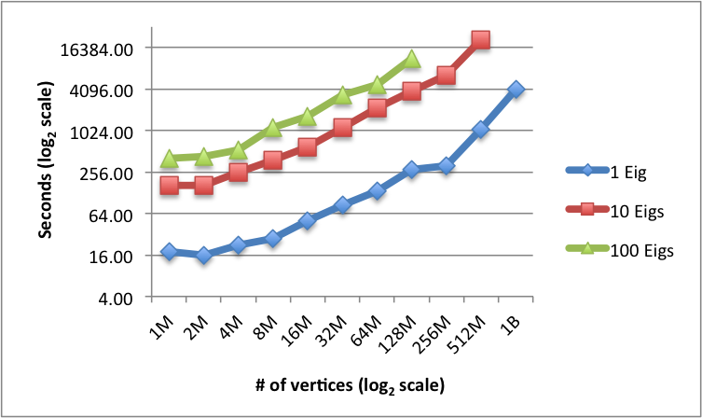
Results
SLEPc 64 Node Average Execution Time
(8)
~3 trillion ops,
~0.1% efficiency
(7)
(37)
10 leading eigenvalues
(64M vertex data set):
(7)
(7)
(7)
(36)
(29)
(2)
(6)
(7)
(7)
(34)
(29)
(2)
(25)
(21)
(26)
(2)
(2)
(19)
(19)
(2)
(2)
Iterations of the method
(2)
(2)
(2)
(2)
(2)
Able to compute 2 eigenvectors for 1 billion node graph (in ~9 hrs)
Problem size limited by memory
Larger problems could be solved with >64 compute nodes
Notes:
We were able to scale to fairly large problem sizes when using 64 compute nodes. This plot shows average execution time of the SLEPc implementation, distributed across 64 nodes, for each of the data sizes and number of eigenvalues/eigenvectors we computed (except for 2 eigenvalues/eigenvectors at 1 billion nodes, the largest problem we were able to solve, which took about 9 hours). Both the horizontal and vertical axes are log(2) scale. Note that there is a significant increase in execution time going from 1 to 10 eigenvalues, but less of an increase when going from 10 to 100 eigenvalues. The reason for the significant increase when going from 1 to 10 eigenvalues is that the first 2 eigenvalues are widely separated compared to the next 9, requiring more iterations of the method. Fewer iterations of the method are required when computing 100 eigenvalues, probably because the number of iterations is proportional to the number of matrix-vector multiplies required, which scales with the number of eigenvalues times the matrix size (number of vertices). Also note that, as expected, the execution time scales fairly linearly with the number of vertices for much of the parameter space. The exceptions are the small and large data sizes. For the small data sizes, per-message communication cost probably dominates, so increasing the data size (and computation burden) does not proportionally increase overall execution time. More investigation is required to determine why execution time scales greater than linearly for large data sizes.

Slide 23
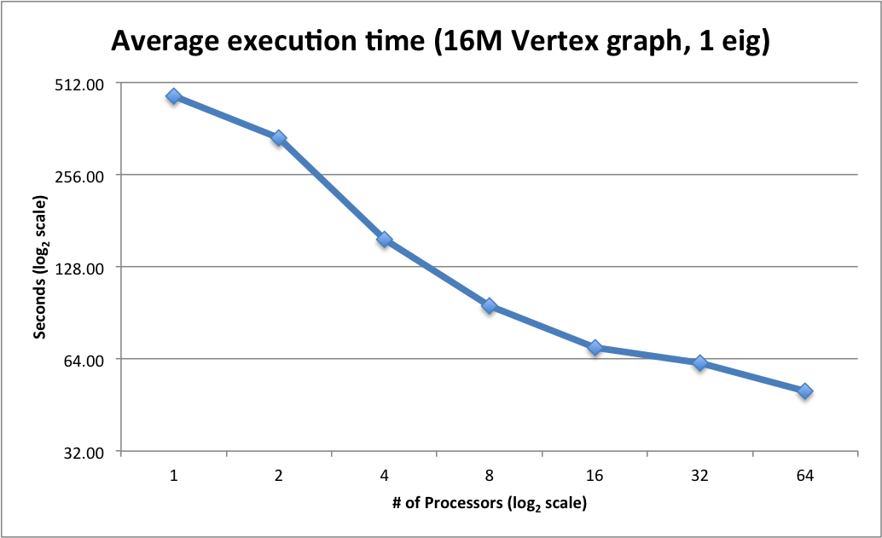
Results
Effect of Processor Count on Execution Time
(2)
(2)
(2)
Iterations of the method
(2)
(2)
(2)
(2)
Additional processing resources decrease processing time
Speedup nearly linear for a few nodes, decreases with increasing node count
Notes:
This plot shows execution time as a function of number of processors for computing the first eigenvalue/eigenvector of a 16 million vertex directed graph modularity matrix. Both the horizontal and vertical axes are log(2) scale. For small numbers of processors, near linear speedup is achieved when adding more processors. For larger numbers of processors, speedup is much less than linear. This is because the communication overhead begins to dominate the overall execution time as more processors are added. For the smallest data sizes, we observed an increase in execution time when running on a large number of processors.

Slide 24
Outline
Introduction
Algorithm description
Implementation
Benchmarks
Summary
Notes:
Outline

Slide 25
Summary
Reviewed problem of computing eigen decomposition for directed graph modularity matrix
Benchmarked directed graph modularity matrix eigen decomposition using SLEPc
  Performance similar to Matlab on single node
  Performance scales reasonably well as compute nodes are added
Able to solve large problems on commodity cluster hardware:
  1.1 hours for 1 eigenvalue of billion vertex graph
  9 hours for 2 eigenvalues of billion vertex graph
  5.8 hours for 10 eigenvalues of 512 million vertex graph
  3.2 hours for 100 eigenvalues of 128 million vertex graph
Graph analysis based on modularity matrix eigen decomposition is feasible for graphs with billions of nodes and edges
Notes:
Summary: we reviewed eigen decomposition for the directed graph modularity matrix, benchmarked this computation using the SLEPc library on LLGrid, and demonstrated that we are able to solve very large problems in reasonable timeframes.

Slide 26
Potential Future Work
Optimize implementation
  Use SLEPc/PETSc parameters better suited to our application
    Example: storing values in single precision instead of double precision will roughly halve memory use
  Further specialize data structures for our application
    Example: eliminate storage of non-zero adjacency matrix entries
Run with greater than 64 nodes to process larger problems
Modify implementation to remove 4 billion vertex limitation
Experiment with other eigensolvers (specifically, ANASAZI)
Apply these methods to other graph problems
  E.g., finding eigenvectors with smallest magnitude in graph Laplacian
Notes:
In the future, we can extend our work by further optimizing our implementation using SLEPc/PETSc parameters better suited to our application, and creating specialized data structures for our application. We can also scale to larger problems by running on more than 64 compute nodes, and by using 64 bit integers to represent vertex IDs, thus removing our current implementation’s 4 billion vertex limitation. We may also experiment with other eigensolvers, e.g. ANASAZI, and apply our methods to other graph problems.

Slide 27
Backup
Notes:
The rest of the slides are backup material

Slide 28
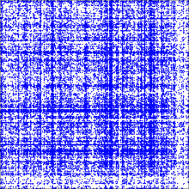
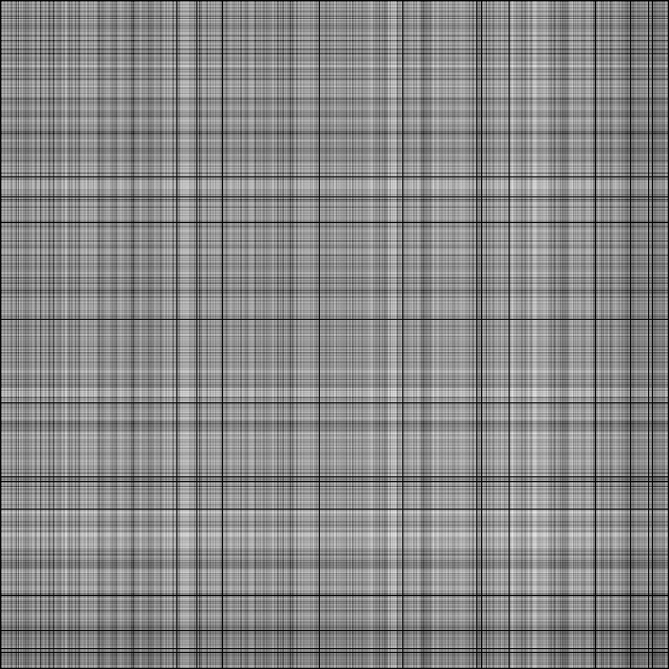
Graph Model Construction
DIMENSIONALITY REDUCTION
Graph Model Construction
Residual Decomposition
Component Selection
Anomaly Detection
Identification
A
E(A)
R(A)
-
=
Observed
Expected
Residuals
Notes:
The first stage of the processing chain constructs a model of the adjacency matrix. There are many different types of graph models, but typical models used are rank-1 approximations of the adjacency matrix. The residual matrix is calculated as the difference between the observed data and graph model.

Slide 29
Readily Available Free Parallel Eigensolvers*
Name | Description | Distributed Memory? | Latest Release | Language
ANASAZI | Block Krylov-Schur, block Davidson, LOBPCG | yes | 2012 | C++
BLOPEX | LOBPCG | yes | 2011 | C/Matlab
BLZPACK | Block Lanczos | yes | 2000 | F77
MPB | Conjugate Gradient, Davidson | yes | 2003 | C
PDACG | Deflation-accelerated Conjugate Gradient | yes | 2000 | F77
PRIMME | Block Davidson, JDQMR, JDQR, LOBPCG | yes | 2006 | C/F77
PROPACK | SVD via Lanczos | no | 2005 | F77/Matlab
SLEPc | Krylov-Schur, Arnoldi, Lanczos, RQI, Subspace | yes | 2012 | C/F77
TRLAN | Lanczos (dynamic thick-restart) | yes | 2010 | F90
* V. Hernandez, J. E. Roman, A. Tomas, V. Vidal (2009). A Survey of Software for Sparse Eigenvalue Problems.
SLEPc Technical Report STR-6, Universidad Politecnica de Valencia.
Both SLEPc and ANASAZI are actively supported and either should meet our needs
Notes:
There are a number of freely available eigensolver software packages. A partial list is shown above. The table includes those packages listed in the survey referenced above that support parallelism. A parallel eigensolver can solve problems more quickly than a non-parallel eigensolver, and an eigensolver with a distributed memory programming model can solve larger problems. The ANASAZI and SLEPc packages are both actively supported, with releases in 2012, and either should meet our needs. In this presentation, we focus on SLEPc. However, we may also experiment with ANASAZI (and other packages listed here) in future work.

