Slide 1
Driving Big Data With Big Compute
Chansup Byun, William Arcand, David Bestor, Bill Bergeron, Matthew Hubbell, Jeremy Kepner, Andrew McCabe, Peter Michaleas, Julie Mullen, David O’Gwynn, Andrew Prout, Albert Reuther, Antonio Rosa, Charles Yee
2012 IEEE High Performance Extreme Computing Conference
10 - 12 September 2012
This work is sponsored by the Department of the Air Force under Air Force contract FA8721-05-C-0002. Opinions, interpretations, conclusions and recommendations are those of the author and are not necessarily endorsed by the United States Government.
Notes:
Title slide

Slide 2
Outline
Introduction
LLGrid MapReduce
Dynamic Distributed Dimensional Data Model (D4M)
Demonstration
Data Ingestion Performance
Database Query Performance
Summary
Notes:
Outline agenda for the talk

Slide 3
The Big Four Cloud Ecosystems
Enterprise
Supercomputing
IaaS
- Interactive
- On-demand
- Elastic
PaaS
- High performance
- Parallel Languages
- Scientific computing
PaaS
- Java
- Map/Reduce
- Easy admin
SaaS
- Indexing
- Search
- Security
Big Data
DBMS
Each ecosystem is at the center of a multi-$B market
Pros/cons of each are numerous; diverging hardware/software
Some missions can exist wholly in one ecosystem; some can’t
IaaS: Infrastructure as Service
PaaS: Platform as a Service
SaaS: Software as a Service
Notes:
Currently there are four ecosystems that dominates large scale computing applications. They have their own pros and cons.

Slide 4
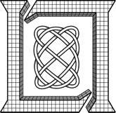
The Big Four Cloud Ecosystems
Enterprise
LLGrid
Supercomputing
IaaS
- Interactive
- On-demand
- Elastic
PaaS
- High performance
- Parallel Languages
- Scientific computing
PaaS
- Java
- Map/Reduce
- Easy admin
SaaS
- Indexing
- Search
- Security
Big Data
DBMS
LLGrid provides interactive, on-demand supercomputing
Accumulo database provides high performance indexing, search, and authorizations within a Hadoop environment
IaaS: Infrastructure as Service
PaaS: Platform as a Service
SaaS: Software as a Service
Notes:
LLGrid provides Enterprise level interactive, on-demand and elastic computing environment in a supercomputing environment. So LLGrid environment provides both Enterpris and Supercomputing features within the environment. Accumulo and Hbase databases are enhancing Hadoop HDFS technology by providing high performance indexing, search, and authorizations within a Hadoop environment.

Slide 5
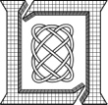
The Big Four Cloud Ecosystems
Enterprise
LLGrid
Supercomputing
IaaS
- Interactive
- On-demand
- Elastic
PaaS
- High performance
- Parallel Languages
- Scientific computing
MapReduce
PaaS
- Java
- Map/Reduce
- Easy admin
SaaS
- Indexing
- Search
- Security
Big Data
DBMS
LLGrid MapReduce provides map/reduce interface to supercomputing
D4M provides an interactive parallel scientific computing environment to databases
IaaS: Infrastructure as Service
PaaS: Platform as a Service
SaaS: Software as a Service
Notes:
LLGrid_MapReduce and D4M is designed to provide an easy-to-use interface to map/reduce supercomputing and an interactive parallel scientific computing environment to databases.

Slide 6
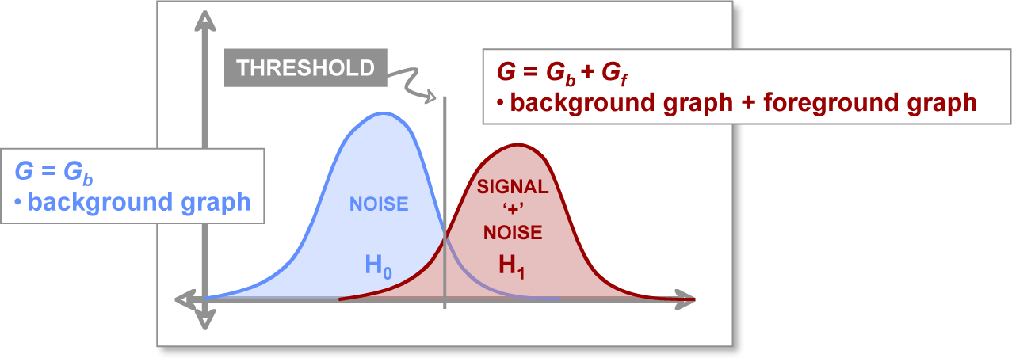
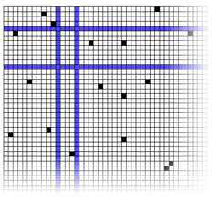
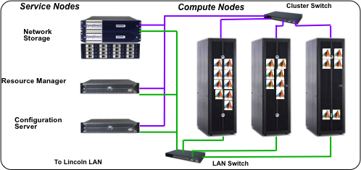
Big Compute + Big Data Stack
Novel Analytics for:
Text, Cyber, Bio
Weak Signatures,
Noisy Data,
Dynamics
A
B
Array Algebra
High Level Composable API: D4M (“Databases for Matlab”)
C
E
D
Distributed Database: Accumulo/HBase (triple store)
Distributed Database/ Distributed File System
High Performance Computing: LLGrid + Hadoop
Interactive Super-computing
Combining Big Compute and Big Data enables entirely new domains
Notes:
Exploiting big data requires new software across the entire stack.

Slide 7
Outline
Introduction
LLGrid MapReduce
Dynamic Distributed Dimensional Data Model (D4M)
Demonstration
Data Ingestion Performance
Database Query Performance
Summary
Notes:
Outline agenda for introducing LLGrid MapReduce.

Slide 8
Hadoop Architecture Overview
JobTracker
TaskTracker
TaskTracker
TaskTracker
Hadoop cluster
NameNode
DataNode
DataNode
DataNode
Hadoop MapReduce Jobs
Notes:
Hadoop architecture is explained : Key components in Hadoop Distributed File System and Hadoop MapReduce Framework.

Slide 9
LLGrid_MapReduce Diagram
1
input
a
b
output
a.out
b.out
scan
scan
4
LLGrid_MapReduce
Mapper Task 1
Reduce Out
Reduce Task
Mapper Task 2
5
Scheduler
2
3
Set dependency on Mapper Tasks
Notes:
This is a LLGrid_MapReduce architecture diagram. LLGrid MapReduce will scan the input directory and check how many input files are there. Then, it will generate a unique run script for each input file and submit them as an array job to the scheduler. It will also save its job ID number in a file, MapJobID, at the current working directory. When the Map tasks are completed, if needed, one can set up a Reduce task to process the results from the Map tasks.

Slide 10
LLGrid_MapReduce API
LLGrid_MapReduce –-np nTasks \
–-mapper MyMapper \
–-input input_dir \
–-output output_dir \
[--reducer MyReducer \]
[--redout output_filename]
MyMapper must have two inputs: input filename and output filename.
LLGrid_MapReduce creates an array job to process all the input files in the input directory for MyMapper
[Optional] LLGrid_MapReduce creates a job for MyReducer to process the output from MyMapper.
Notes:
LLGrid MapReduce API (Application Programming Interface) is described in the slide.

Slide 11
Outline
Introduction
LLGrid MapReduce
Dynamic Distributed Dimensional Data Model (D4M)
Demonstration
Data Ingestion Performance
Database Query Performance
Summary
Notes:
Outline agenda for D4M

Slide 12
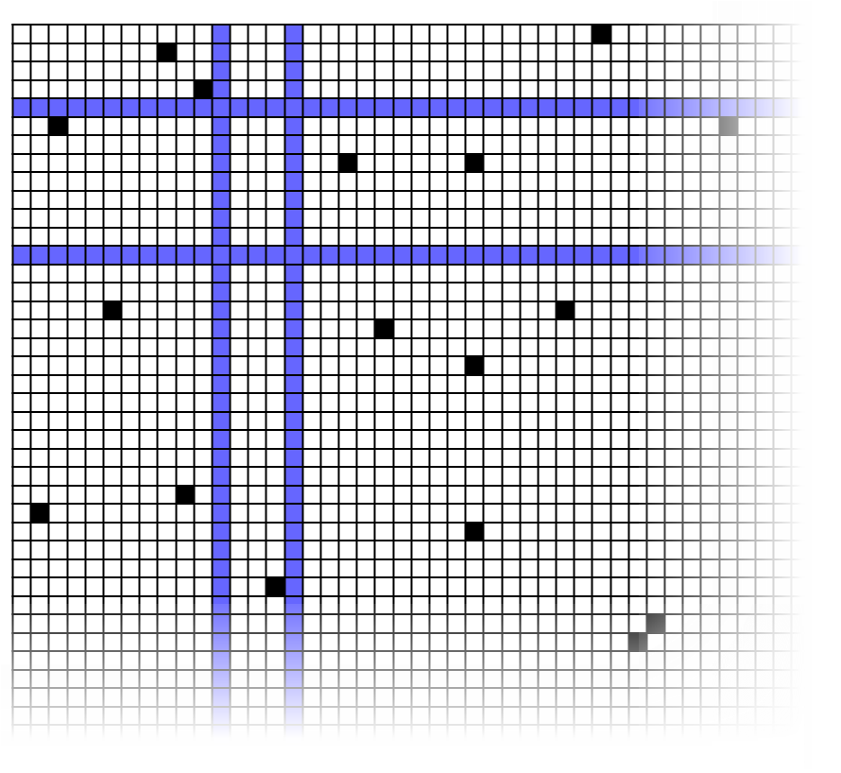
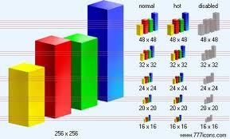
High Level Language: D4M
D4M
Dynamic
Distributed
Dimensional
Data
Model
Associative Arrays
Numerical Computing Environment
Distributed Database
A
B
C
Query:
Alice
Bob
Cathy
David
Earl
E
D
A D4M query returns a sparse matrix or a graph…
…for statistical signal processing or graph analysis in MATLAB
D4M binds associative arrays to databases, enabling rapid prototyping of data-intensive cloud analytics and visualization
Notes:
We make use of the high-level language D4M to enable to construction of graph representations of large-scale data

Slide 13
Triple Store Representation: Graphs as Matrices
Graphs can be represented as a sparse matrices
Multiply by adjacency matrix → step to neighbor vertices
Work-efficient implementation from sparse data structures
1
2
→
4
7
5
3
6
A^{T}
x
A^{T}x
Notes:
Graphs can be represented as a sparse matrices.
Most algorithms reduce to products on semi-rings.

Slide 14
Associative Arrays Concept
Like Perl associative arrays but in 2D and mixed data types
A('alice ','bob ') = 'talked '
or A('alice ','bob ') = 47.0
1-to-1 correspondence with triple store
('alice ','bob ’,'talked ’)
or ('alice ','bob ’,47.0)
bob
talked
bob
alice
alice
Notes:
Associative arrays can represent complex relationships in either a sparse matrix or a graph form. Associative arrays are thus a natural data structure for environments such as Matlab to perform both matrix and graph algorithms.

Slide 15
Associative Arrays Implementation
Composable mathematical operations
A + B A - B A & B A|B A*B
Composable query operations via array indexing
A('alice ', :) alice row
A('alice bob ', :) alice and bob row
A('al* ', :) rows beginning with al
A('alice : bob ', :) rows alice to bob
A(1:2, :) first two rows
A == 47.0 all entries equal to 47.0
Complex queries with ~50x less effort than Java/SQL
Naturally leads to high performance parallel implementation
Notes:
The slides shows what operations can be done with Associative arrays. Constructing complex composable query operations can be expressed using simple array indexing of the associative array keys and values, which themselves return associative arrays.

Slide 16
Outline
Introduction
LLGrid MapReduce
Dynamic Distributed Dimensional Data Model (D4M)
Demonstration
Data Ingestion
Database Query
Summary
Notes:
Outline for demonstration on data ingestion and database query using LLGrid MapReduce and parallel MATLAB D4M implementation.

Slide 17
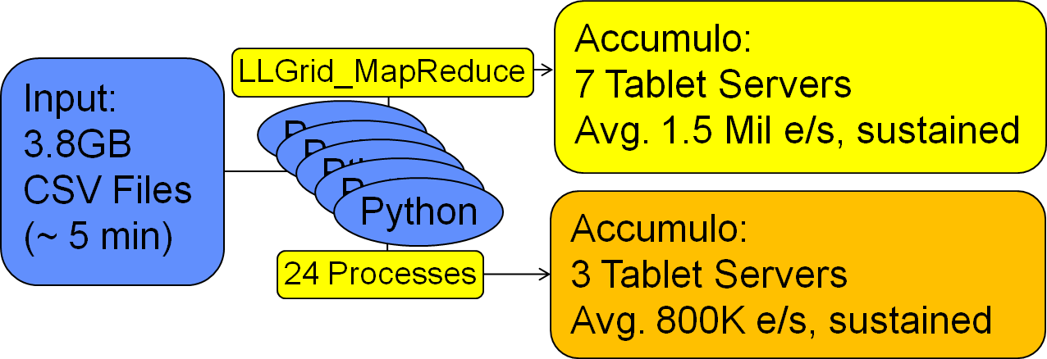
Data Ingestion With LLGrid MapReduce
A Python application to parse ASCII files and to ingest the result into an Accumulo database
Presplit the table by letters+numbers+punctuation
Prepend random string (32 in this case) to row keys
Notes:
As a demonstration for LLGrid MapReduce, a Python script was launched by LLGrid MapReduce to parse a set of web proxy log files, stored in the tabular CSV formation and to ingest the results into the Accumulo database.

Slide 18
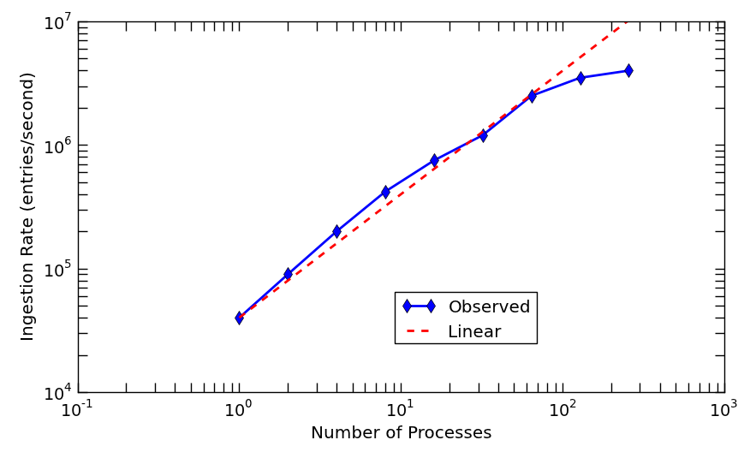
Accumulo Ingestion Scalability Study LLGrid MapReduce With A Python Application
Accumulo Database: 1 Master + 7 Tablet servers
4 Mil e/s
Data #1:
5 GB of 200 files
Data #2:
30 GB of 1000 files
Notes:
A set of web proxy log files were used for the ingestion scalability study on a Accumulo cluster (each node has dual 12-core processors with 64 GB RAM). In this case, two different sets of data were used. The size of the smaller set was 5GBytes, which holds 200 files, with sizes are ranging from 8 to 100 Mbytes. This set was used for the ingestion experiment with up to 64 processes. With 128 and 256 processes, we used another set of web proxy log files made up of 1000 files. The database used for the study was Accumulo (version 1.3.5) with 8 nodes (7 tablet servers). With 256 ingestion processes, we achieved about 4 million ingestions per sec with 256 processes.

Slide 19
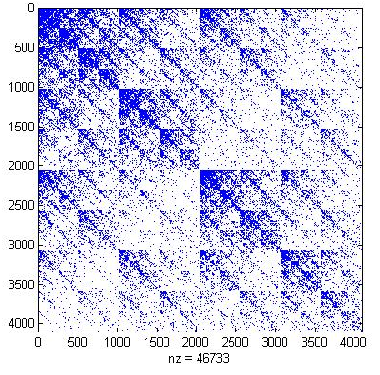
Graph500 Benchmark
Scalable benchmark specified by graph community
Very large power law graph
Local Rows, Cols, Vals: 220790, 220935, 2047790
Adjacency Matrix
Vertex In Degree Distribution
Power Law
Number of Vertices
In Degree
Notes:
Graph500 benchmark was used to demonstrate data ingestion and database query with a parallel Matlab D4M implementation of Graph500 benchmark.
We used a very large power low graph, that many nodes have few edges; a few nodes have many edges as shown in the vertex in degree distribution graph.

Slide 20
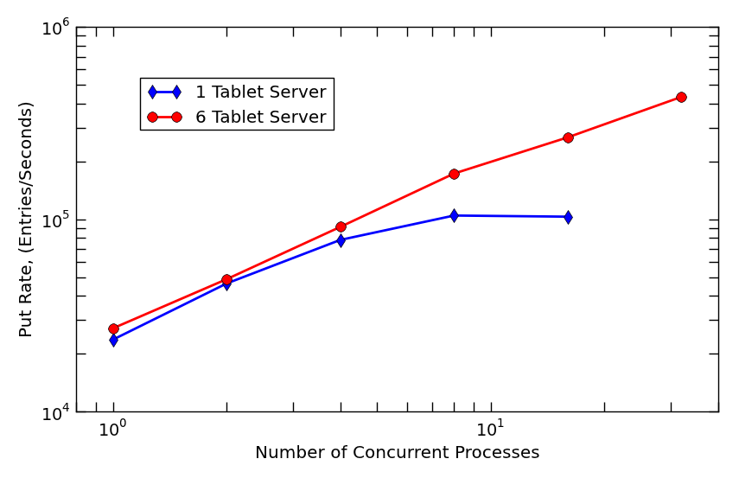
Accumulo Data Ingestion Scalability pMATLAB Application Using D4M
Notes:
Scalability study for Accumulo database ingestion performance was performed on a Accumulo cluster of dual single-core processors machines. For a single tablet server case, as increasing the number of clients, the ingestion rate increases linearly initially, up to 4 clients and then, flattened out beyond 8 clients. When using 8 MATLAB clients, the ingestion rate peaked at about 105K entries/second and then decreased with 16 clients. However, if 6 tablet servers (one tablet server per each Hadoop HDFS data node) are running, the ingestion rate continues to scale well up to 32 clients.

Slide 21
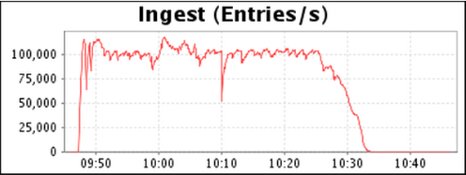
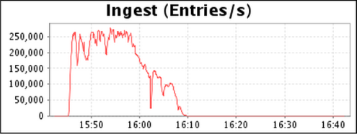
Ingestion Rate History
Ingestion Rate History with 1 Tablet Server
Number of entries/second
Ingestion Rate History with 6 Tablet Servers
Time (HH:MM)
Notes:
This slide shows the ingestion performance history with a single and six tablet servers in the Accumulo cluster, respectively. In both cases, 16 MATLAB clients were ingesting data into the Accumulo database. Maximum ingestion rate was around 100K entries/second with a single tablet server.

Slide 22
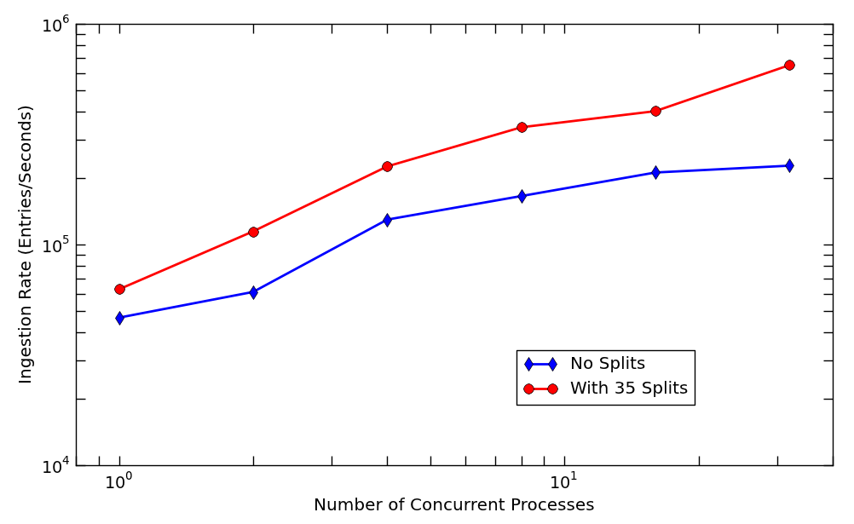
Effect of Pre-Split
Accumulo with 8 tablet servers
Notes:
Effect of pre-splitting Accumulo database on ingestion performance was studied on a Accumulo database running 8 tablet servers.

Slide 23
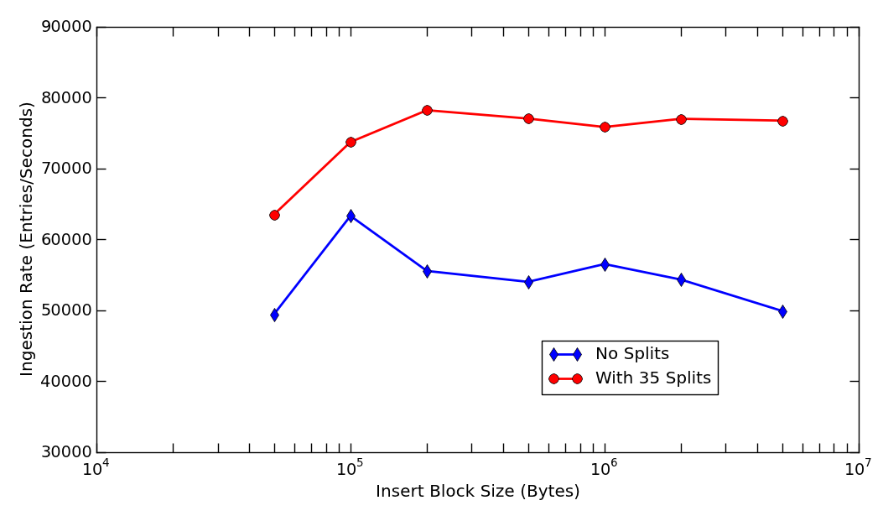
Effect of Ingestion Block Size
Accumulo with 8 tablet servers
Notes:
Effect of ingestion block size on ingesiton rate to Accumulo database was studied on a Accumulo database running 8 tablet servers.

Slide 24
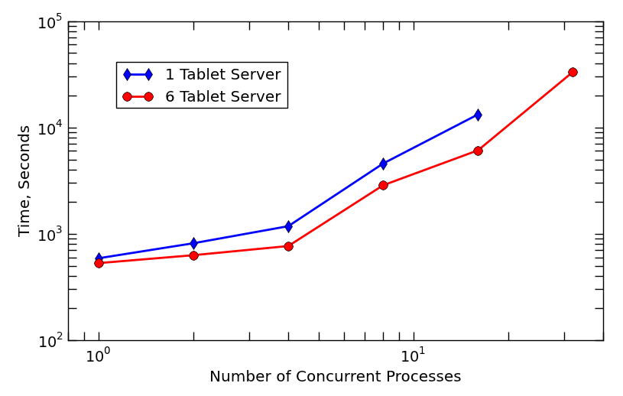
Accumulo Column Query Time pMATLAB Application Using D4M
Notes:
In this slide, we selected an arbitrary vertex in the graph, which was stored in the Accumulo database from the ingestion experiment, and queried any column entries associated with the vertex. The average time was measured for the column query for a given number of pMATLAB clients.

Slide 25
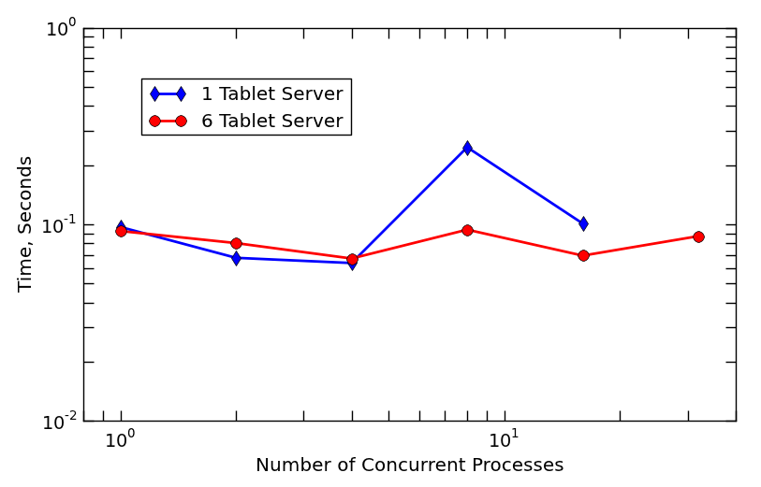
Accumulo Row Query Time pMATLAB Application Using D4M
Notes:
In this slide, we selected an arbitrary vertex in the graph, which was stored in the Accumulo database from the ingestion experiment, and queried any row entries associated with the vertex. The average time was measured for the row query for a given number of pMATLAB clients.

Slide 26
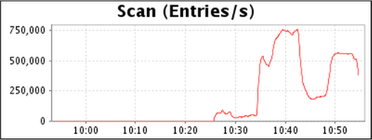
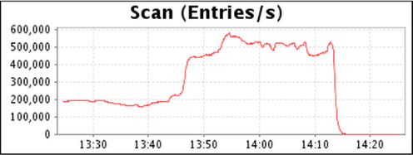
Scan Rate History Accumulo DB With 1 Tablet Server
Start of the query operation
Scan Rate (entries/second)
End of the query operation
Time (HH:MM)
Notes:
The slide shows the time history of the scan rate at the beginning and at the end of the query operations, which were requested by 16 concurrent MATLAB clients while only a single tablet server was running in the Accumulo cluster. As shown in the slide, over the period of the query time, the scan rate fluctuated significantly.

Slide 27
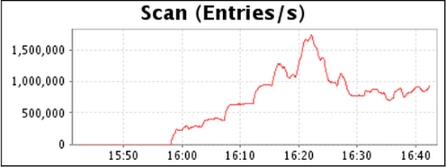
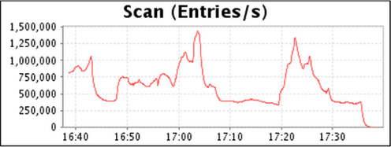
Scan Rate History Accumulo DB With 6 Tablet Server
Start of the query operation
Scan Rate (entries/second)
End of the query operation
Time (HH:MM)
Notes:
This slide shows similar scan rate history graphs when 6 tablet servers (one per each data node) were running. These scan rate history graphs show that they are highly fluctuating with time. However, when comparing the peak scan rate, the scan rate with 6 tablet servers is about twice faster as compared to the scan rate with a single tablet server.

Slide 28
Summary
We have demonstrated using an MPI cluster (LLGrid) environment to drive big data application on a Hadoop cluster environment.
LLGrid MapReduce
Parallel Matlab with D4M (Dynamic Distributed Dimensional Data Model )
Data ingestion and database query results show good scalability in the following use-case scenarios.
A Python application with LLGrid MapReduce
A parallel Matlab application with D4M
Graph500 benchmark
Notes:
Summary of the presentation

