Slide 1
Multithreaded FPGA Acceleration of DNA Sequence Mapping
Edward Fernandez, Walid Najjar, Stefano Lonardi, Jason Villarreal
UC Riverside, Department of Computer Science and Engineering
Jacquard Computing

Slide 2
Introduction
Multithreaded architectures masks long memory latencies by context switching threads.
FPGA provides a platform for hardware acceleration of multithreaded architectures targeting a specific application
Our target application for this research is DNA sequence matching

Slide 3
Introduction
FHAST (FPGA Hardware Accelerated Sequencing Tool) implements a heuristic based on the FM-Index string matching algorithm
FHAST is implemented on Convey Computer HC-1 which can be used as a drop-in replacement for the Bowtie sequencing tool
Speed up of FHAST compared to Bowtie ranges from 7x to 70x dependent on allowed number of mismatches

Slide 4
Presentation Outline
FM-Index String Matching Algorithm
Hardware Architecture
Exact String Matching Architecture
Approximate String Matching Architecture
Implementation
Results Evaluation
Conclusion

Slide 5
FM-Index String Matching Algorithm
The FM-index operates on the Burrows-Wheeler Transform of the text
The top and bottom pointers of the FM-index indicate a matching pattern on the text for every character of the pattern processed
Top >= Bottom: pattern does not exist
Top < Bottom: pattern exists

Slide 6
FM-Index String Matching Algorithm
Text: GCTAATTAGGTACC$
Search pattern: T A G G
Search pattern: C C G A
0
1
2
3
4
5
6
7
8
9
10
11
12
13
14
C
T
T
T
A
C
A
G
$
A
G
C
G
T
A
0
1
2
3
4
5
6
7
8
9
10
11
12
13
14
C
T
T
T
A
C
A
G
$
A
G
C
G
T
A
Top
Bottom
Top
Bottom
PATTERN EXISTS
PATTERN DOES NOT EXISTS

Slide 7
FM-Index String Matching Algorithm
Limited block RAM available on the FPGA for storing the Burrows-Wheeler Transform (BWT) of an extremely long text
Utilization of external memory to store BWT of the text
Exploitation of multiple threads to masks long latencies because of memory access.

Slide 8
Multithreading
Memory
Waiting Threads
Ready Threads
Threads wait in queues while waiting for memory to return required data
Multiple threads are processed to achieve parallelism and faster execution

Slide 9
Exact String Matching Architecture
Pattern source
(External)
Fetch
Receive
C-Table
(External)
Update
Output file
(External)
Locate
Send
A thread represents a pattern in the queue of the components.
Multiple threads are processed to hide latencies due to memory access.

Slide 10
Approximate String Matching Architecture
C-Table (External)
Pattern
source
(External)
pattern
….
Engine 0
Engine 1
Engine n
Locate
Block
A miss on Engine n creates three new threads and passed to Engine n+1
Each new thread on the succeeding thread replaces the failing base pair with the other three base pairs

Slide 11
Implementation
(Software)
Allocate memory
Setup input table
Setup registers
Setup output table
Pattern
source
(External)
C-Table/Suffix Array (External)
Coprocessor call
(Hardware)
Report output table
Convey HC-1 hybrid core:
Dual core Intel Xeon processor 2.13 GHz
Four Xilinx Virtex 5 FPGAs as coprocessor with eight memory controller supporting peak bandwidth of 80 GB/s at 150 MHz.
Software: Performs memory allocation for reading the C tables, the suffix arrays, the reads and writing the results to external memory.
Hardware: Executes the search algorithm

Slide 12
Experimental Setup
18 million unique reads with 101 base pairs on Chromosome 14 of the human genome (length of 107 million base pairs)
Bowtie is executed in the two following setup
 | CPU1 | CPU2
Processor Type | Xeon L540B | Xeon E5520
# of cores | 2 dual cores | 2 quad cores
Memory size | 192 GB | 24 GB
Cache size | 6 MB | 8 MB
Frequency | 2.13 GHz | 2.27 GHz

Slide 13
Execution Time
Longer execution time of Bowtie running in both CPUs compared to FHAST
Simultaneous searching of the reads in three engines of FHAST results to no significant difference in execution time for difference mismatches
Mismatch | FHAST | Bowtie
 |  | CPU1 | CPU2
0 | 55.43 | 715 | 404
1 | 71.17 | 1924 | 1142
2 | 73.25 | 5410 | 3698

Slide 14
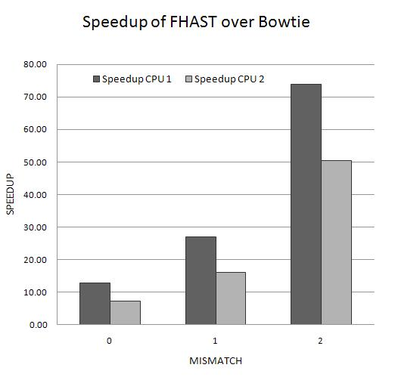
Speed Up
Highest speed up (70x) is achieved in detecting two mismatches where execution time of Bowtie is longest

Slide 15
Conclusion
We demonstrated a multithreaded approach using FPGAs to accelerate execution of DNA sequence matching
We compared FHAST execution time to Bowtie which is a widely used tool for sequencing reads and showed an actual performance improvement up to 70x

Slide 16
Thanks for Listening

Slide 17
Back up slides

Slide 18
Performance Improvement
RAM
New pointer
Old read
New read
Old pointer
read
pointer
Update block
The memory address are pre-calculated and stored on a RAM for all character combinations up to a specific length such that each combination of characters represent a range.
Instead of initializing the address to the first and last rows of the C-table, we initialize the top and bottom pointers to the pre-calculated values

Slide 19
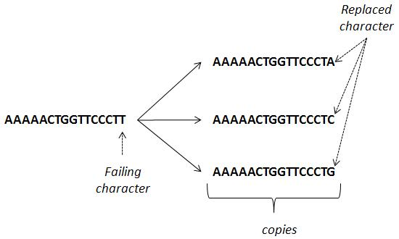
Replace Block
Replace
block
Pointer of Read in Engine N
Pointer of Read in Engine N-1
Read in Engine N-1
Read in Engine N
read
pointer
Update block
Replace: The replace block creates three copies of the failing read and replaces the failing character with the other base pairs.
The update block of Engine 1 accepts reads from replace block instead of
the fetch block.

Slide 20
Scaling Factor
Scaling factor defined as execution time on a single device divided by the number of devices
Results show that FHAST scales better if more FPGAs are used for searching

