Slide 1
HPC-VMs: Virtual Machines in High Performance Computing Systems
Albert Reuther
IEEE-HPEC 2012
September 11, 2012
This work is sponsored by the Department of the Air Force under Air Force contract FA8721-05-C-0002. Opinions, interpretations, conclusions and recommendations are those of the author and are not necessarily endorsed by the United States Government.
Notes:
1
1
Time to introduce the title.

Slide 2
Outline
Introduction to Virtual Machines
VM Features
VMs in HPC
Launch Time Results
Summary and Future Work
Notes:
This is just the outline.

Slide 3
Operating System Basics
Applications and their User Interfaces – Programs that users run
Application Programming Interface (API) – Rules and specifications for libraries and frameworks
Libraries/Frameworks – Reusable software routines for building applications
Operating System (OS) Kernel – Manager of computer hardware resources and of common services for application software
Hardware – Physical components of the computer
User(s)
User Interfaces
Applications
APIs
Libraries/ Frameworks
OS Kernel & Device Drivers
Hardware
Manages and controls shared hardware resources
Provides common services to applications
Abstracts hardware for users and applications
Silbershatz, Galvin and Gagne, Operating System Concepts, Addison Wesley, 2011.
Notes:
This slide shows the basic operating system software stack for a canonical computer system.

Slide 4
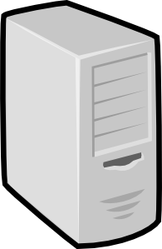
Virtual Machines
User(s)
Operating System (OS) – Manager of computer hardware resources and of common services for application software
Virtual Machine (VM) – Software implementation of a computer that executes programs like a computer machine
Hypervisor – Virtual operating platform that monitors the execution of one or more VMs
Hardware – Physical components of the computer
of the computer
Virtual Machine (VM)
User Interfaces
Applications
APIs
Libraries/ Frameworks
Operating System
Virtual Machines
Hypervisor
App
App
App
Hardware
OS
Mon
OS
Mon
OS
Mon
VM
VM
VM
Emulate the underlying hardware
Isolate and encapsulate guest operating systems
Allocate hardware resources
Hypervisor
Mgmt
Dittner and Rule, Best Damn Server Virtualization Book Period, Syngress, 2007.
Notes:
In order to better understand these service categories, we must first explain a generic computer system stack including VMs, which are commonly used in all three service models. This system stack is depicted in the figure here, and each of the layers of the stack is described.

Slide 5
Cloud Computing Service Paradigms
Infrastructure as a Service (IaaS)
Platform as a Service (PaaS)
Software as a Service (SaaS)
User(s)
User(s)
User(s)
Provided
by User,
Admin,
etc.
Virtual Machine (VM)
User Interfaces
Virtual Machine (VM)
User Interfaces
Provided
as a
Service
Virtual Machine (VM)
Applications
Applications
User Interfaces
Applications
APIs
Libraries/ Frameworks
APIs
APIs
Libraries/ Frameworks
Libraries/ Frameworks
Operating System
Operating System
Operating System
Hypervisor
Hypervisor
Hypervisor
Hardware
Hardware
Hardware
Provide hardware to execute VMs
Provide software execution platform
Provide entire software application
Each service paradigm has different security and reliability implications
Notes:
The key interfaces for cloud computing are the User Interfaces, APIs, and Hypervisor for SaaS, PaaS, and IaaS, respectfully. These key interfaces are depicted in the figure here. Using user interfaces, SaaS delivers entire software packages to users across the network. The consumer is generally not authorized to manage or control any of the underlying infrastructure including libraries, operating system, virtual machines, nor computational, network or storage hardware. For certain applications, though, consumers do have control over their application preferences. PaaS shares a set of APIs and tools with which applications can be developed and executed. While developers often have some control over their application deployment, they do not have any control over the distribution of their application nor do they have control of the hardware on which their application executes. For IaaS, the Hypervisor interface enables the execution of VMs provided by users and executes the VMs on infrastructure hardware. Also, IaaS often allows users to deploy virtual private networks (VPNs) to segregate their system environment from other system environments. Simply put, SaaS enables the running of applications, PaaS enables the writing of applications, and IaaS enables the installation of applications.

Slide 6
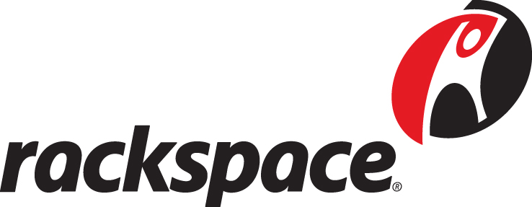
Cloud Computing Service Paradigms
Infrastructure as a Service (IaaS)
Platform as a Service (PaaS)
Software as a Service (SaaS)
User(s)
User(s)
User(s)
Provided
by User,
Admin,
etc.
Virtual Machine (VM)
User Interfaces
Virtual Machine (VM)
User Interfaces
Provided
as a
Service
Virtual Machine (VM)
Applications
Applications
User Interfaces
Applications
APIs
Libraries/ Frameworks
APIs
APIs
Libraries/ Frameworks
Libraries/ Frameworks
Operating System
Operating System
Operating System
Hypervisor
Hypervisor
Hypervisor
Hardware
Hardware
Hardware
Utility Cloud Examples
Amazon Elastic Compute Cloud (EC2), ITricity, Joyent, Rackspace, VMWare Cloud
Amazon Web Services (AWS), Amazon Simple Storage Service (S3), Windows Azure, FaceBook Apps
SalesForce.com, Google Apps, Gmail, Microsoft Suite 365, NetFlix Streaming, FaceBook
Notes:
In SaaS, consumers use applications provided to them by the cloud. Examples include Google Docs, Gmail, SalesForce.com, Facebook, Amazon Simple Storage Service (S3), and NetFlix Streaming. When consumers use provided tools and development environments to create and deploy their own applications, this is PaaS. Such platform services include Amazon Web Services (AWS), Facebook Apps, Microsoft Windows Azure, and Force.com. Finally, users can deploy their own application, generally within virtual machine (VM) instances, in the IaaS model. Providers of IaaS are Amazon Elastic Compute Cloud (EC2), Joyent, Rackspace, VMWare, and others.

Slide 7
A Brief History of Virtual Machines
Mainframes with Terminals
Distributed Servers with Distributed PCs
Central Servers with Distributed PCs
Multicore CPUs
Web Services with Browser (PCs, Laptops, Mobile Devices)
Servers
IBM
CP/CMP (first VMs)
Hypervisors
Portable, Heterogeneous, Ubiquitous VMs
DEC VAX (virtual memory)
Hardware Emulation
Software VMs
(Java VM)
Virtualization
DEC VMS
AIX
Solaris
HP-UX
Linux 1.0 Kernel
Linux 2.6 Kernel
Multics
Unix System V
OSs
BSD 1.0
Windows 3.1
Windows NT
Windows XP
ARPANET First Message
Ethernet First Deployment
Ethernet 10BASE5
Ethernet 100BASE-T
Ethernet 10GBASE-T
LANs
Ethernet 10BASE-T
Ethernet 1000BASE-T
Direct-attached Tapes
Direct-attached Disks
Disk Farms
Redundant Array of Independent Disks (RAID)
Storage-Attached Networks (SANs)
Network-Attached Storage (NASs)
Distributed Replicated, Network Storage
Storage
1960s
1970s
1980s
1990s
2000s
2010s
Distributed computing has been in CS research since Multics and ARPANET.
Cloud Computing is the convergence and commercialization of many distributed computing areas.
Color Legend:
Mainframe Era
LAN/Web Era
PC Era
Cloud Era
Notes:
The success of virtual machines was 5 decades in the making. The technology maturities of these five areas converged in the 2000s to enable ubiquitous virtual machines.

Slide 8
Types of Modern Virtual Machines
Emulation: Translate all instructions from guest OS to host hardware
Paravirtualization: Partial simulation of underlying hardware for guest OSs
Jump table for protected guest OS instructions
Some guest OS modifications
Full Virtualization: Complete simulation of underlying hardware for guest OSs
Hardware support for virtualization
Ring 3
Ring 2
Ring 1
Ring 0
Kernel
Device Drivers
Device Drivers
OS Protection Rings
User
Virtual Machines
Virtual Machines
App
App
App
App
App
App
Type 1: Bare metal hypervisor
Type 2: Host OS and hypervisor
OS
Mon
OS
Mon
OS
Mon
OS
Mon
OS
Mon
OS
Mon
VM
VM
VM
VM
VM
VM
Hypervisor
Mgmt
Hypervisor
Mgmt
Host Operating System
Notes:
We also need to describe the OS Protection Rings, privileged (protected) OS instructions, and VM-enabling instructions. Next are type 1 and type 2 hypervisors. This is whether there is a host OS (type 2) or bare-metal hypervisors (type-1).

Slide 9
Outline
Introduction to Virtual Machines
VM Features
VMs in HPC
Launch Time Results
Summary and Future Work
Notes:
This is just the outline.

Slide 10
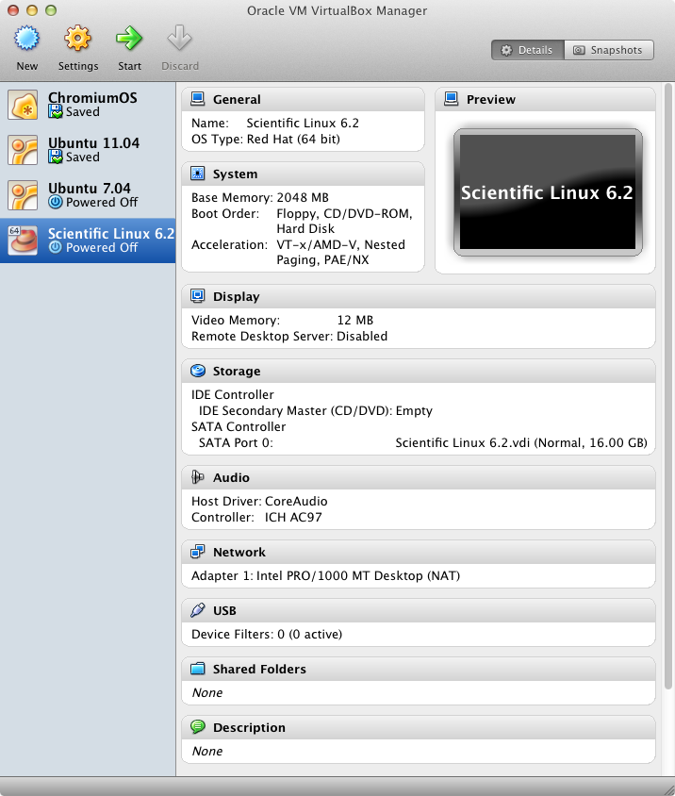
VM Resources
Choose number of CPU cores
Choose main memory size
Choose devices to present to guest OS
Network
Storage
Display
Audio
USB
Etc.
Virtual Machines
App
App
App
OS
Mon
OS
Mon
OS
Mon
VM
VM
VM
Hypervisor
Mgmt
Hardware
Notes:
This slide describes the VM resources that can be controlled for each VM image. The screen shot is from Oracle VM Virtual Box manager.

Slide 11
Common Virtual Machines
Name | Organization/License | Type | Virtualization | Speed | API
KVM | Qumranet | 1 | Virtualization | Up to near native | libvert
Microsoft Virtual Server | Microsoft | 2 | Virtualization | Up to near native | COM
Microsoft Hyper-V | Microsoft | 1 | Virtualization | Up to near native | libvert, WMI
QEMU | Fabrice Bellard and others | 2 | Emulation | Less than native | libvirt, libguestfs
Virtual Box | Oracle | 2 | Virtualization | Up to near native | Command line, libvirt, Main API
VMware Workstation and Server | VMware (EMC) | 2 | Paravirtualization and Virtualization | Up to near native | libvirt, VMware
VMware ESX | VMware (EMC) | 1 | Virtualization | Up to near native | libvirt, VMware
Xen | Xensource and Citrix | 1 | Paravirtualization and Hardware Virtualization | Up to native | libvirt, xenaccess, XenAPI
From: http://en.wikipedia.org/wiki/Comparison_of_platform_virtual_machines
Notes:
Here is a table describing the virtual machine environments that are the most popular and the ones we considered. Note that each technology only supports either Type 1 or Type 2, not both. Also, most support standard virtualization which takes advantage of the AMD-V and Intel-VT-x instruction set extensions. All of the technologies promise up to near native speed except for QEMU, which virtualizes via emulation. Finally, Virtual Box is unique in that it provides a full command line interface.

Slide 12
Enterprise VM Trade-Offs
Advantages
Server consolidation with isolation
Rapid provisioning (no hardware purchase needed)
VM migration between hardware servers
Flexibility of running multiple OS types
Flexible virtual hardware configuration
Probably better security stance
Challenges
Performance
Network
I/O (disks, etc.)
Management of VM images
Load balancing on hardware
But HPC is Different.
It is all about performance and productivity.
Notes:
This slide outlines the advantages and challenges for enterprise VMs. However, HPC is different. It is all about performance and productivity.

Slide 13
Outline
Introduction to Virtual Machines
VM Features
VMs in HPC
Launch Time Results
Summary and Future Work
Notes:
This is just the outline.

Slide 14
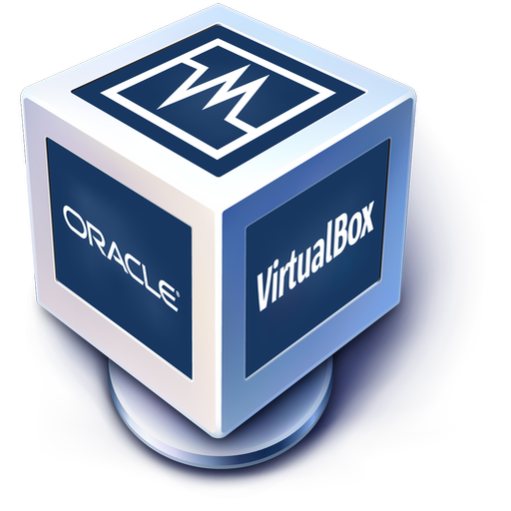
HPC and Virtual Machines Two Common Approaches
HPC on an IaaS cloud
High cost for consistent use
Requires good bandwidth to cloud provider
Security and privacy considerations
Static VMs on hardware with scheduler
Every user incurs VM performance penalties
Static mix of VM configurations
Notes:
There are two common ways to deploy virtual machines for HPC purposes. One is to deploy HPC-oriented VMs in a public cloud, while the other is to deploy VMs on all nodes of a cluster. Both have their challenges.

Slide 15
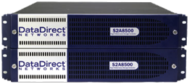
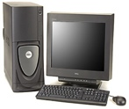
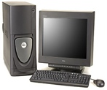
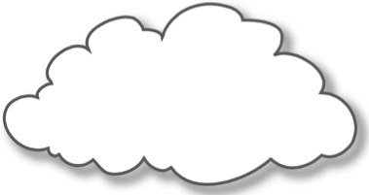
VMs on LLGrid: Providing Productivity to Users
Service Nodes
Compute Nodes
Cluster Switch
Interactive
Users
Network
Storage
Resource Manager
Login Node(s)
Configuration
Server
LLAN
To Lincoln LAN
LAN Switch
Two primary HPC VM users
Older or different OS requirement
Code validated on legacy OS (e.g. RHEL 3)
Application only available on Solaris
Prototyping heterogeneous distributed computing environments
Scheduler executes VMs on cluster as OS encapsulation environment
Deploy on Type 2 hypervisor
Hypervisor API enables VM configuration
Intercept VM shutdown for job shutdown
Provide set of “standard” VMs
Store user VMs in user account
Notes:
For LLGrid, we decided to take a different approach. We choose to launch VMs as a job through the scheduler. There are two primary reason for using VMs in HPC: needing older or different OSs than the bare metal OS on the cluster or the need to prototype heterogeneous, distributed computing environments. Otherwise, users just run their jobs on the bare-metal OS.

Slide 16
VMs on LLGrid Features
Stripped virtual machines
Stock kernel
Scientific libraries
No services or applications
Job execution written into /etc/init.d script
Job completion triggers VM shutdown/teardown
Central file system shared through host OS
Single job slots and job array launching
Jobslot overloading available
Launch more than one VM per jobslot
Constrained by compute node resources (memory, cores, etc.)
Notes:
Here are more features that this approach affords.

Slide 17
Outline
Introduction to Virtual Machines
VM Features
VMs in HPC
Launch Time Results
Summary and Future Work
Notes:
This is just the outline.

Slide 18
Launch Time Experiment Setup
Service Nodes
Compute Nodes
Cluster Switch
Network
Storage
Resource Manager
Login Node(s)
Configuration
Server
LAN Switch
Dell PowerEdge 1955 blades
Dual-dual core 3.2 GHz Xeon CPU
8 GB RAM per blade
10GigE core network, 1GigE to blades
DDN SFA 10K storage array
Grid Engine ver. 6.2u5 scheduler
VM images: Debian Linux 6.0.4 i386
Eight dedicated nodes
Compare un-optimized VMs with optimized VM images
Varied jobslots launched and jobslot overloads
Socket-based time logger
Notes:
This slide provides the details of our VM launch time experiment. It would be no use to pursue this method of using VMs in an HPC environment if launch times were bad. We used 8 dedicated blades and compared un-optimized VMs with optimized VMs. We varied the number of jobslots used for launches and the jobslot overload. For timing we used a socket-based time logger which gave us as good or better timing results than using network time protocol (NTP).

Slide 19
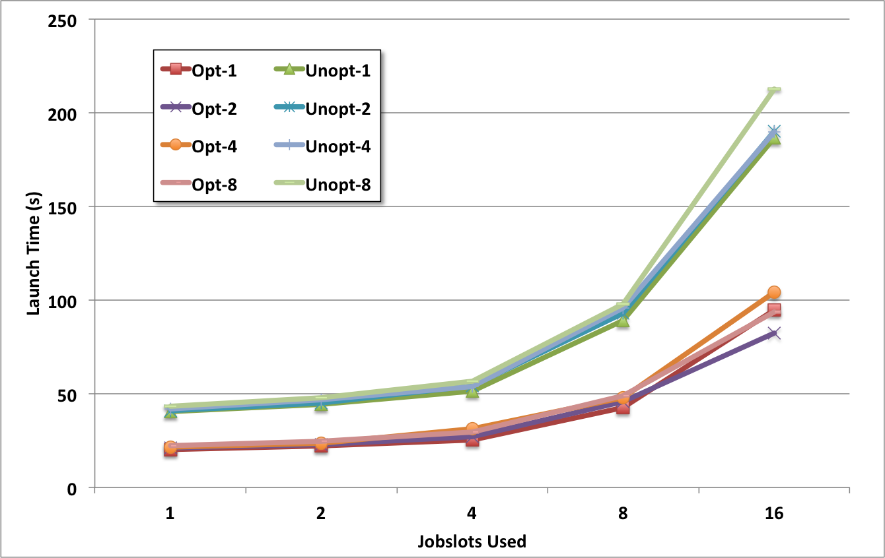
Launch Time Results
Optimized VMs launch significantly faster than unoptimized
Overloading jobslots does not impact launch time much
Notes:
The launch time results show that optimized VMs launch significantly faster than unoptimized ones, and overloading jobslots does not impact launch time much.

Slide 20
Outline
Introduction to Virtual Machines
VM Features
VMs in HPC
Launch Time Results
Summary and Future Work
Notes:
This is just the outline.

Slide 21
Summary and Future Work
VMs at the heart of Cloud Computing
Can judiciously use VMs in HPC environments
Encapsulate older OS environments rather than re-validate software
Enable large-scale distributed environments in clusters
VM launches add modest overhead to job launches
Can add performance penalty to disk and network I/O
Future work
Parallel job launches (MPI, PGAS ,etc.)
Support VMWare virtual machines
Demonstrate persistent services in VMs (including dynamic DNS)
Transition technology to researchers and sponsored projects
Notes:
This slide summarizes and lists some future work.

